Slide 1
WELCOME TO THE NILE WEBINAR FOR July 2022!
Immunize Nevada is a nonprofit 501c3 coalition that is widely recognized as Nevada’s trusted resource for immunization information and community health outreach for all ages. We accomplish this by fostering education and statewide collaboration with a variety of health partners and collaborators.
You may view current and past web trainings at ImmunizeNevada.org/NILE-webinars
Thank you for joining us today!

Slide 2
HOUSEKEEPING ITEMS
Connectivity Issues
Please log back in and we’ll continue where we left off.
Have a Question?
Locate the Q & A box and type them there. We will address questions throughout the presentation.
Recording & Slides
The recorded webinar and slides will be posted to ImmunizeNevada.org/NILE-webinars.

Slide 3
DISCLAMER
Immunize Nevada’s NILE webinars are made possible by the generosity of speakers who donate their time and expertise to benefit the coalition. The expectation and goal is for community partners to gain knowledge on immunization/infectious disease-related topics through a non-branded, unbiased presentation. The opinions expressed are those of today’s presenter and do not necessarily reflect those shared by Immunize Nevada or its partners.

Slide 4
Division of Public and Behavioral Health
Sensory Friendly Vaccine Kits
Nevada State Immunization Program &
Maternal Child Adolescent Health Program
Sarah Jane Smith, MPH, MA & Sydnie Walters, MPH Intern
Notes:
SJ

Slide 5
Overview of Children and Youth with Special Health Care Needs (CYSHCN)
Disproportional Impact of COVID-19 on CYSCHNS
COVID-19 Vaccines for Children and Youth
Sensory-friendly Vaccine Clinic Environments
Sensory-friendly Vaccine Kits in Nevada
Notes:
SJ

Slide 6
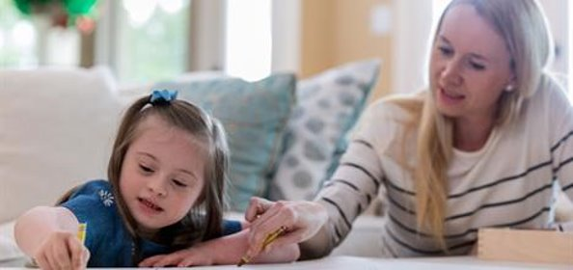
Children and Youth With Special Health Care Needs in Nevada
As of 2016/17, the National Survey of Children's Health estimated 106,845 children and youth live with special healthcare needs in Nevada, representing 15.9% of all children statewide
National Survey of Children's Health
Notes:
SJ
Citation: https://www.childhealthdata.org/learn-about-the-nsch/NSCH/data

Slide 7
Impact of COVID-19 on Children and Youth as of 7/18/22
In the United States:
Children are just as likely to be infected with COVID-19 as adults
COVID-19 vaccine rates in the U.S. for children remain low
In Nevada (as of 7/18/22):
266,129 children 6 months to 19 years of age have received at least 1 dose of the COVID-19 vaccine as of 7/18/22
There were 126,539 cases of COVID-19 in children ages 0-19 in Nevada
Centers for Disease Control, September 2021
JAMA Pediatrics, October 2021​
NVDPBH COVID-19 Data Dashboard
Notes:
SJ
In the United States:
Children are just as likely to be infected with COVID-19 as adults
Vaccine rates within the U.S. for children against COVID-19 remain low
In Nevada:
266,129 children 6 months to 19 years of age have received at least 1 dose of the COVID-19 vaccine as of 7/18/22
As of 7/18/22, there were 126,539 cases of COVID-19 in children ages 0-19 in Nevada
Citations:
[1] https://www.cdc.gov/ncbddd/developmentaldisabilities/features/increase-in-developmental-disabilities.htm
[2] https://www.nationalcmv.org/resources/blog/jan-2022/covid-19-vaccine-in-children-with-disabilities-and#_msoanchor_2
[3] https://nvhealthresponse.nv.gov/

Slide 8
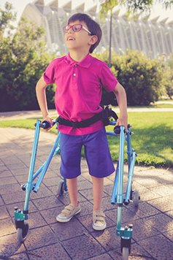
Impact of COVID-19 on Children and Youth with Special Healthcare Needs
Children living with developmental disabilities (DD) and intellectual disabilities (ID) are especially vulnerable to the effects of the pandemic due to:
Greater healthcare needs
Need for community-based services
Mental health concerns
J Autism Dev Discord, August 2020
Notes:
Sydnie
Greater Healthcare Needs
Higher prevalence of other chronic medical conditions
Greater need for healthcare services
Greater burden of illness on their daily life in regards to mobility and adaptive skills
Need for Community-Based Services
Dependence on and need for therapy and support from intervention services and schools
COVID-19 has resulted in limited services throughout the community; school closures have also impacted the provision of continued intervention services, including home-bound therapies
Mental Health Concerns
May be at a higher risk of mental health effects of the pandemic – generalized anxiety disorder, phobias, obsessive compulsive disorder and mood disorders
Parents of children living with special healthcare needs have also reported greater levels of stress which are exacerbated by: mandated alternate work arrangements, financial stressors, uncertainty and lack of childcare support
Citation: https://www.ncbi.nlm.nih.gov/pmc/articles/PMC7438977/

Slide 9
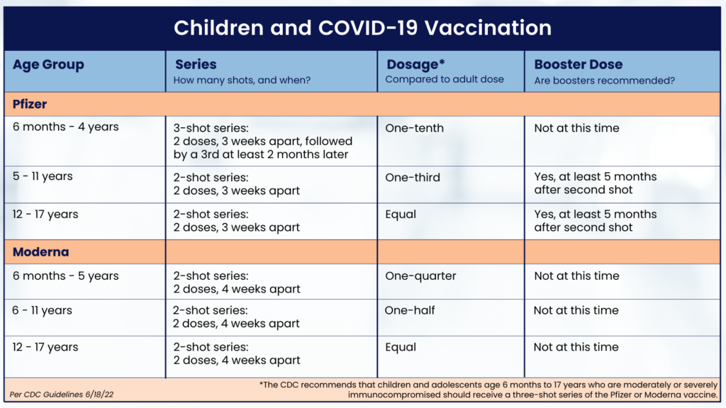
COVID-19 Vaccines for Children and Youth
Children with underlying medical conditions, including children and youth living with intellectual and developmental disabilities, are more likely to get severely ill from COVID-19.
Notes:
SJ
The CDC recommends that children age 6 months and older should get a Pfizer or Moderna COVID-19 vaccine. The decision was made after analyzing substantial data from clinical trials involving thousands of children, confirming the vaccine’s safety and effectiveness for children in this age group. The CDC also advises that children age 5 and older who receive the Pfizer vaccine should get a booster at least 5 months after their second shot.
Vaccinating children can:
Prevent children from getting seriously sick if they do get COVID-19. COVID-19 vaccination continues to protect children against severe disease, including hospitalization. There is no way to tell in advance how children will be affected by COVID-19. Children with underlying medical conditions are more likely to get severely ill from COVID-19. However, healthy children without underlying medical conditions can also experience severe illness.
Give parents greater confidence for children to participate in childcare and school and in sports, playdates, extracurricular activities, and other group activities.

Slide 10
Sensory-Friendly Vaccine Clinic Environments
Many people find vaccine clinics to be sensory-rich environments, which can be a barrier to vaccination
People who experience sensory sensitivity or sensory overload can benefit from sensory-friendly experiences and environments
Sensory-friendly vaccine clinics are vaccine facilities that have been adapted to be more calming to the senses
Notes:
Sydnie
Many people find vaccine clinics to be sensory-rich environments, which can be a barrier to vaccination.
People who experience sensory sensitivity or sensory overload can benefit from sensory-friendly experiences and environments.
This may include children and youth with special healthcare needs, including individuals living with autism, PTSD, or hearing loss.
Sensory-friendly vaccine clinics are vaccine facilitates that have been adapted to be more calming to the senses.
This can include changes to the environment and utilizing tools to support the vaccine experience for patients.

Slide 11
Sensory-Friendly Vaccine Clinic Environments
Ways to create a sensory-friendly vaccine clinic include:
Reduce noise
Remove bright or flashing lights
Provide accessible bathrooms
Welcome caregivers
Provide snacks and water
Develop clear and concise instructions
Create sensory-friendly hours
Sensory Friendly Solutions, August 2021
Notes:
Sydnie
Ways to create a sensory-friendly vaccine clinic include:
Reduce noise
Separating people into different waiting rooms with certain rooms dedicated as quiet zones
Provide noise-cancelling headphones or earplugs
Remove bright or flashing lights
Natural light is preferred over fluorescent lighting
Use lower lighting, if possible, in waiting and recovery rooms following vaccination
Provide sunglasses
Provide accessible bathrooms
Having to use the restroom without access can lead to sensory overload, so it is important to ensure that bathrooms are available for all
Welcome caregivers
Preventing a caregiver from accompanying their child, family member, or friend can lead to increased stress and anxiety
Provide snacks and water
Hunger and thirst can lead to sensory overload, so providing snacks and water can help the patient stay comfortable throughout the vaccination process
Develop clear and concise instructions
The vaccination process can be confusing for many people
To help make this process more accessible, you can create user-friendly booking systems, ensure there is large, easy to follow signage around the clinic, and have staff available to help direct patients
Create sensory-friendly hours
During these hours, you could implement some of the these tips
Sensory-friendly hours oftentimes include fewer appointments in order to lower noise levels and crowding in the clinic
The clinic can also adjust the sensory experience by providing sensory-friendly toys or weighted lap pads
Citation:
https://www.sensoryfriendly.net/what-is-a-sensory-friendly-vaccination-clinic/

Slide 12
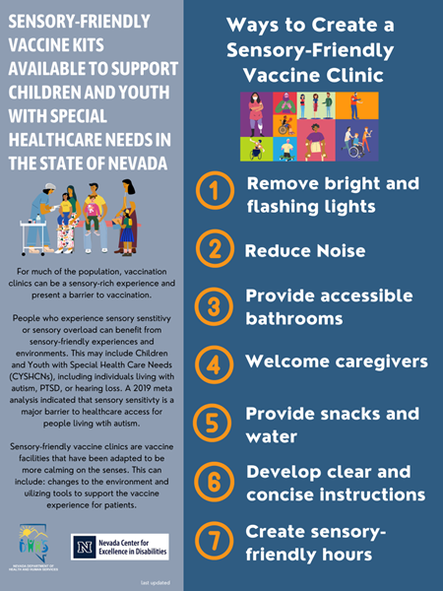
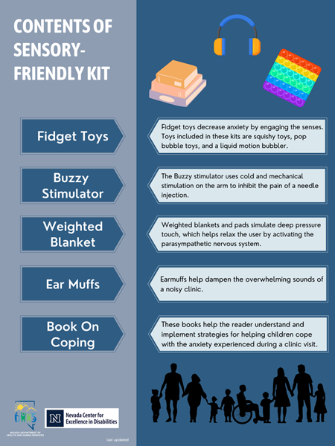
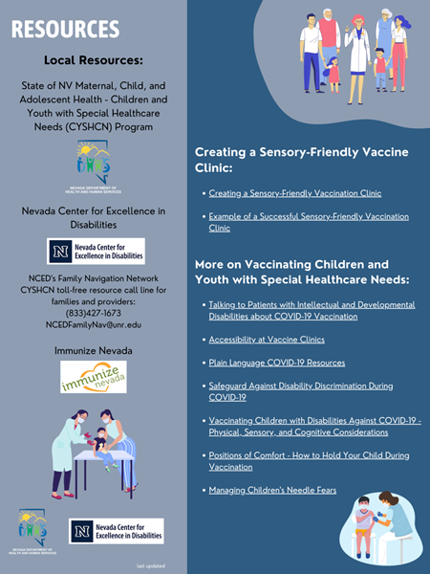
Sensory-Friendly Vaccine Kits in Nevada available now
Notes:
SJ
Our partners from the Nevada Center for Excellence in Disabilities will provide an in-depth overview of the sensory-friendly vaccine kits we developed, however we wanted to provide you with some context and history for how these kits came to be. A state-wide workgroup was formed to address the needs of CYSHCNs in Nevada, especially as it relates to COVID-19 and Vaccines. One of the issues raised in the workgroup, was the need for sensory-friendly vaccine environments and tools – especially for children and youth living with autism, as well as those with PTSD, hearing loss and/or any other disabilities and special healthcare needs. Part of this included, SNHD spear-heading a CYSHCN strike team, to have a team of nurses do in-home visits to vaccinate CYSHCNS. NCED took the lead on developing these SFVKs, and have distributed them to jurisdictions across the state to utilize in developing sensory-friendly clinic experiences. NCED will now present on the contents of the kit, as well as training on how to utilize and care for the tools in the kit. Prior to wrapping up today, you will receive this completed infographic with the information we've covered, resources related to vaccinating CYSHCNs and creating a SF clinic environment, along with contact information for each jurisdiction – where these kits can be requested/utilized.

Slide 13
NCED Presentation

Slide 14
Randall Owen, Director
July 28, 2022

Slide 15
WHAT IS THE Nevada Center for Excellence in Disabilities (NCED)?
The NCED serves as Nevada’s University Center for Excellence in Developmental Disabilities (UCEDD).
UCEDDs are funded by the Developmental Disabilities Rights Assistance and Rights Act (DD Act) along with DD Council and Protection and Advocacy.
There are 67 UCEDDs with at least one in every state and territory.
Since 1963, UCEDDs have worked towards a shared vision that foresees a nation in which all Americans, including Americans with disabilities, participate fully in their communities. Independence, productivity, and community inclusion are key components of this vision.
The NCED was established in 1991 at the University of Nevada, Reno. The NCED is a statewide program.

Slide 16
Training
Community
Service
Impact on People with DD
Research
Dissemination

Slide 17
Nevada Center for Excellence in Disabilities (NCED)
During 2021-22, the NCED accomplished all goals, maintained funding, supported over 60 faculty and staff, and conducted 29 projects. Additionally the NCED has:
Reached/served someone in every county in Nevada.
Provided community trainings for over 980 individuals.
Provided training to 464 pre-service students and 6,1363 continuing education professionals.
Served 935 individuals with disabilities and their families.
Provided 1,946 hours of technical assistance/consultation.
Distributed information on disabilities and services to almost 20,000 people
Conducted 17 research/evaluation projects

Slide 18
Sensory Friendly Vaccine Kits
Provided to all Nevada counties
Designed for kids and adults with disabilities
Purpose:
Items are designed to help provide distractions and pain relief during shots, as well as calming techniques to help reduce fear and anxiety
Kit items are not one size fits all: individual preferences are important to consider

Slide 19
Procedural Pain Management ¹
Evidence-based strategies to reduce procedural pain:
Giving sweet-tasting liquids (orally)
Injecting vaccines rapidly without aspiration
Injecting the most painful vaccine last
Using tactile stimulation (rubbing/stroking near the injections site before and during injection)
Distracting the patient (done by either the parent or clinician)
Having the patient seated rather than laying down
Using topical anesthetics
¹ Centers for Disease Control (n.d.)
Notes:
Before we get into talking about the kit items, we wanted to highlight some of the evidence behind why these kits were created and the research supporting their use. In discussing how healthcare providers can better support patients, the CDC has a number of evidence-based strategies that they recommend be utilized when possible to help reduce procedural pain. Although these are likely all things you are familiar with, we wanted to specifically highlight 2 of these strategies, using… and… as these are directly strategies that these kits were designed to help you all with.

Slide 20
Making shots less stressful
9 things you can do for you and your baby/child ¹
6: Bring your child’s favorite things
7: Distract your child
8: Big kids need support too
Coping/calming techniques are important skills for kids and adults ²
¹ https://www.cdc.gov/vaccines/parents/visit/less-stressful.html ² Compas et al. (2017)
Notes:
The CDC also lists out more specifically what things can be done to make shots less stressful for parents when assisting their children or babies in getting shots, many of which go directly back to ways to distract the individual. Although we will go a little more in depth with ideas for ways in which these can be accomplished, some of the particularly relevant ideas here are…
6: Bring your child’s favorite things (They mention favorite toys, blankets, books, etc.)
They also talk about ways in which you can
7: Distract your child (such as Singing, tell a story, being silly)
And lastly, they talk about how
8: Big kids need support too (and give examples such as “Take deep breaths to blow out the pain” and so on.)
Ultimately, despite the age, we ultimately want to find ways in which we can support the individual patient we are working with. For children and adults with disabilities, we want to make sure we are communicating and interacting with them in a way they understand, so when we discuss specific kit items, be keeping that in mind.
And just to highlight another benefit of the kits, we ultimately hope that the kits items and ideas will help the individual patients you are working with to be able to better cope and calm in the often stressful situation that vaccines and other procedures can sometimes create.

Slide 21
The Cycle of Escalation
* Colvin & Sugai (1989); Colvin (2004); Colvin & Martin (2012)
Notes:
And lastly, we wanted to highlight something else that is really important to consider whenever you are utilizing or prompting coping and calming techniques. This is called the Cycle of Escalation or Escalation cycle, and it goes over the stages that individuals tend to go through when they encounter stressful or challenging situations. Those stages listed in order are…
One of the main reasons we like to discuss the cycle of escalation is because oftentimes, we can overlook or miss early teaching opportunities where we can point the child to doing something differently that might result in less stress, tears, anxiety, and so on. Culturally and across so many situations, we tend to see responses to challenging behaviors or when children are really upset when they reach their peak, but research shows that this is really not the time in to intervene. For example, imagine a time when you were really upset or angry about something. Now imagine if, at the peak time when you were most upset or angry, I came over and said “you need to use your calming strategy or take deep breaths”, that might not go over very well. It is much harder to hear others and be able to change what we are doing when we are really stressed our and upset. So whenever we talk about the cycle of escalation, we like to promote and remind everyone to really prompt those coping strategies beforehand when the individual is less likely to be as upset and is more likely to be able to hear what we are saying and hopefully engage in those coping techniques much earlier on. This also goes back to what I know many of you are families with in the medical world of letting the patient experience everything beforehand, so for the buzzy that we will talk about and all of the sensory items, letting the patient engage with those items prior can reduce stress and make it less likely that they have a peak or get really upset. I want to also mention that, just because we want to focus a lot of our teaching and prompting strategies around non-peak times, just know that if the child is upset or ther are those stressful peak moments, we are looking more at how to support the individual that time by making sure they and everyone around them is safe.

Slide 22
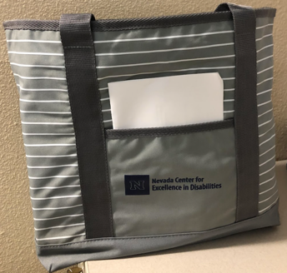
Sensory Kits
Contents:
8 fidget toys
1 buzzy stimulator
1 pair of earmuffs
1 weighted blanket
1 book on coping strategies

Slide 23
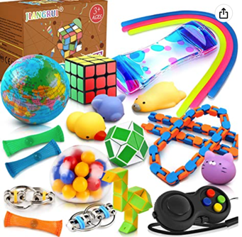
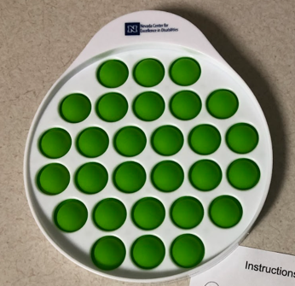
Fidget Toys
Notes:
Distraction:
Sensory stimulation (visual, tactile, auditory)

Slide 24
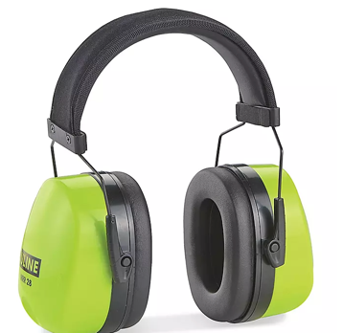
Earmuffs
For any kids who struggle with being auditorily overly stimulated
For those that do well with preferred music, can also encourage use of headphones

Slide 25
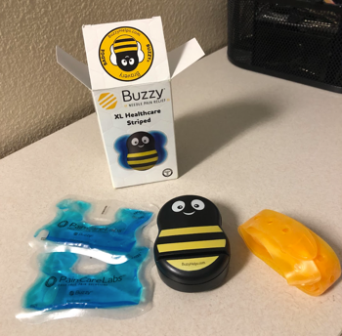
Buzzy Needle Pain Reliever
Uses mechanical stimulation and ice technology block pain on contact
Research has shown to be effective at reducing needle pain/fear
Notes:
Buzzy combines high-frequency vibration (Gate Control) and cold (Descending Noxious Inhibitory Control/DNIC) to control sharp pain. DNIC develops around age 4, and younger children may not tolerate the ice-cold sensation of Buzzy. For these children, the vibration of Buzzy will still provide some pain relief and the competing sensation of holding the ice-cold wing in the hand offers additional distraction - physical and cognitive - from the procedure. The patented technology works even better for adults than children. Over 50 clinical trials demonstrate that Buzzy is effective at relieving pain. It is the only solution that reduces both pain fear. Buzzy is the most proven intervention for injections. See the research summary by clicking here.

Slide 26
Weighted Blanket*
For kids who have a preference for pressure/weighted items
* Note: this is based solely on individual preference

Slide 27
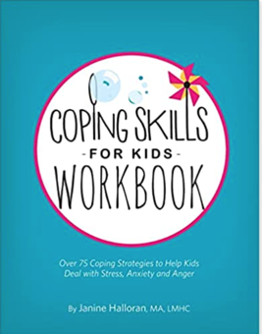
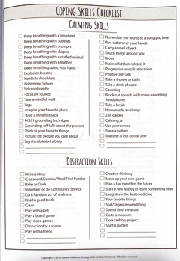
Coping Strategies Workbook
Activities focused on helping kids to calm during stressful moments
Notes:
Bring up some of the longer term strategies versus short term

Slide 28
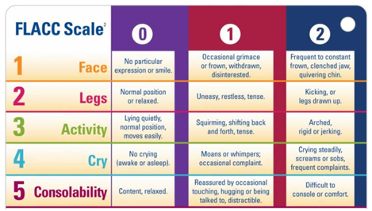
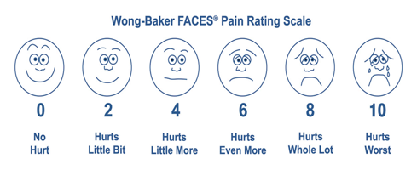
Pain Management ^{1,2}
¹ Merkel et al. (1997) ² Wong & Baker (1988; 1989)
Notes:
These are likely scales you are familiar with,

Slide 29
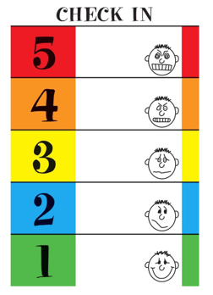
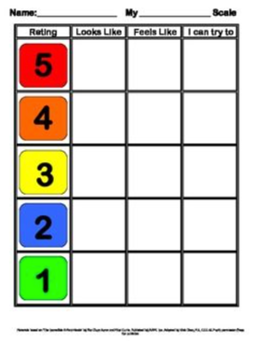
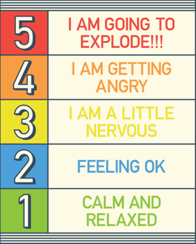
Coping Strategy: Feelings Chart
Notes:
The incredible 5 point scale – Kari Dunn Baron
The Zones of Regulation – Leah Kuypers
Can become part of a plan: develop for inidivudals that come back for procedures
If you are utilizing some of these strategies during in or outpatient procedures, another reminder of something you are likely familiar with which is one voice, or trying not to overwhelm the individual by having multiple people talking to the individual at the same time. It is much easier for people to focus and calm when there is that one person talking to them, whether it is a parent or healthcare worker.

Slide 30
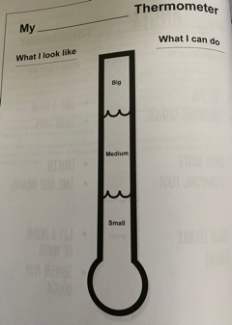
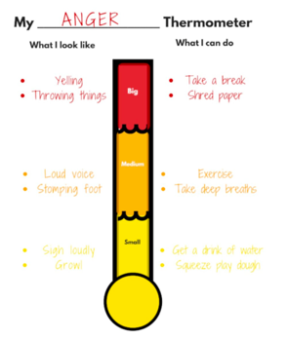
Coping Strategy: Thermometer
Notes:
The Zones of Regulation – Leah Kuypers

Slide 31
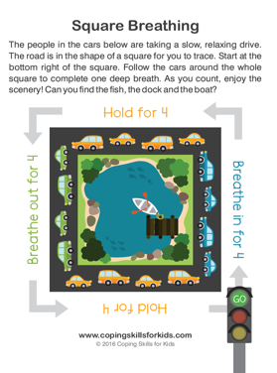
Workbook
Free printable coping/breathing activities:
https://www.janinehalloran.com/free
https://www.teacherspayteachers.com
Notes:
Download some of the resources here: https://www.janinehalloran.com/free
If you want to hand out or give these to kids

Slide 32
Cleaning Kit Items
Plastic items
Disinfectant spray, wipes, soap and warm water
“Sticky” fidget items
Soap and warm water
Weighted blanket
Machine washable, cold water (no fabric softener), hang dry

Slide 33
NCED Family Projects
Family Navigation Network (FNN)
Help with finding health care support and community resources for children/youth with special health care needs
Positive Behavior Support of Nevada (PBS-NV)
Offer workshops on targeted problems (e.g., picky eating) and overall challenging behaviors
Develop person-centered plans on how challenges can be prevented and how to appropriate behaviors are taught and reinforced
Healthy Home Life (HHL)
Available to rural Nevada communities
Similar workshop to PBS-Nv, targeted around parent-child relationship building
Notes:
The Family Navigation Network, helps individuals, families, and professionals who serve them to find health care support and community resources for children and youth with special health care needs and their families. We encourage anyone who could use support in navigating health care support to contact the FNN.
Our other two family-specific projects are for any parents, caregivers, families, or professionals supporting individuals with disabilities or who engage in challenging behaviors. PBS-NV, or Positive Behavior Support of Nevada project, offers topic specific workshops on things like picky eating, potty training, or routines and transitions, as well as an addressing challenging behaviors workshop that walks parents and caregivers through creating a behavior plan for their child, identifying ways in which challenging behaviors can be prevented and ensuring appropriate behaviors are taught and reinforced. Our other project, Healthy Home Life, offers a similar training as the addressing challenging behaviors workshop, but is focused primarily on offering trainings in the rural communities of Nevada and focuses on relationship building strategies for parents and their children. Both PBS-NV and HHL are entirely grant-funded and offer all of their trainings for free to any Nevada families wishing to participate.

Slide 34
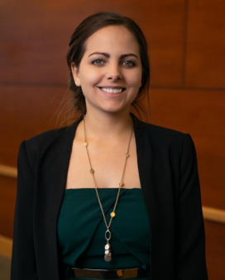
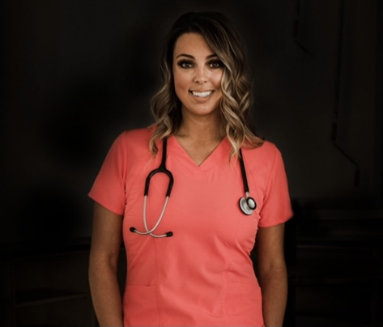
Question & Answer Period:
Lauren Brown, Ph.D., BCBA, LBA (NV)
Lauren is Administrative Faculty in the Nevada PBIS Technical Assistance Center and Nevada Center for Excellence in Disabilities.
Jessica Lamb, RN
Jessica is a Public Health Nurse from the Nevada Division of Public and Behavioral Health. Much of her clinical experience has been focused on working in the Pediatric Acute Care hospital setting, as well as working in Adolescent Behavioral Health residential facilities.

Slide 35
Sarah Jane Smith, MPH, MA
Health Equity Project Manager
Sjsmith@health.nv.gov
Randall Owen, PhD Director, Nevada Center for Excellence in Disabilities
Associate Professor of Special Education
randallowen@unr.edu https://www.unr.edu/nced
Lauren Brown, Ph.D., BCBA, LBA (NV) Project Coordinator, Nevada Center for Excellence in Disabilities
ldbrown@unr.edu

Slide 36
LAST MINUTE QUESTIONS & HOUSEKEEPING ITEM REVIEW
Have a Question?
Locate the Q & A box and type them there. We will address as many questions as we can today.
Recording & Slides
The recorded webinar and slides will be posted to ImmunizeNevada.org/nile-webinars.

