Slide 1
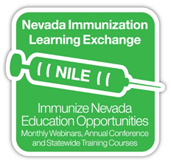
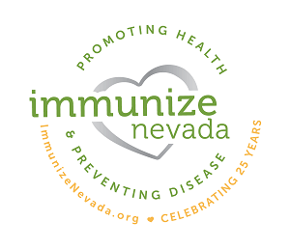
WELCOME TO THE NILE WEBINAR FOR
April 2022!
Immunize Nevada is a nonprofit 501c3 coalition that is widely recognized as Nevada’s trusted resource for immunization information and community health outreach for all ages. We accomplish this by fostering education and statewide collaboration with a variety of health partners and collaborators.
You may view upcoming web trainings at ImmunizeNevada.org/NILE-webinars
Thank you for joining us today!

Slide 2
HOUSEKEEPING ITEMS
Connectivity Issues
Please log back in and we’ll continue where we left off.
Have a Question?
Locate the Q & A box and type them there. We will address questions throughout the presentation.
Recording & Slides
The recorded webinar and slides will be posted to ImmunizeNevada.org/NILE-webinars.

Slide 3
DISCLAMER
Immunize Nevada’s NILE webinars are made possible by the generosity of speakers who donate their time and expertise to benefit the coalition. The expectation and goal is for community partners to gain knowledge on immunization/infectious disease-related topics through a non-branded, unbiased presentation.
The opinions expressed are those of today’s presenter and do not necessarily reflect those shared by Immunize Nevada or its partners.

Slide 4
Division of Public and Behavioral Health
COVID-19: Vaccines, Myths & Implications for Pregnancy, Breast and Chest Feeding
Presented by Sarah Jane Smith, MPH, MA
Maternal, Child & Adolescent Health and Immunization Sections

Slide 5
Agenda
General Overview and Recommendations: Pregnancy and COVID-19
The Impact of COVID-19 on Pregnancy Outcomes
The Burden of COVID-19 and Health Disparities
Science and the COVID-19 Vaccine: Pregnancy, Breast or Chest Feeding
Pregnancy-related COVID-19 Vaccine Frequently Asked Questions and Resources

Slide 6
General Overview: Pregnancy and COVID-19
If you are pregnant, or recently pregnant, you are more likely to get “severely ill” from COVID-19, compared to people who are not pregnant. Severe illness means that a person with COVID-19 may need:
  Hospitalization
  Admission to the Intensive Care Unit (ICU)
  A ventilator or special equipment to help them breathe
  People with COVID-19 who become severely ill can die
If you have COVID-19 during pregnancy, you are at increased risk of complications that can affect your pregnancy and developing baby
Having underlying medical conditions, and other factors – including age – can further increase risk for getting severely ill from COVID-19 during or recently after pregnancy (for at least 42 days following end of pregnancy)
Centers for Disease Control and Prevention, March 2022
Notes:
If you are pregnant, or recently pregnant, you are more likely to get “severely ill” from COVID-19, compared to people who are not pregnant. Severe illness means that a person with COVID-19 may need:
Hospitalization
Admission to the Intensive Care Unit (ICU)
A ventilator or special equipment to help them breathe
People with COVID-19 who become severely ill can die
If you have COVID-19 during pregnancy, you are at increased risk of complications that can affect your pregnancy and developing baby
Having underlying medical conditions, and other factors – including age – can further increase risk for getting very sick from COVID-19 during or recently after pregnancy (for at least 42 days following end of pregnancy)

Slide 7
Pregnancy, COVID-19 and Increased Risk
Other factors can further increase the risk of getting severely ill from COVID-19 during or recently after pregnancy, such as having certain underlying medical conditions:
  cancer, chronic kidney disease, chronic liver disease, chronic lung diseases, cystic fibrosis, dementia or other neurological conditions, diabetes (type 1 or 2), disabilities, heart conditions, HIV infection, immunocompromised, mental health conditions, obesity, sickle cell disease, smoking (current or former), organ or blood stem cell transplant, stroke or cerebrovascular disease, substance use disorders, tuberculosis
Being older than 25 years of age
Living or working in a community with high numbers of COVID-19 Cases
Living or working in a community with low levels of COVID-19 vaccination
Working in places where it is difficult or not possible to keep at least 6 feet apart from people who might be sick
Being part of some racial and ethnic minority groups, which have been put at increased risk from getting sick from COVID-19 due to the health inequities they face:
  discrimination, healthcare access and use, occupation, educational, income and wealth gaps, housing
Centers for Disease Control and Prevention, March 2022
Notes:
Other factors can further increase the risk of getting severely ill from COVID-19 during or recently after pregnancy, such as having certain underlying medical conditions (don’t read, but say they’re listed here):
cancer, chronic kidney disease, chronic liver disease, chronic lung diseases, cystic fibrosis, dementia or other neurological conditions, diabetes (type 1 or 2), disabilities, heart conditions, HIV infection, immunocompromised, mental health conditions, obesity, pregnancy, sickle cell disease, smoking (current or former), organ or blood stem cell transplant, stroke or cerebrovascular disease, substance use disorders, tuberculosis
Being older than 25 years of age
Living or working in a community with high numbers of COVID-19 Cases
Living or working in a community with low levels of COVID-19 vaccination
Working in places where it is difficult or not possible to keep at least 6 feet apart from people who might be sick
Being part of some racial and ethnic minority groups, which have been put at increased risk from getting sick from COVID-19 due to the health inequities they face:
discrimination, healthcare access and use, occupation, educational, income and wealth gaps, housing

Slide 8
General Recommendations:
Pregnancy & COVID-19
Wear a mask indoors in public in areas with a high COVID-19 Community Level
  People who are pregnant or have other conditions that could put them at higher risk for severe illness should speak with their healthcare provider about wearing a mask in public indoor spaces at the medium COVID-19 Community Level
Stay up to date with your COVID-19 Vaccines
  The COVID-19 Vaccine helps to reduce the risk of infection and to protect from serious illness from COVID-19 by boosting the slightly weakened immune system of pregnant people to build antibodies to protect themselves and their babies
  A new study from the Centers for Disease Control and Prevention (CDC) showed that infants whose mothers received two doses of an mRNA COVID-19 Vaccine during pregnancy are less likely to be admitted to the hospital for COVID-19 in the first six months of their life, indicating that vaccination during pregnancy was 61% effective at preventing infant hospitalization
Avoid crowds and poorly ventilated spaces
Test to prevent the spread to others
Wash your hands often
Cover coughs and sneezes
Centers for Disease Control and Prevention, March 2022
Notes:
To maximize protection from variants and prevent possibly spreading the virus to others, wear a mask indoors in public in areas with a high COVID-19 Community Level. People who are pregnant or have other conditions that could put them at higher risk for severe illness should speak with their healthcare provider about wearing a mask in public indoor spaces at the medium COVID-19 Community Level.
Stay up to date with your COVID-19 Vaccines
The COVID-19 Vaccine helps to reduce the risk of infection and to protect from serious illness from COVID-19 by boosting the slightly weakened immune system of pregnant people to build antibodies to protect themselves and their babies
A new study from the Centers for Disease Control (CDC) showed that infants whose mothers received two doses of an mRNA COVID-19 Vaccine during pregnancy are less likely to be admitted to the hospital for COVID-19 in the first six months of their life, indicating that maternal vaccination was 61% effective at preventing infant hospitalization
Avoid crowds and poorly ventilated spaces
Test to prevent the spread to others
Wash your hands often
Cover coughs and sneezes
***Public facing presentation in May: add picture of how to get the community-level data***

Slide 9
The Impact of COVID-19 on Pregnancy Outcomes
People with COVID-19 during pregnancy are more likely to experience complications that can affect their pregnancy and developing baby compared to people without COVID-19 during pregnancy
  COVID-19 during pregnancy increases the risk of delivering a preterm (earlier than 37 weeks) or stillborn infant
  COVID-19 in pregnancy can also lead to miscarriage, intrauterine death, fetal growth restriction, long term morbidity and disability
When compared with pregnant people without COVID-19, studies have shown that pregnant persons with COVID-19 have higher odds of:
  Maternal Death
  Preeclampsia
  Preterm Birth
  Stillbirth
  Need for Neonatal Intensive Care Unit (NICU) Admission
Centers for Disease Control and Prevention, 2022
Allotey, J., Stallings, E., Bonet, M., Yap, M., Chatterjee, S., Kew, T., ... & Thangaratinam, S. (2020)
Notes:
People with COVID-19 during pregnancy are more likely to experience complications that can affect their pregnancy and developing baby compared to people without COVID-19 during pregnancy
COVID-19 during pregnancy increases the risk of delivering a preterm (earlier than 37 weeks) or stillborn infant
COVID-19 in pregnancy can also lead to miscarriage, intrauterine death, fetal growth restriction, long term morbidity and disability
When compared pregnant people without COVID-19, studies have shown that pregnant persons with COVID-19 have higher odds of:
Maternal Death
Preeclampsia
Preterm Birth
Stillbirth
Need for Neonatal Intensive Care Unit (NICU) Admission
Clinical manifestations, risk factors, and maternal and perinatal outcomes of coronavirus disease 2019 in pregnancy: living systematic review and meta-analysis | The BMJ
Allotey, J., Stallings, E., Bonet, M., Yap, M., Chatterjee, S., Kew, T., ... & Thangaratinam, S. (2020). Clinical manifestations, risk factors, and maternal and perinatal outcomes of coronavirus disease 2019 in pregnancy: living systematic review and meta-analysis. Bmj, 370.
***Public Facing one: provide more context for the risk bullets

Slide 10
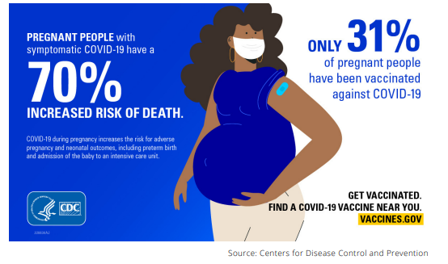
The Impact of COVID-19 on Pregnancy Outcomes
Centers for Disease Control and Prevention, 2022
Notes:
CDC COVID Data Tracker

Slide 11
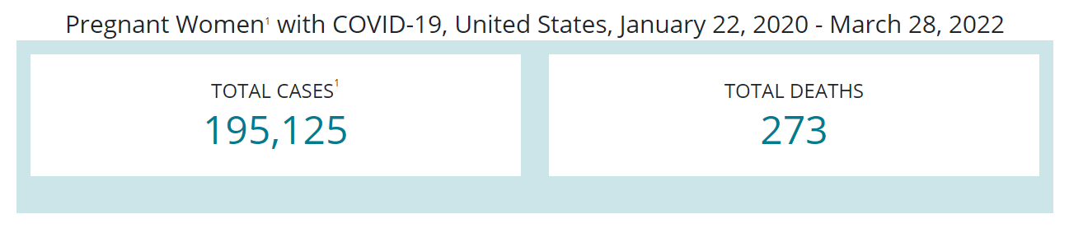
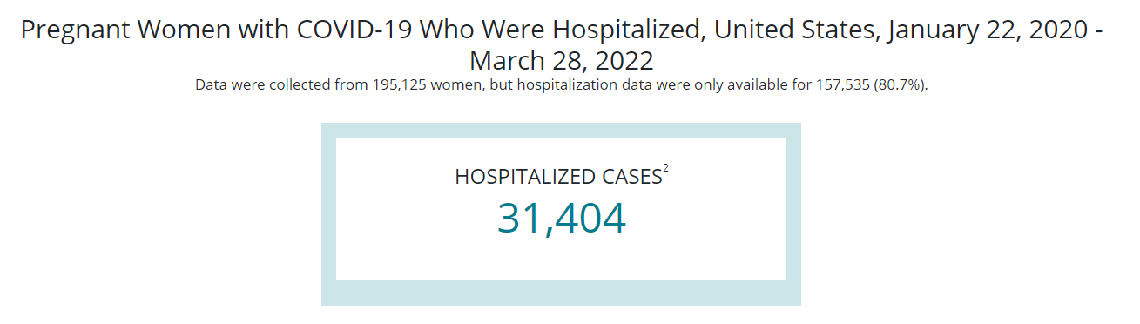
Data on COVID-19 during Pregnancy: Birth and Infant Outcomes Nationally
Centers for Disease Control and Prevention, March 28, 2022
¹Cases with age <9 years and >54 years are excluded. Cases with unknown age are included.
²Data were not available to distinguish hospitalization for COVID-19-related indications, such as worsening respiratory status, from hospital admission for pregnancy-related indications, such as delivery.
Notes:
CDC COVID Data Tracker

Slide 12
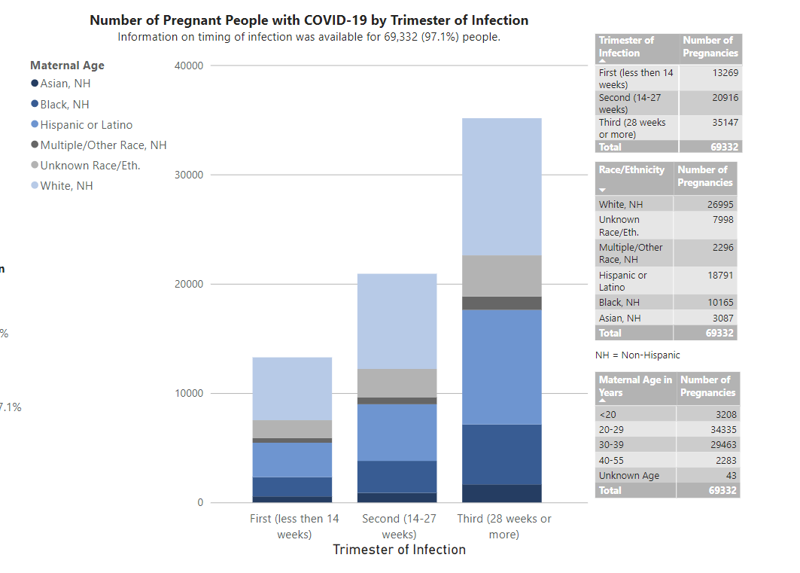
Data on COVID-19 during Pregnancy: Birth and Infant Outcomes Nationally
Centers for Disease Control and Prevention, March 28, 2022
Notes:
CDC COVID Data Tracker

Slide 13
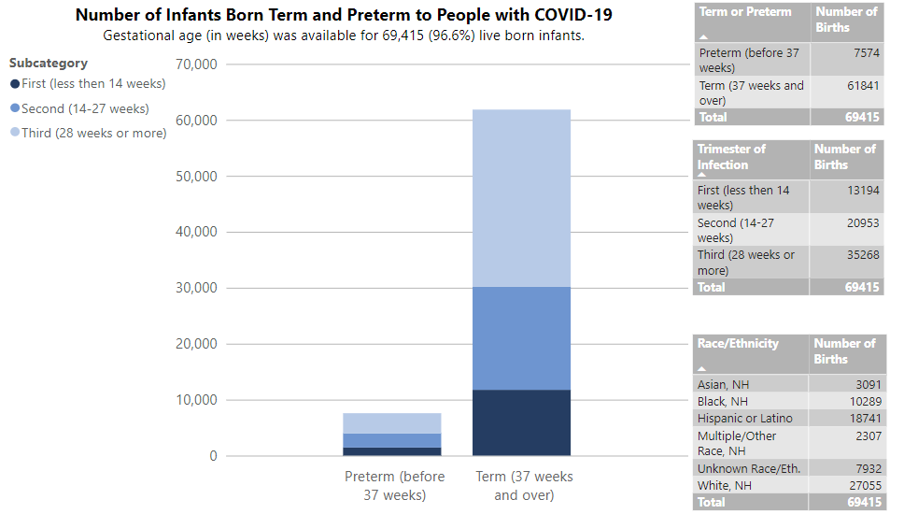
Data on COVID-19 during Pregnancy: Birth and Infant Outcomes Nationally
Centers for Disease Control and Prevention, March 28, 2022
Notes:
CDC COVID Data Tracker

Slide 14
Snapshot: Data in Nevada
Number of Women who are Nevada Residents with COVID-19 During Pregnancy between 2020-2021; self-reported from birth certificate data:
857 out of 67,257 or 1.3%
Women of Childbearing Age (14-44) who are Nevada Residents with confirmed cases of COVID-19 between 2020-April 4th, 2022
184,098 cases
Confirmed COVID-19 Cases of Children (0-19) who are Nevada Residents between 2020 – April 4th, 2022
110,637 cases
Between January 1 and December 31, 2021, there were 34 diagnosed MIS-C cases in Nevada
22 of the diagnosed MIS-C cases also tested positive for COVID-19
There were 32 diagnosed cases of MIS-C in 2020
Technical Notes/Disclaimer:
All data with this presentation is subject to change
Small counts have been suppressed
Similarly, to other states nationally, a significant number of Nevada records are missing demographic information such as, but not limited to, Race/Ethnicity, age and gender
Notes:
MIS-C: Multisystem Inflammatory Syndrome in Children
MIS-C is a serious inflammatory syndrom in children, including some teenagers. This syndrom is rare, but there appears to be an emerging link between children, MIS-C and COVID-19. This link is being researched nationally and there remains a lot to be learned about the connection.
Prior to the COVID-19 global pandemic, MIS-C symptoms have been monitored via syndromic surveillance with Nevada hospitals, and an MIS-C diagnoses must be reported to the State.

Slide 15
The Burden of COVID-19 and Health Disparities
COVID-19 stands to worsen maternal health disparities across the U.S.
Black, American Indian and Alaska Native women were already up to 4 times more likely to die from pregnancy-related complications than white women
Current data indicate disproportionate rates of COVID-19 infection, severe morbidity and mortality in communities of color – particularly among Black, Latinx, and Native American peoples
Much of the data currently collected across the U.S. on COVID-19 and Pregnancy is coming from single center institutions; more research and data collection is needed to take a deeper look at the social determinants of health and national trends related to pregnancy and COVID-19 health disparities
Centers for Disease Control and Prevention, 2019, 2021
American Journal of Obstetrics and Gynecology
American College of Obstetricians and Gynecologists, May 2020
Notes:
COVID-19 stands to worsen maternal health disparities across the U.S.
Black, American Indian and Alaska Native women were already up to 4 times more likely to die from pregnancy-related complications than white women
Current data indicate disproportionate rates of COVID-19 infection, severe morbidity and mortality in communities of color – particularly among Black, Latinx, and Native American peoples
Much of the data currently collected across the U.S. on COVID-19 and Pregnancy is coming from single center institutions; more research and data collection is needed to take a deeper look at the social determinants of health and national trends related to pregnancy and COVID-19 health disparities
Social determinants of health, current and historic inequities in access to health care and other resources, and structural racism contribute to these disparate outcomes. These factors also contribute to disproportionate rates of comorbidities in communities of color, which place individuals at higher risk of severe illness from COVID-19. Access to preventive strategies, COVID-19 testing, and health care resources for those affected may also be limited in some communities. Additional data are needed to understand the full extent of these inequities and to guide equitable allocation of health care resources and other public health interventions.

Slide 16
Science and the COVID-19 Vaccines: Pregnancy
Scientific studies have shown no safety concerns for babies born to people who were vaccinated against COVID-19 during pregnancy.
The Centers for Disease Control and Prevention (CDC), the American College of Obstetricians and Gynecologists (ACOG), and the Society for Maternal-Fetal Medicine, all recommend COVID-19 vaccination at any point in pregnancy, as well as booster doses for the eligible.
In most situations, including for people who are pregnant and people who are breastfeeding, Pfizer-BioNTech or Moderna COVID-19 vaccines (mRNA COVID-19 vaccines) are preferred over the J&J/Janssen COVID-19 vaccine for primary and booster vaccination.
Side effects can occur after receiving any of the available COVID-19 vaccines. People who are pregnant have not reported different side effects from people who are not pregnant after vaccination with mRNA COVID-19 vaccines (Moderna and Pfizer-BioNTech vaccines)
Centers for Disease Control and Prevention, 2022
Notes:
Scientific studies have shown no safety concerns for babies born to people who were vaccinated against COVID-19 during pregnancy. Given how the vaccine works in the body, experts believe they are unlikely to pose a risk for long-term health effects. CDC continues to monitor, analyze, and disseminate information from people vaccinated during all trimesters of pregnancy to better understand effects on pregnancy and babies.
The Centers for Disease Control (CDC), the American College of Obstetricians and Gynecologists (ACOG), and the Society for Maternal-Fetal Medicine, all recommend COVID-19 vaccination at any point in pregnancy, as well as booster doses for the eligible. COVID-19 vaccination can protect you from getting very sick from COVID-19, and keeping you as healthy as possible during pregnancy is important for the health of your baby.
In most situations, including for people who are pregnant and people who are breastfeeding, Pfizer-BioNTech or Moderna COVID-19 vaccines (mRNA COVID-19 vaccines) are preferred over the J&J/Janssen COVID-19 vaccine for primary and booster vaccination due to the risk of serious adverse events. Thrombosis with thrombocytopenia syndrome (TTS) is a rare but serious adverse event that causes blood clots in large blood vessels and low platelets (blood cells that help form clots) and is associated with the J&J/Janssen COVID-19 vaccine. Vaccine recipients must be informed of the risks and benefits of J&J/Janssen COVID-19 vaccination. The J&J/Janssen COVID-19 vaccine may be considered in some situations, including for persons who
Had a severe reaction after an mRNA vaccine dose or who have a severe allergy to an ingredient of Pfizer-BioNTech or Moderna (mRNA COVID-19 vaccines),
Would otherwise remain unvaccinated for COVID-19 due to limited access to Pfizer-BioNTech or Moderna (mRNA COVID-19 vaccines); or
Wants to get the J&J/Janssen COVID-19 vaccine despite the safety concerns.
Side effects can occur after receiving any of the available COVID-19 vaccines. People who are pregnant have not reported different side effects from people who are not pregnant after vaccination with mRNA COVID-19 vaccines (Moderna and Pfizer-BioNTech vaccines)

Slide 17
Science and the COVID-19 Vaccines: Pregnancy, Breast or Chest Feeding
CDC recommends that people who are breastfeeding get vaccinated and stay up to date with their COVID-19 vaccines, including getting a COVID-19 booster shot when it’s time to get one
COVID-19 vaccines cannot cause COVID-19 infection in anyone, including the pregnant person or the baby; none of the COVID-19 vaccines contain live virus
Currently, there is no data to suggest that getting the COVID-19 vaccine while breast or chest feeding will affect milk supply
Vaccines are effective at preventing COVID-19 in people who are breastfeeding - recent reports have shown that breastfeeding people who have received mRNA COVID-19 vaccines have antibodies in their breastmilk, which could help protect their babies
  More data are needed to determine what level of protection these antibodies may provide to the baby
Centers for Disease Control and Prevention, 2022
Notes:
CDC recommends that people who are breastfeeding get vaccinated and stay up to date with their COVID-19 vaccines, including getting a COVID-19 booster shot when it’s time to get one
COVID-19 vaccines cannot cause COVID-19 infection in anyone, including the pregnant person or the baby; none of the COVID-19 vaccines contain live virus
Currently, there is no data to suggest that getting the COVID-19 vaccine while breast or chest feeding will affect milk supply
Vaccines are effective at preventing COVID-19 in people who are breastfeeding - recent reports have shown that breastfeeding people who have received mRNA COVID-19 vaccines have antibodies in their breastmilk, which could help protect their babies
More data are needed to determine what level of protection these antibodies may provide to the baby

Slide 18
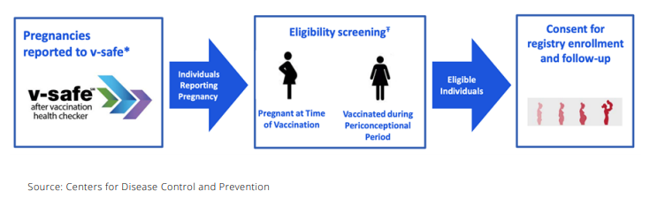
Safety of the COVID-19 Vaccines While Pregnant, Breast or Chest Feeding
Vaccine safety surveillance system: v-safe COVID-19 Vaccine Pregnancy Registry
Research Study:
  35,000 pregnant v-safe participants who received mRNA COVID-19 vaccine; found no safety concerns for them for their baby
  As of December 20, 2021: More than 180,000 individuals signed up for v-safe and indicated they were pregnant at the time they received the COVID-19 Vaccine
Centers for Disease Control and Prevention, 2022
Notes:
There is a vaccine safety surveillance system focused on pregnant people known as the v-safe COVID-19 Vaccine Pregnancy Registry. This surveillance system collects information from people who received the COVID-19 vaccination in the periconception period (within 30 days before last menstrual period) or during pregnancy. Participation is voluntary and participants can opt out at any time. Participants are contacted several times during their pregnancy and asked health questions about their pregnancy and health history. Once the baby has been delivered, participants might be contacted again. The information gathered is used to better understand pregnancy outcomes (e.g., miscarriage and stillbirth), pregnancy complications (e.g., preeclampsia and gestational diabetes) and problems with the newborn (e.g., preterm birth, poor growth, or birth defects).

Slide 19
Other Recommended Vaccines during Pregnancy
Tdap Vaccine
  Centers for Disease Control and Prevention (CDC) recommends a pertussis (also known as whooping cough) "booster" for all new parents and pregnant women
    With each pregnancy between 27-36 weeks gestation as the best and safest option, or right after delivery before discharge from the hospital if not immunized with the Tdap during pregnancy
    State of NV Cocooning Program allows for one free Tdap for the mother in the third trimester and one free Tdap to another close contact of baby (parent, grandparent, other caregiver)
Flu Vaccine
  Pregnant people are more likely to have severe illness from flu
  The best way for pregnant people to protect against flu and protect the baby for several months after birth from flu-related complications
  CDC recommends getting a flu vaccine by the end of October despite flu seasons varying in their timing from season to season
Centers for Disease Control and Prevention, 2022

Slide 20
Resources
MotherToBaby: Recommended by the Centers for Disease Control and Prevention
  Experts are available to answer questions in English or Spanish by phone or chat; free confidential service
  1-866-626-6847
  www.mothertobaby.org
Vaccine Finder
  Use Vaccines.gov to find a location near you, then call (available in English and Spanish) or visit their website to make an appointment
  1-800-232-0233
  www.vaccines.gov
Immunize Nevada
  COVID-19 Resources throughout the state of Nevada, in both English and Spanish including: vaccines, testing, information related to COVID-19
  1-775-624-7117
  www.immunizenevada.org
Nevada Health Response Data Dashboard
  Data dashboard with total number of cases throughout the state
  https://nvhealthresponse.nv.gov
Notes:
Ask An Expert – MotherToBaby
Add in handouts w/resources (images of) once complete

Slide 21
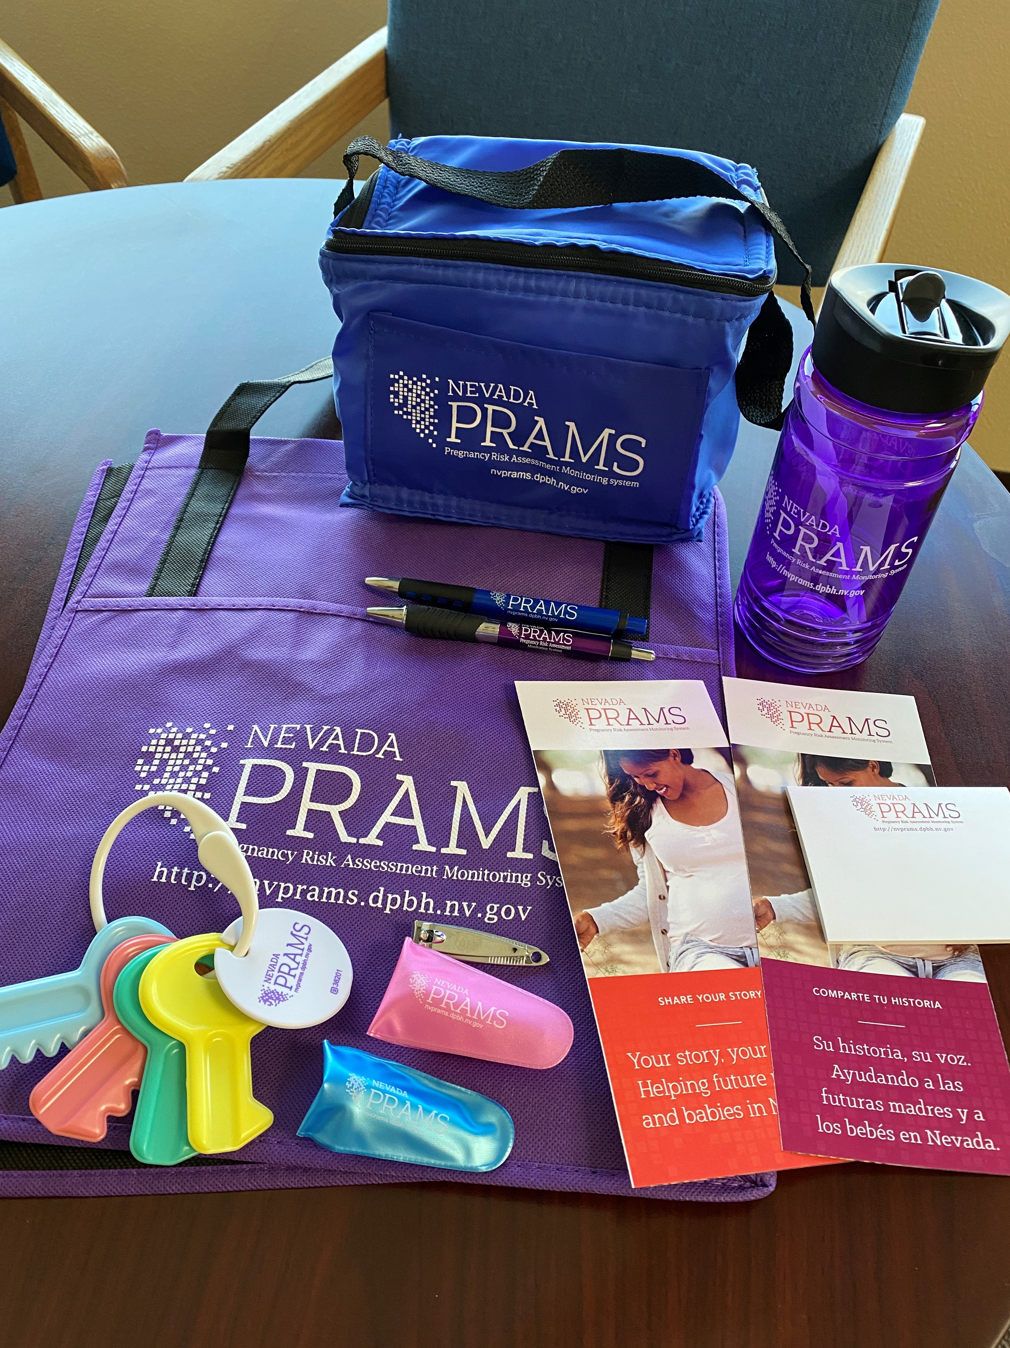
Resources Continued...
A variety of resources from different programs within the Nevada Department of Health and Human Services Title V Maternal Child Health Program are available upon request:
  Safe Sleep Brochures
  Nevada Breastfeeds Handouts and Breastfeeding Welcome Here stickers
  Breastfeeding Support Materials
  Does Your Teen Needs Health Coverage? Brochures
  Health Care Transition from Pediatric to Adult Medicine Information Sheets and Timelines
  EHDI resources
  Nevada Home Visiting brochures
  The Tenth Month of Pregnancy
  Medical Home Portal materials
  Pregnancy Risk Assessment Monitoring System Materials
  Contact kgriffin@health.nv.gov to request!
Notes:
Ask An Expert – MotherToBaby
Add in handouts w/resources (images of) once complete

Slide 22
Providers are the most trusted source of information!
We know that providers continue to be the most trusted source of information about COVID-19 Vaccines. If your practice is interested in offering the COVID-19 Vaccine, please send an email of interest to:
dpbh-avars@health.nv.gov
Request a COVID-19 flu and vaccine clinic with Immunize NV
COVID-19 & Flu Vaccine Clinic Request Form (google.com)
Additional resources provided in handouts

Slide 23
Contact Information
Sarah Jane Smith, MPH, MA
Health Equity Project Manager
Sjsmith@health.nv.gov

Slide 24
Nevada SET-NET Data for NILE Webinar - Providers
High Sierra Area Health Education Center (AHEC)
Jaimee Maranon, MS & Natasha Nyquist-Smith, MPH/CPH
This publication (journal, article, etc.) was supported by the Nevada State Department of Health and Human Services through Grant Number 5 NU50CK000560-03-00 from The Center for Disease Control and Prevention. Its contents are solely the responsibility of the authors and do not necessarily represent the official views of the Department nor The Center for Disease Control and Prevention.

Slide 25
Overview
Who we are
SET-NET Project
COVID-19 and Pregnancy
Nevada Birthing Trends
Sampled Population Vaccination Status
Questions and Concerns
Contact Information

Slide 26

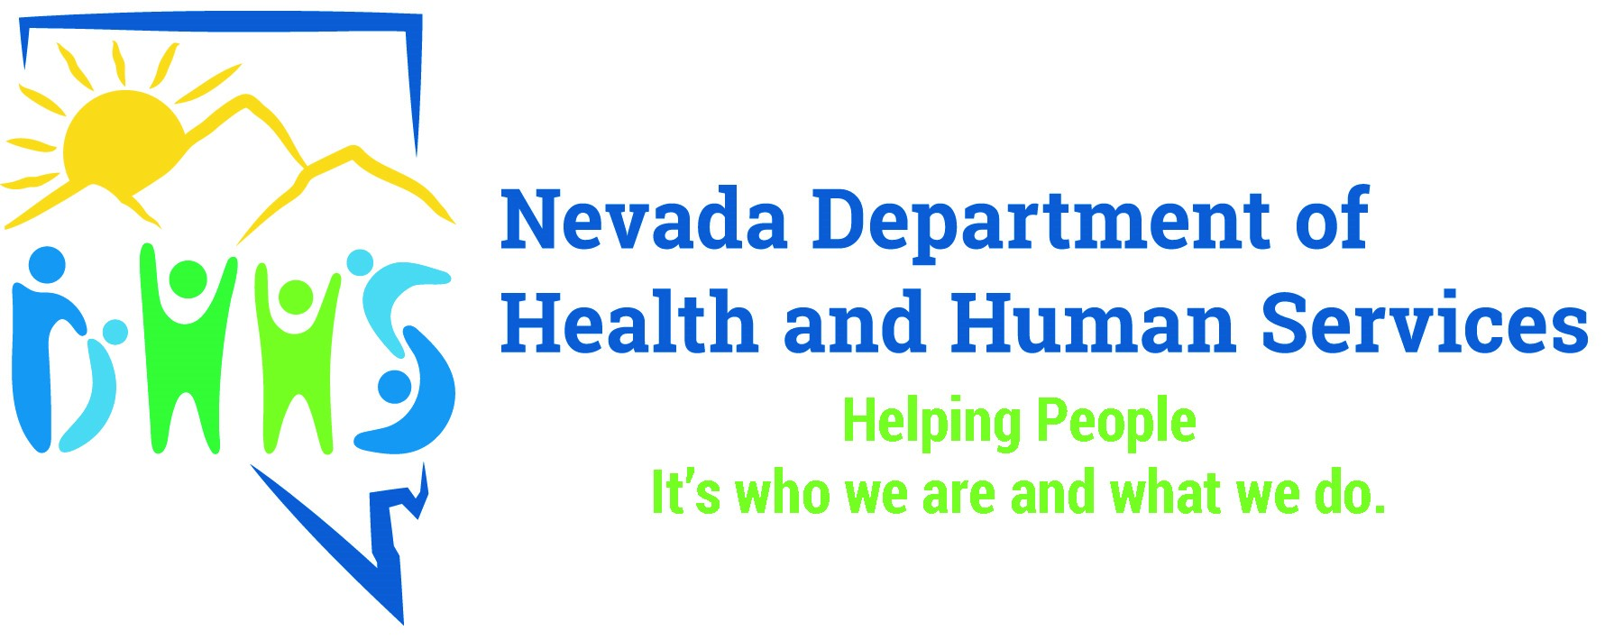
Introduction
In collaboration with the Center for Disease Control and Prevention (CDC) and Nevada Office of Public Health Investigations & Epidemiology (OPHIE), High Sierra Area Health Education Center (AHEC) collects, analyzes, and submits maternal health data as it relates to pregnant individuals and their neonates who test positive for COVID-19. Through our efforts in representing our jurisdiction, our goal is to act as a resource to develop, share, and maintain educational materials for the State’s OB/GYN Providers and Patients.
This presentation was supported by the Nevada State Department of Health and Human Services through Grant Number 5 NU50CK000560-30-00 from the Center for Disease Control and Prevention. Its contents are solely the responsibility of the authors and do not necessarily represent the official views of the Department nor The Center for Disease Control and Prevention.

Slide 27
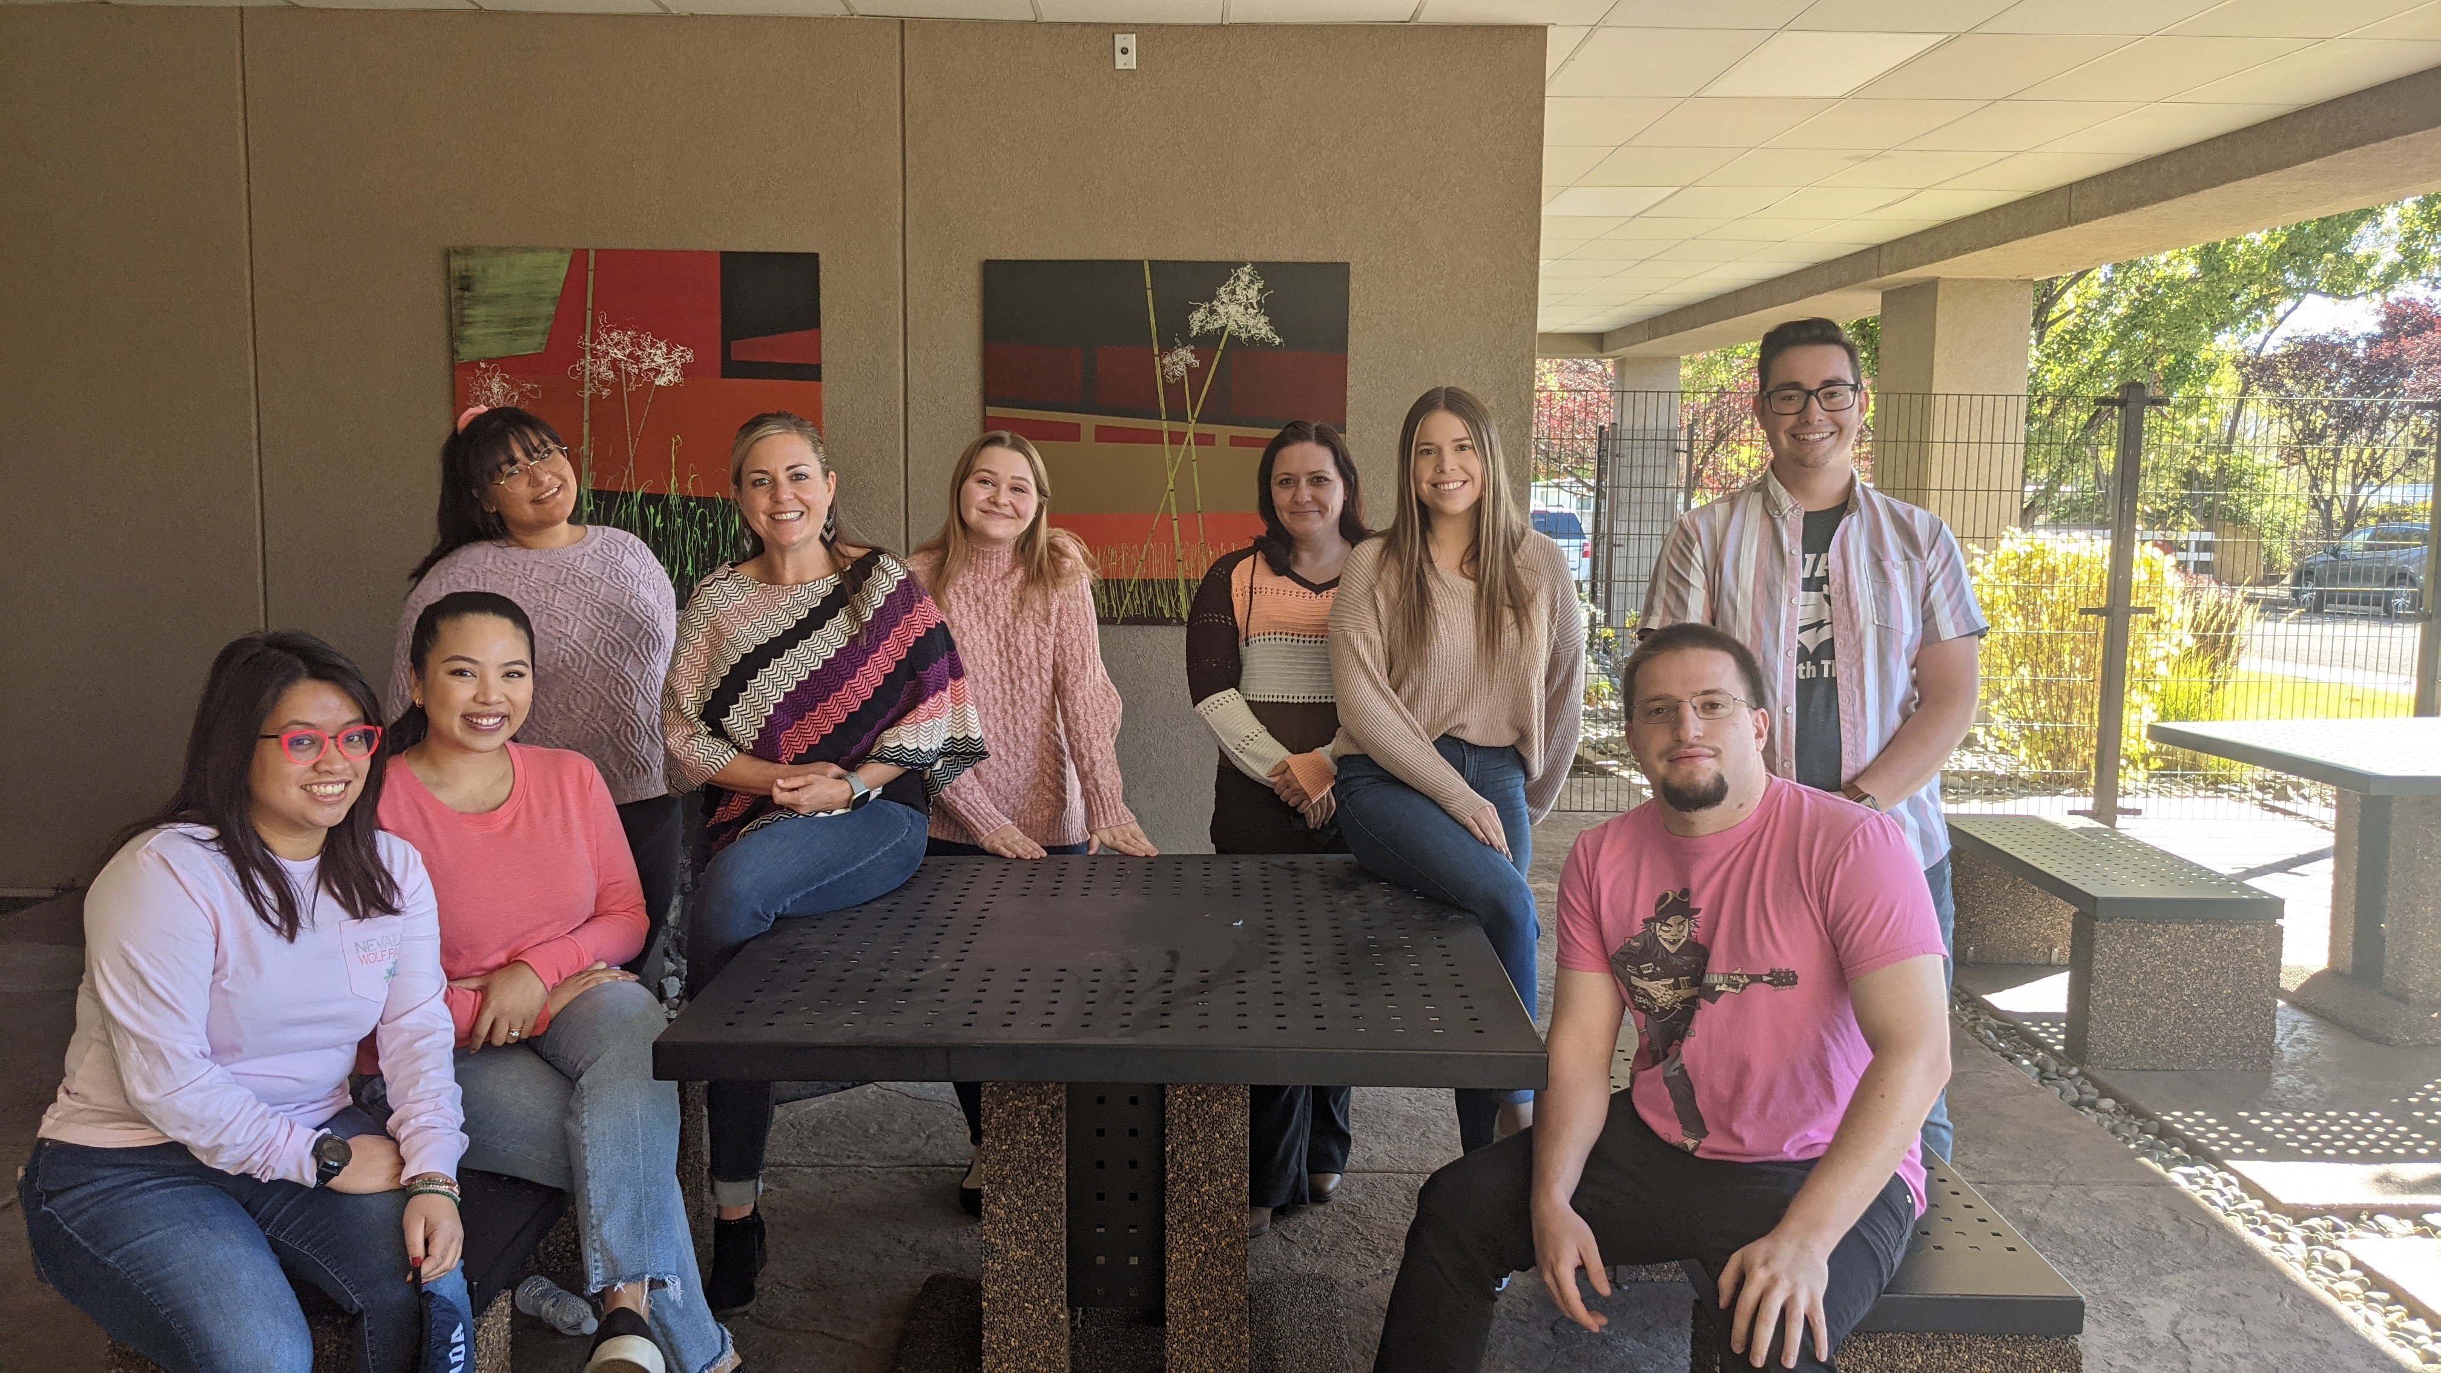
Who we are
High Sierra Area Health Education Center is a federally and state-funded 501(c)(3) public health nonprofit committed to serving an under-served and rural population of Northwestern Nevada in collaboration with the University of Nevada, Reno School of Medicine, and the Office of Statewide Initiatives. Our purpose is to meet the needs of the communities we serve through robust community-academic partnerships, with a focus on recruiting, developing, and cultivating our health care workforce pipeline. Through various valuable partnerships, we develop future leaders in health care.

Slide 28
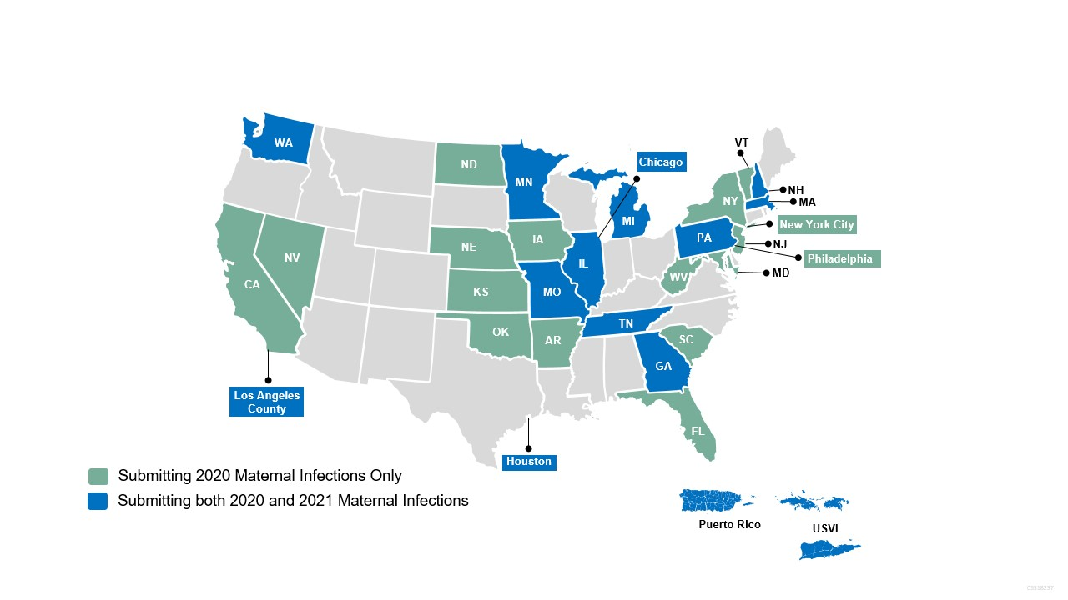
Surveillance of Emerging Threats to Mothers and Babies Network (SET-NET)
A CDC surveillance project for current and emerging threats for pregnant persons and their infants
Surveillance for:
  Zika,
  Hepatitis C
  Syphilis
  COVID-19

Slide 29
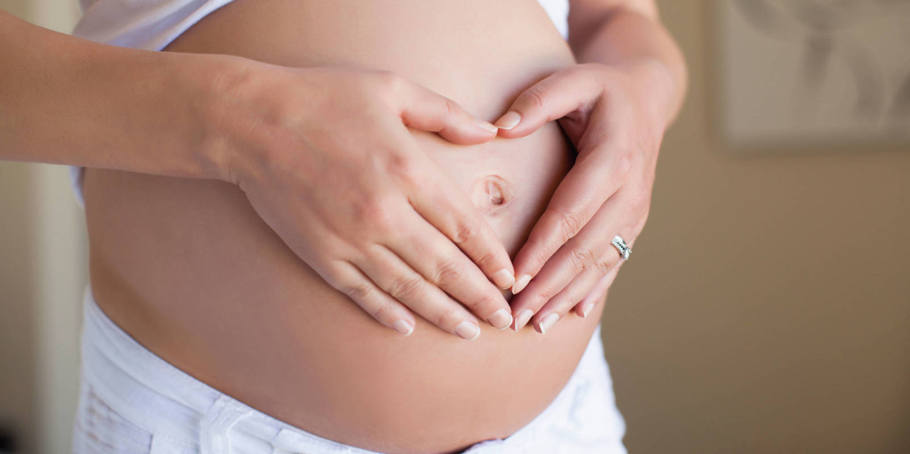
COVID-19 and Pregnancy
Physiological changes during pregnancy can put individuals at higher risk for severe illness and may have adverse birthing outcomes such a preterm deliveries
Symptomatic COVID-19 pregnant persons may require
  Intensive Care unit (ICU) admission
  Mechanical ventilation (MV intubation)
  Specialized heart-lung bypass treatment (ECMO)

Slide 30
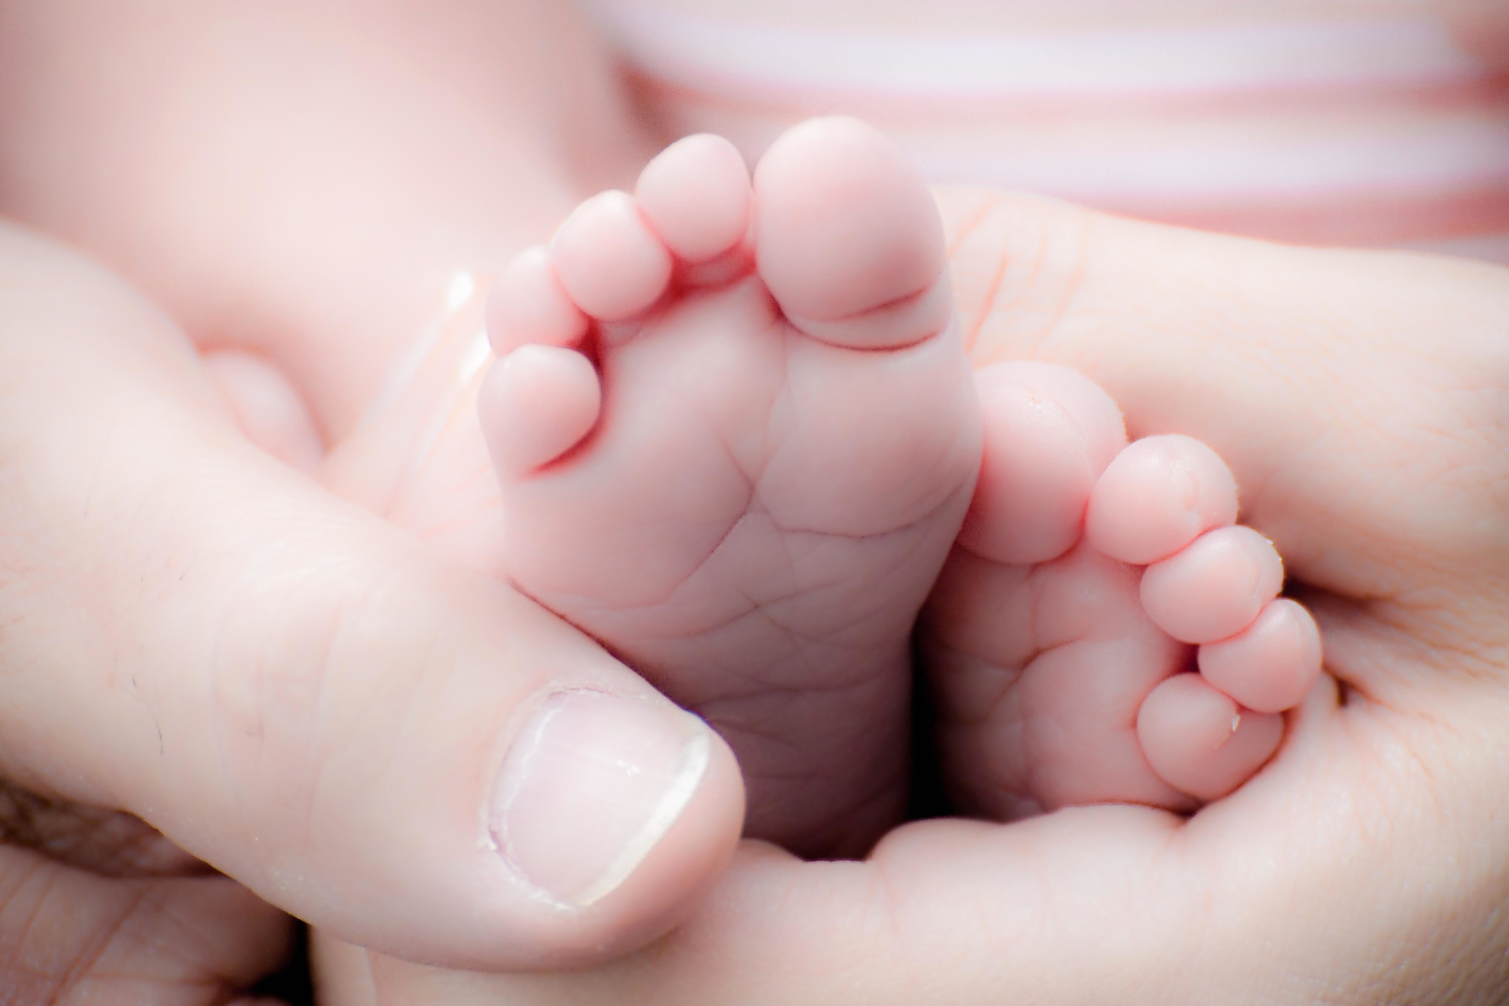
COVID-19 and Infants
COVID-19 has put infants/neonates at an Increased risk for preterm birth, stillbirth or neonatal ICU admission
Neonates/Infants have immature immune systems which increases their risk for getting COVID-19
COVID-19 Symptoms in neonates include
  feeling weak
  runny nose
  cough
  rapid breathing
  vomiting
  diarrhea
  decreased intake consumption

Slide 31
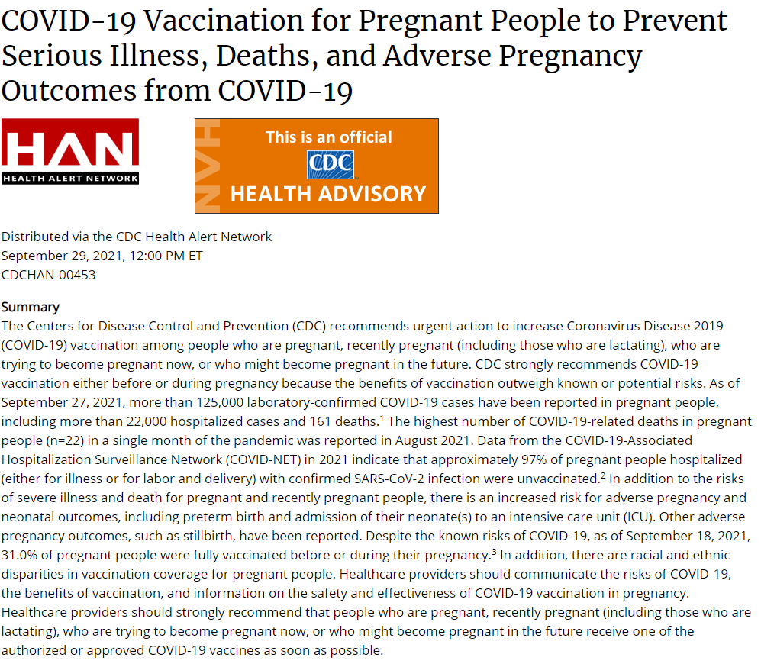
National Data
September 29, 2021, The CDC released Health Advisory on the importance of vaccination among Pregnant Individuals
Nationally, 31% of pregnant population is vaccinated against COVID-19
COVID-19 Vaccination Clinical & Professional Resources https://www.cdc.gov/vaccines/covid-19/index.html

Slide 32

Nevada Birthing Trends
The Nevada Department of Health and Human Services Office of Analytics reported
  During 2020 there were 33,590 births
921 births were to a pregnant person that had a lab confirmed COVID-19 infection
  12 Pregnant Individuals were admitted to the ICU due to COVID-19 complications

Slide 33
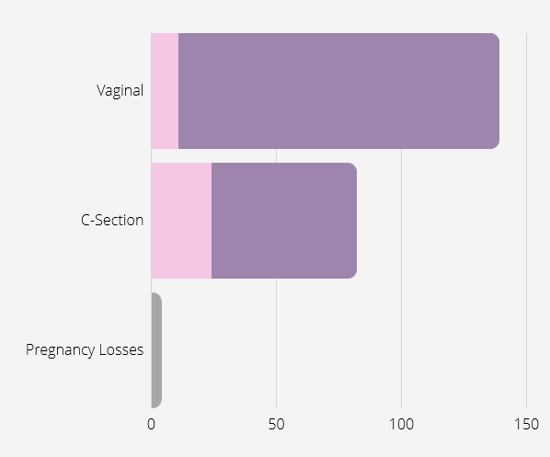
Birthing Trends
139 Maternal COVID-19 positive cases with Vaginal deliveries
  11 Premature (<37 Weeks)
  128 Term (37 weeks or more)
82 Maternal COVID-19 positive cases with C-section deliveries
  24 Premature (<37 Weeks)
  58 Term (37 weeks or more)
4 Pregnancy losses
  2 Stillbirths
  2 Miscarriages

Slide 34
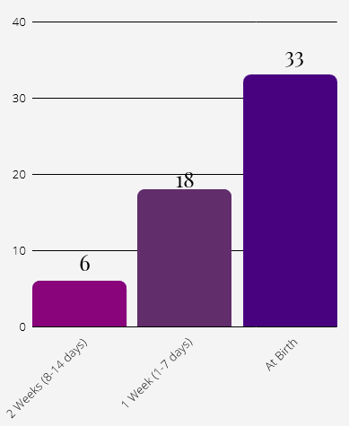
At Birth COVID-19 Diagnoses'
At birth diagnosis
      (Individuals who were diagnosis of COVID-19 two weeks prior to the birth)
57 cases with a diagnosis at birth
  33 Detected due to COVID-19 testing at the Birthing Hospital
  5 Pregnant Individuals were admitted to the ICU
  1 pregnant individual with a 2nd Trimester at Birth Diagnosis led to Pre-term delivery (< 36 weeks)
  2 COVID-19 Positive Neonates
  1 Stillbirth

Slide 35
SET-NET Data on Vaccines for 2020
Sampled 369 Pregnant Individuals who tested positive for COVID-19 during 2020
  (40% of Nevada’s total number of positive pregnant population)
In the 2020 sample
  5 pregnant individuals who received the COVID-19 vaccine during pregnancy
Many were vaccinated when it became available for the general public in their postpartum timeframe

Slide 36
SET-NET Data on Vaccines for 2021
Sampled 204 Pregnant Individuals who tested positive for COVID-19 during 2021
  (15% of Nevada’s total positive pregnant cases population)
In the 2021 sample
  6 pregnant individuals who received the COVID-19 vaccine during pregnancy
  7 pregnant positive persons in the population were a breakthrough case (defined as diagnosis of COVID-19 after being fully-vaccinated)

Slide 37
Conclusion
SET-NET Data helps us understand the adverse birth defects on pregnant individuals and their neonates
We were able to look at the birthing trends, at birth-diagnosis trends, vaccination for COVID-19 among this population
Our data is important for developing education to providers and patients to inform about how this disease impacts two people

Slide 38
Contact Information
Ashlyn Torrez, CCM
HPS I CDCF Contractor
atorrez@health.nv.gov
Jaimee Maranon, MS
Disease Control Specialist
jaimee@highsierraahec.org
Natasha Nyquist-Smith, MPH, CPH, CCHW
Disease Control Specialist
natasha@highsierraahec.org
setnetproject@highsierraahec.org
775-507-4022

Slide 39

Question & Answer with Dr. David N. Jackson, MD
Vice Chair, Nevada ACOG
Division Director, Maternal-Fetal Medicine, Mountain View Hospital, Las Vegas
Clinical Professor, MFM, University of Nevada Las Vegas and Reno
Clinical consultant, High Risk Pregnancy Center, Las Vegas.

Slide 40
LAST MINUTE QUESTIONS & HOUSEKEEPING ITEM REVIEW
Have a Question?
Locate the Q & A box and type them there. We will address as many questions as we can today.
Recording & Slides
The recorded webinar and slides will be posted to ImmunizeNevada.org/nile-webinars.

