Slide 1
WELCOME TO THE NILE WEBINAR FOR March 2022!
Immunize Nevada is a nonprofit 501c3 coalition that is widely recognized as Nevada’s trusted resource for immunization information and community health outreach for all ages. We accomplish this by fostering education and statewide collaboration with a variety of health partners and collaborators.
You may view upcoming web trainings at ImmunizeNevada.org/NILE-webinars
Thank you for joining us today!

Slide 2
HOUSEKEEPING ITEMS
Connectivity Issues
Please log back in and we’ll continue where we left off.
Have a Question?
Locate the Q & A box and type them there. We will address questions throughout the presentation.
Recording & Slides
The recorded webinar and slides will be posted to ImmunizeNevada.org/NILE-webinars.

Slide 3
DISCLAMER
Immunize Nevada’s NILE webinars are made possible by the generosity of speakers who donate their time and expertise to benefit the coalition. The expectation and goal is for community partners to gain knowledge on immunization/infectious disease-related topics through a non-branded, unbiased presentation. The opinions expressed are those of today’s presenter and do not necessarily reflect those shared by Immunize Nevada or its partners.

Slide 4
Influenza Immunization in Children & Families: Challenges and Best Practices
Michelle Hoffman, MD, FAAP
Pediatric Infectious Diseases
Golisano Children's Hospital of Southwest Florida

Slide 5
Visiting Immunization Expert Initiative
The Visiting Immunization Expert Initiative through the national American Academy of Pediatrics provides support for immunization experts to virtually visit organizations to address pediatric influenza and Human Papillomavirus (HPV) in effort to help physicians and practice staff make strong recommendations for HPV and pediatric influenza vaccination
This presentation is supported by the Centers for Disease Control and Prevention (CDC) of the U.S. Department of Health and Human Services (HHS). The contents are those of the author(s) and do not necessarily represent the official, nor an endorsement, by CDC/HHS, or the U.S. Government

Slide 6
Disclosures
Dr. Hoffman has no financial relationships to disclose

Slide 7
Objectives
Review the science of influenza vaccines
Review Nevada’s influenza vaccine statistics
Address barriers to influenza vaccination uptake including racial and ethnic disparities
Discuss the impact of the COVID-19 pandemic on influenza season and vaccination rates
Outline strategies to improve influenza vaccination rates

Slide 8
Review of Influenza Vaccine Science

Slide 9
Influenza Virus
Source: Rajaram S, et al. Ther Adv Vaccines Immunother. 2020 Feb 22;8:2515135520908121.

Slide 10
Influenza Virus Variation
Influenza A
Subtypes based on hemagglutinin and neuraminidase
Influenza B
Lineages ie. B/Yamagata and B/Victoria
Point mutations
Hemagglutinin (HA)
Neuraminidase (NA)
Epidemic influenza
Antigenic Drift
Whole gene segment recombination
HA or NA
Avian or pig
Leads to novel subtype virus
Pandemic influenza
Influenza A
Antigenic Shift
Sources: Rajaram S, et al. Ther Adv Vaccines Immunother. 2020 Feb 22;8:2515135520908121
Paules C, Subbarao K. Influenza. Lancet. 2017 Aug 12;390(10095):697-708

Slide 11
Source: Rajaram S, et al. Ther Adv Vaccines Immunother. 2020 Feb 22;8:2515135520908121.

Slide 12
Influenza Vaccine Types
Inactivated influenza vaccine (IIV)
4 candidate vaccine viruses (quadrivalent) grown in chicken eggs
Humoral response
≥6 months of age
Adjuvanted inactivated influenza vaccine (aIIV)
Egg based with M59 adjuvant
≥65 years of age
Cell culture-based inactivated influenza vaccine (ccIIV)
Manufactured in Madin-Darby Canine Kidney (MDCK) cells
≥2 years of age
Recombinant influenza vaccine (RIV)
HA protein from CVV’s in egg-free systems
≥18 years of age
Live attenuated influenza vaccine (LAIV)
Cold adapted to replicate only in respiratory tract
Humoral and cellular immune response
2 through 49 years of age
Sources: Estrada LD, Schultz-Cherry S. Development of a Universal Influenza Vaccine. J Immunol. 2019 Jan 15;202(2):392-398.
Notes:
This antigenic drift requires that the World Health Organization advisory group of experts meet biannually to analyze influenza surveillance data generated by the World Health Organization Global Influenza Surveillance and Response System to determine if the influenza vaccine candidate viruses must be updated
-IIV is composed of three or four candidate vaccine viruses (CVVs), including an influenza A H1N1 and H3N2 virus, as well as influenza B viruses representing either one or both genetically distinct clades (Victoria or Yamagata). Some examples of the IIV include Fluzone, Fluarix, and Flucelvax. CVVs used in the IIV can be grown in embryonated chicken eggs or MadinDarby canine kidney cells, after which they are inactivated, purified, and detergent split (4) The Ag is primarily composed of the influenza HA protein, although trace amounts of NA protein may also be present. The vaccine is administered i.m. to elicit a protective Ab immune response
-The second vaccine category is the recombinant influenza vaccine (RIV), known as Flublok. The RIV is solely composed of the HA protein from the chosen CVVs for that particular year (5). Unlike IIV, RIV is produced and isolated solely in egg-free systems by expressing the HA in insect cells by baculovirus (6)
-Finally, a live attenuated influenza vaccine (LAIV) is available as FluMist. Like the IIV, the LAIV is composed of three or four CVVs. However, these viruses have been engineered to grow at or below 33˚C, limiting replication to the upper respiratory tract (URT) (7, 8). Because they are attenuated live viruses, they elicit a more robust immune response, including both B and T cell responses (9, 10).
The traditional manufacturing process for influenza vaccines relies on fertilized chicken eggs that are used for vaccine production. Vaccines must be produced in large volumes and the complete process requires approximately 6months for the egg-based process. In addition, egg adaptation of seed viruses occurs when viruses adapt to avian receptors found within eggs to allow for growth in eggs. These changes to key viral antigens may result in antigenic mismatch and thereby reduce vaccine effectiveness. By contrast, cell-derived seed viruses do not require fertilized eggs and eliminate the potential for egg-adapted changes. As a result, cell-culture technology improves the match between the vaccine virus strain and the vaccine selected strain, and has been associated with increased vaccine effectiveness during a predominantly H3N2 season.
grows viruses in Madin–Darby Canine Kidney (MDCK) cells rather than fertilized eggs. The production of cell-based influenza vaccines and the cell-grown CVVs allows for the elimination of the potential for egg-adapted changes and grows viruses that are closer to the circulating strain.25,26 In addition, cell-based production is not dependent on a supply of eggs; instead MDCK cells can be frozen in large quantities if needed for a pandemic.25

Slide 13
Source: Rajaram S, et al. Ther Adv Vaccines Immunother. 2020 Feb 22;8:2515135520908121.
Notes:
Growth of CVVs in eggs for vaccine production can also lead to mutations in the HA head region, reducing the efficacy of vaccine-generated Ab responses to circulating viruses (11, 12). This has been an issue for the H3N2 component of the vaccine for several recent influenza seasons (13)

Slide 14
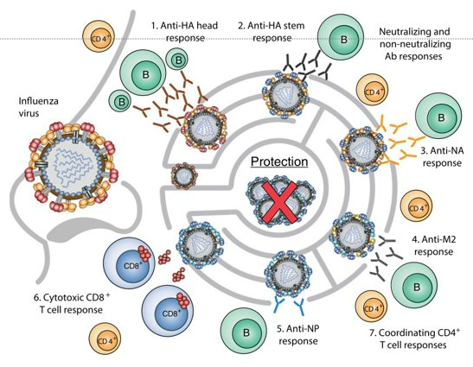
Universal Influenza Vaccine Challenges
Source: Estrada LD, Schultz-Cherry S. Development of a Universal Influenza Vaccine. J Immunol. 2019 Jan 15;202(2):392-398
Notes:
Target of T-cell responses as in LAIV which limit viral spread targeting upper respiratory tract memory CD8+ T cell response which can prevent dissemination to LRT
Paules CI, Marston HD, Eisinger RW, Baltimore D, Fauci AS. The Pathway to a Universal Influenza Vaccine. Immunity. 2017 Oct 17;47(4):599-603. doi: 10.1016/j.immuni.2017.09.007. PMID: 29045889.

Slide 15
Influenza Vaccine Rates Across the Country & in Nevada

Slide 16
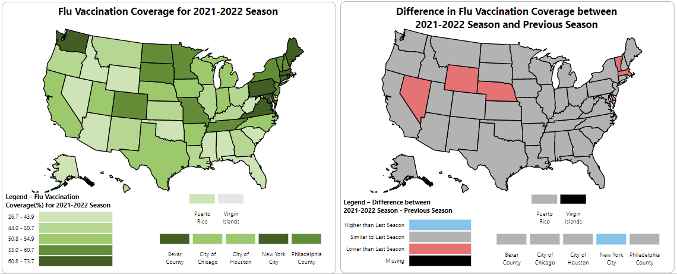
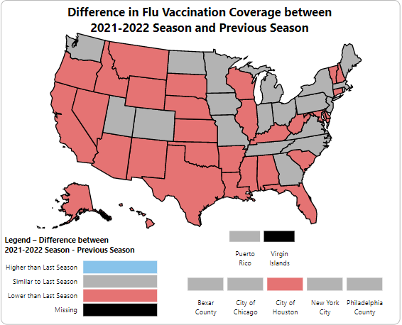
Influenza Vaccination Coverage in the United States
2021-2022 minus 2020-2021
2021-2022 minus 2019-2020
Source: https://www.cdc.gov/flu/fluvaxview/dashboard/vaccination-coverage-race.html

Slide 17
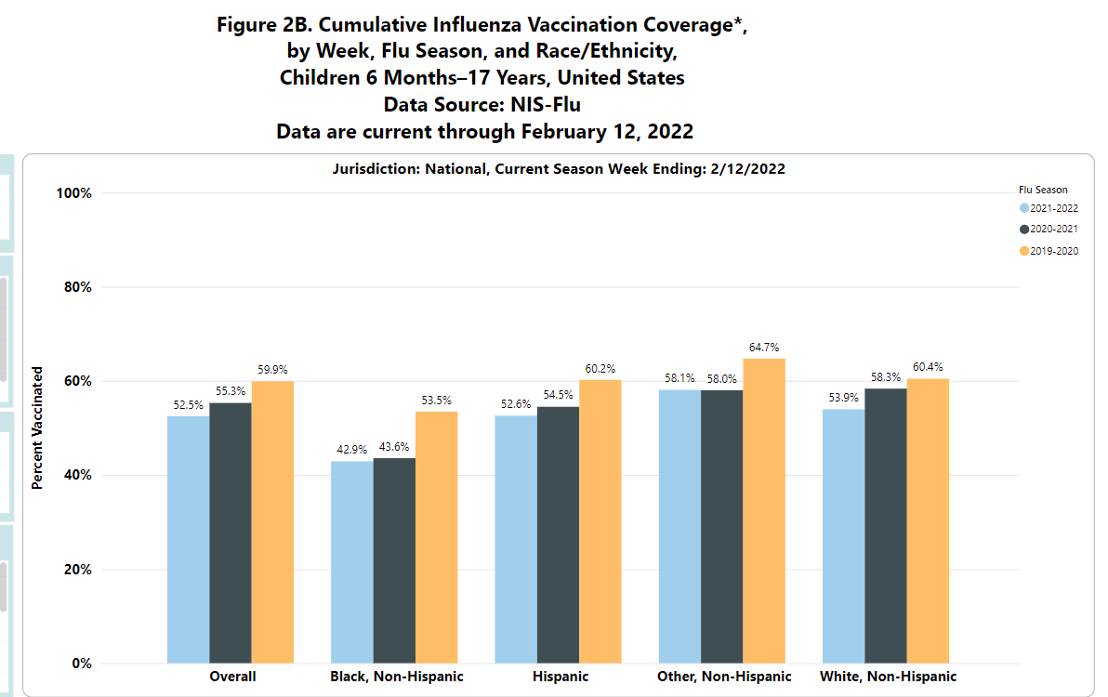
Source: https://www.cdc.gov/flu/fluvaxview/dashboard/vaccination-coverage-race.html

Slide 18
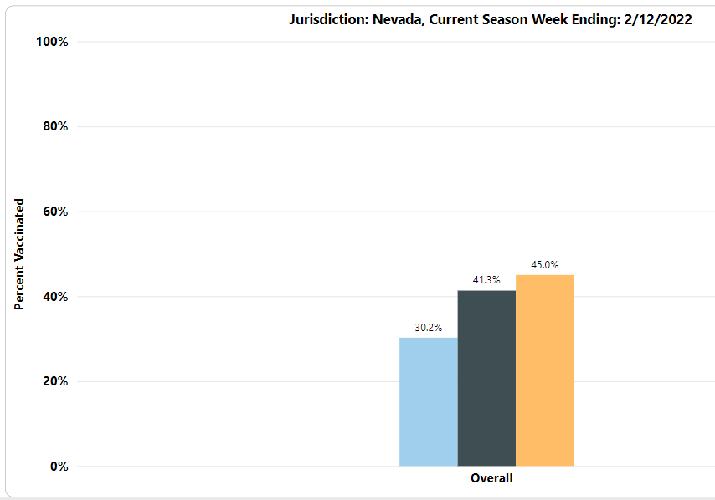
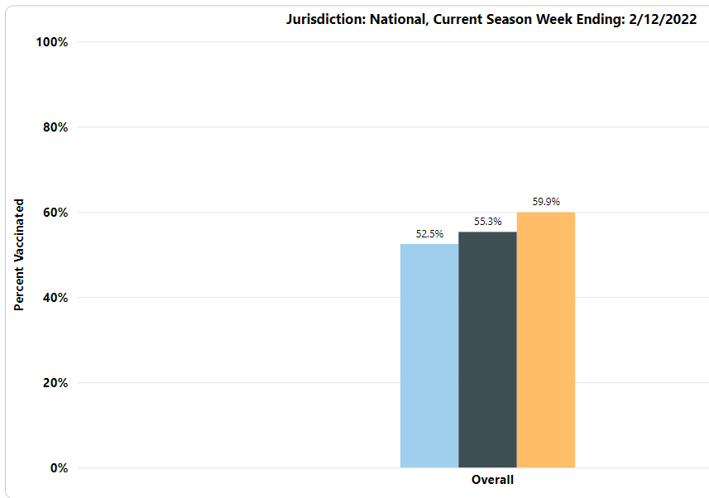
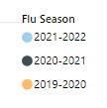
Source: https://www.cdc.gov/flu/fluvaxview/dashboard/vaccination-coverage-race.html

Slide 19
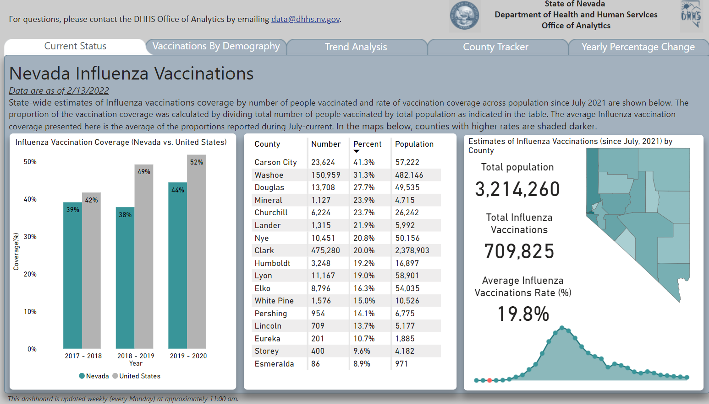
Nevada Influenza Vaccinations
Source: https://dpbh.nv.gov/Programs/Flu/Influenza/
Notes:
matches the highest recorded number for pediatric flu deaths reported during a regular flu season, which occurred during the 2017-2018 flu season.
Of 175 deaths with known info on medical conditions, 76 (43.4%) had a pre-existing medical condition
In 2017-2018: 188 deaths - approximately ½ of deaths were in otherwise healthy children. Among pediatric deaths of children 6 months and older who were eligible for vaccination and for whom vaccination status was known, approximately 80% had not received influenza vaccine during that season.

Slide 20
Influenza Vaccinations in Nevada by Gender and Age
Source: https://dpbh.nv.gov/Programs/Flu/Influenza/

Slide 21
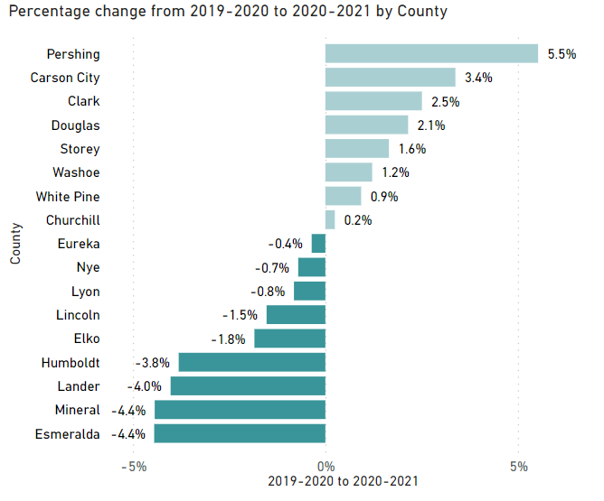
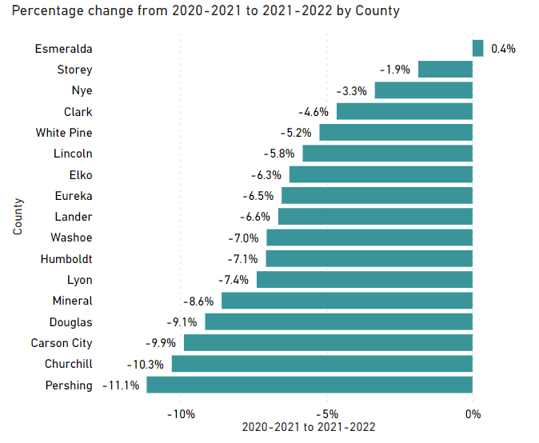
Yearly Percentage Change in Vaccination Rates by County
Source: https://dpbh.nv.gov/Programs/Flu/Influenza/

Slide 22
Barriers to Influenza Vaccine Uptake

Slide 23
Factors Affecting Likelihood of Influenza Vaccination
Education
Parent level of education
Access to information/misinformation
Racial/Ethnic inequities
Access
Insurance (private vs public)
Income
Transportation
Availability of vaccine (times, locations)
Vaccine Hesitancy
Source: Edwards KM, Hackell JM. Pediatrics. 2016;138(3):e20162146

Slide 24
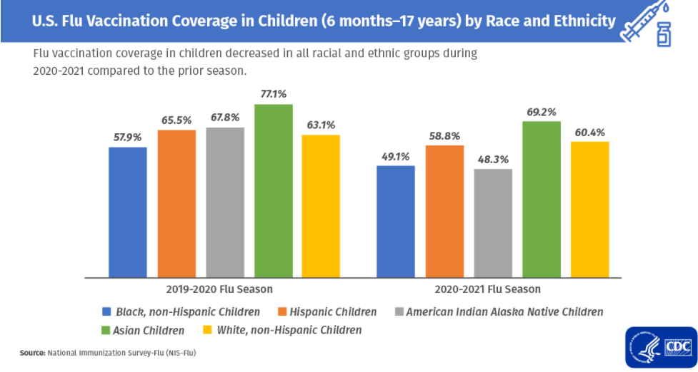
Trends in Influenza Vaccination Status Based on Race/Ethnicity
Source: https://www.cdc.gov/flu/highrisk/disparities-racial-ethnic-minority-groups.html

Slide 25
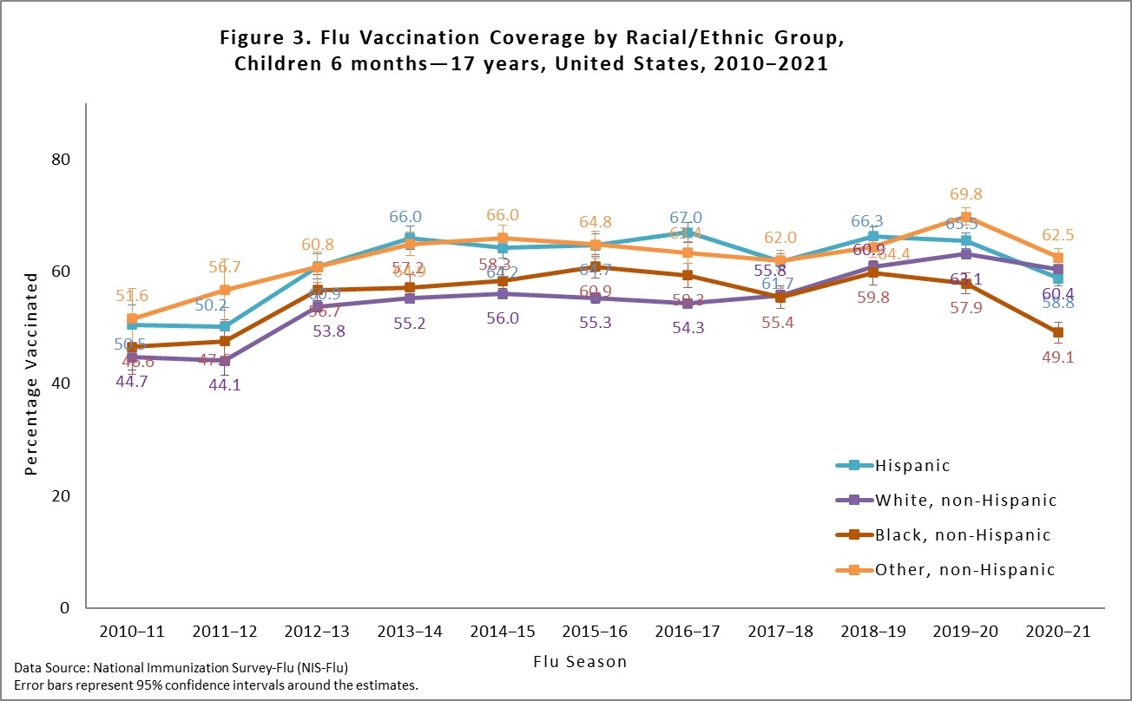
Differences in Race/Ethnicity for Influenza Vaccination Rates
Source: https://www.cdc.gov/flu/fluvaxview/coverage-2021estimates.htm
Notes:
Flu vaccination coverage in children decreased in all racial and ethnic groups during 2020–2021 compared with the prior season, and disparities in vaccination coverage increased among certain racial and ethnic minority groups.
The difference in vaccination coverage between White children and Black children increased from 5.2 percentage points during the 2019–2020 season to 11.3 percentage points during the 2020–2021 season.
And during the 2019–2020 season, Hispanic children had higher coverage than White children by 2.4 percentage points, but during the 2020–2021 season, this reversed, with Hispanic children having lower coverage by 1.6 percentage points.

Slide 26
Disparities in Influenza Disease Outcomes
Hospitalization, ICU, and in-hospital mortality rates 1.3–4.4 times higher among racial and ethnic minorities aged 0–4 years compared with non-Hispanic White children
Rates of severe flu compared to white children
3.0–3.5 times higher in non-Hispanic American Indian or Alaska Native children
2.2–3.4 times higher in non-Hispanic Black children
1.9 - 3.0 times higher in Hispanic or Latino children
1.3 - 4.4 times higher in non-Hispanic Asian or Pacific Islander children
Source: https://www.cdc.gov/flu/highrisk/disparities-racial-ethnic-minority-groups.html

Slide 27
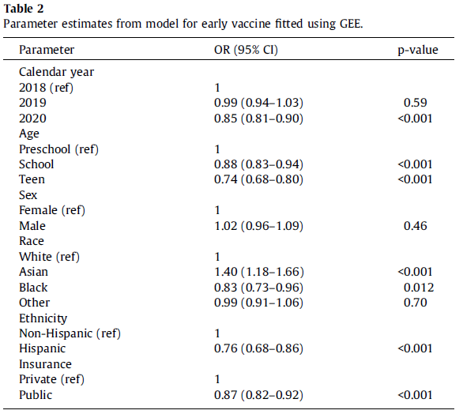
Early Influenza Vaccination Rates During Pandemic
Source: Fogel B, Schaefer EW, Hicks SD. Vaccine. 2021 Jul 13;39(31):4291-4295.
Notes:
Odds ratios from the adjusted model are presented in Table 2,
and demonstrate lower odds of early influenza vaccination in
2020, as in the unadjusted model. Lower odds of early influenza
vaccination were seen in Hispanic children, children with public
insurance, and teens and school aged children (relative to
preschoolers), regardless of the calendar year. Compared with vaccination, and Black children had lower odds of early influenza
vaccination.
We evaluated potential interactions between calendar year and
all demographic variables that demonstrated a significant effect in
the adjusted model. The only significant interaction effect was
between calendar year and insurance (p < 0.001). From 2018 to
2020, patients with private insurance had 51% increased odds of
early vaccination (OR = 1.51, 95% CI: 1.38–1.65). Fig. 1 shows the
interaction across all years using estimated probabilities calculated
from the model.
white children, Asian children had higher odds of early influenza

Slide 28
Definition
Vaccine Hesitancy
A behavior influenced by a number of factors including issues of confidence, complacency, and convenience
Heterogeneous group with varying degrees of indecision about vaccines
Source: Edwards KM, Hackell JM. Pediatrics. 2016;138(3):e20162146

Slide 29
Categorization of Parental Attitudes Towards Vaccines
Parent type | Belief about vaccines | % parents in group
Immunization advocate | Strongly agree vaccines are safe, needed | 33%
Go along to get along | Do not question vaccines, lack knowledge | 26%
Health advocate | Agree vaccines are necessary but are less sure about their safety | 25%
Fence-sitter | Significant concerns, knowledgeable about vaccines, may vaccinate, delay, or refuse | 13%
Refuser | Refuse all vaccines due to distrust, safety concerns, religious beliefs, etc | 3%
Sources: Gust, et al. American Journal of Health Behavior, 2005; https://www.aap.org/en-us/advocacy-and-policy/aap-health-initiatives/immunizations/Pages/vaccine-hesitant-parents.aspx

Slide 30
Influenza Vaccine Hesitancy
WHO designated vaccine hesitancy as 1 of the 10 leading threats to global health
1 in 15 US parents hesitant about routine childhood vaccines
> 1 in 4 US parents hesitant about influenza vaccine
70% strongly agreed routine childhood vaccines effective vs 26% agreed influenza vaccine effective (P<.001)
Source: Kempe A, et al. Pediatrics. 2020;146(1):e20193852

Slide 31
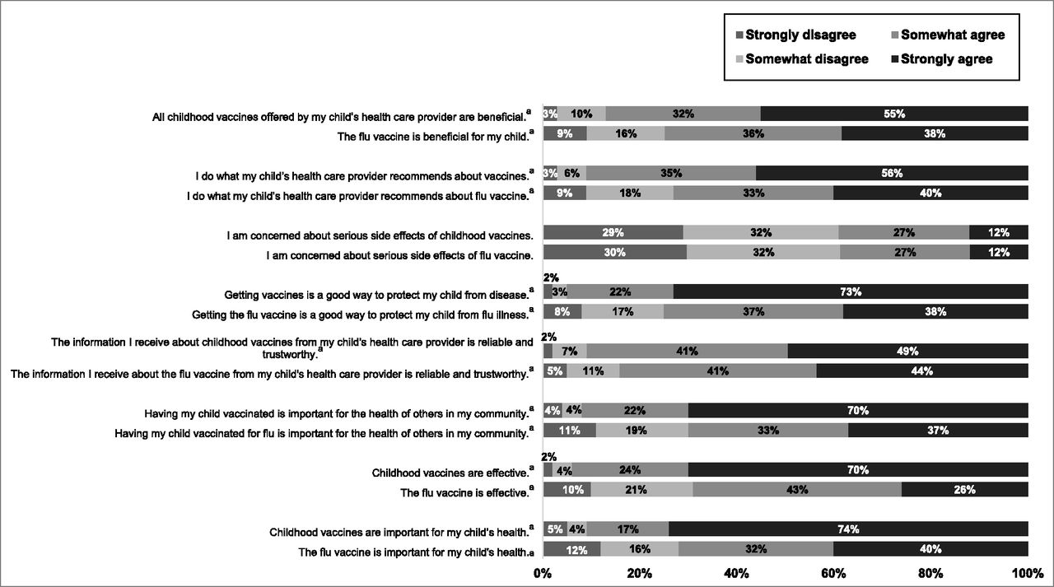
Results of modified VHS for influenza vaccine (8 item) compared with modified VHS for childhood vaccines (8 items). All questions are significant (P < .0001) except for “I am concerned about serious side effects of childhood vaccines” (P = .18)
Source: Allison Kempe et al. Pediatrics 2020;146:e20193852
Notes:
Results of modified VHS for influenza vaccine (8 item) compared with modified VHS for childhood vaccines (8 items). ª All questions are significant (P < .0001) except for “I am concerned about serious side effects of childhood vaccines” (P = .18).

Slide 32
The 3 C’s of Vaccine Hesitancy
Complacency
Do not perceive a need for a vaccine and/or do not value the vaccine
Convenience
Access to vaccines and affordability
Confidence
Trust in safety and effectiveness, the delivery system, including reliability and competence of health services and health professionals and the motivations of policymakers who decide on the needed vaccines
Source: Quinn SC, et al. Vaccine. 2019 Feb 21;37(9):1168-1173.

Slide 33
Reasons Parents May Give for Not Getting the Flu Shot
I just never get around to it
The flu shot is unsafe (ie. thimerosal, GBS)
My kids never get influenza
Flu shot made me or child sick
Flu shot doesn’t work – child still got flu
Influenza is not that bad
Fear of exposure to COVID-19 at doctor’s office
Source: Pellman H. PIDJ 2006 Nov;25(11):1086-7
Notes:
Just did not get around to it” (41 responses). Other common reasons included: “My child does not get the flu” (24); “I or someone I know got the flu from the vaccine in the past” (17); “The flu is not a serious illness”(15); “Safety concerns regarding flu vaccines” (14); and “Not routinely recommended for my child's age or medical condition.” (11) “Cost” (5) and “The vaccine is not very effective” (3) were infrequent responses.

Slide 34
Ways to Address Influenza Vaccine Hesitancy
Standard approach to addressing vaccines
Present flu shot as part of normal well visit
“Would you like the flu vaccine today?”
“Today your child is due for the flu vaccine.”
Personalize the message
Give an example of a child who had serious influenza complications or who died from flu

Slide 35
Announce Inquire Mirror Secure (AIMS)
Announce: Announce vaccination will happen, assume they are ready to be vaccinated
Inquire: Use open-ended questions to understand concerns
Mirror: Reflect back what you have understood to make the person feel heard
Secure: Consolidate each conversation by securing trust
Attell K, et al. Vaccines, 2019:37
Notes:
AIMS thus combines a presumptive approach with tested and teachable methods to foster receptivity and trust in conversations, Irrespective of the approach used, it is important to put human relationships at the heart of vaccine acceptance conversations to help HCPs foster trust in vaccination.

Slide 36
Acknowledge Steer Know (ASK)
Acknowledge concerns
Ask about concerns and get clarification
Steer the conversation
Refute myths and correct misunderstandings
Know your facts
Be confident and prepared
Source: Marshall G. The Vaccine Handbook: A Practical Guide for Clinicians, 9E, 2020

Slide 37
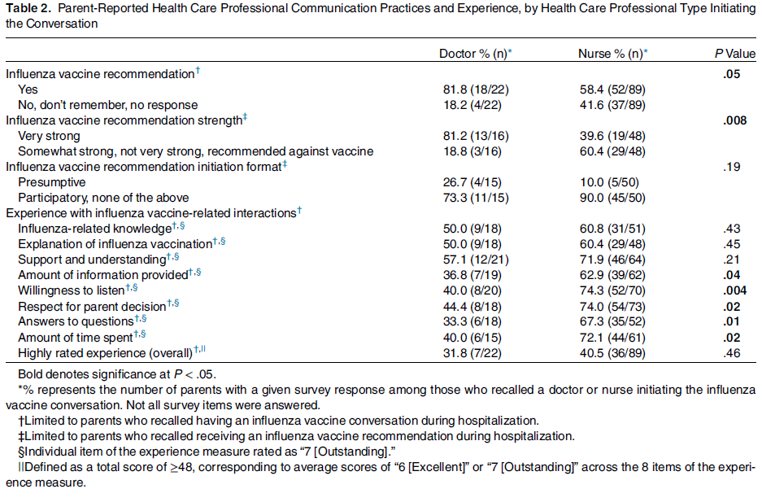
Communication from Health Care Professionals Matter
Source: Hofstetter AM, Opel DJ, Stockwell MS, Hsu C, Zhou C, Mangione-Smith RM, Englund JA. Acad Pediatr. 2021 Sep-Oct;21(7):1142-1150.
Notes:
Among all respondents, 75.3% recalled discussing
influenza vaccination with a HCP during their child’s hospitalization.
This conversation was most commonly initiated
by a nurse (74.8%) rather than by a doctor (18.5%),
parent (5.9%), or other (“therapist”) (0.8%). During these
conversations, parents reported discussing hospital influenza
vaccination screening items (ie, child’s influenza
vaccination status, parental interest in vaccinating their
child) (21.9%), influenza vaccine safety concerns
(19.9%), their child’s risk of influenza infection (17.8%),
seriousness of influenza infection (11.0%), influenza vaccine
effectiveness (15.1%), and other related topics
(8.9%).
Among parents who recalled a vaccine conversation,
61.0% reported receiving an influenza vaccine recommendation
from the inpatient HCP. Of these parents, 53.8%
reported that the HCP recommended the vaccine “very
strongly” and 11.1% noted that the HCP used a presumptive
approach to initiate the vaccine recommendation.
Fewer parents reported receiving a very strong recommendation
if the conversation was initiated by a nurse
rather than by a doctor (Table 2).

Slide 38
Impacts of COVID-19 on Seasonal Influenza and Influenza Vaccination

Slide 39
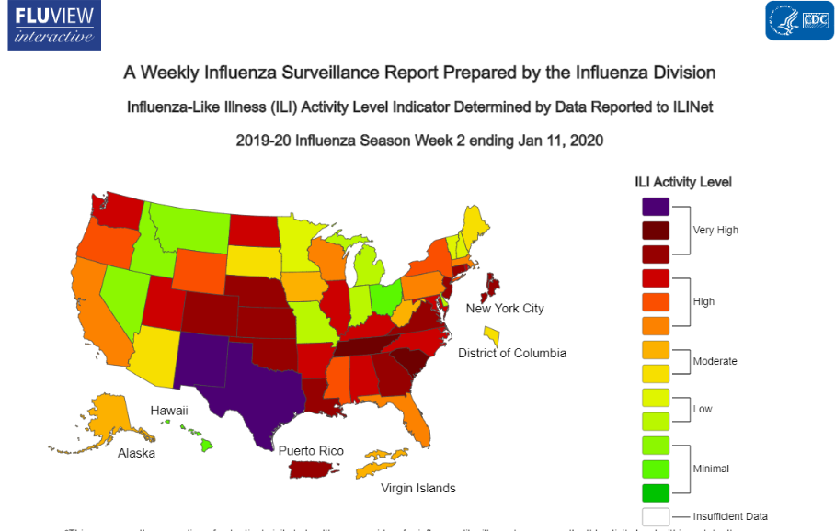
Source: https://www.cdc.gov/flu/weekly/fluviewinteractive.htm

Slide 40
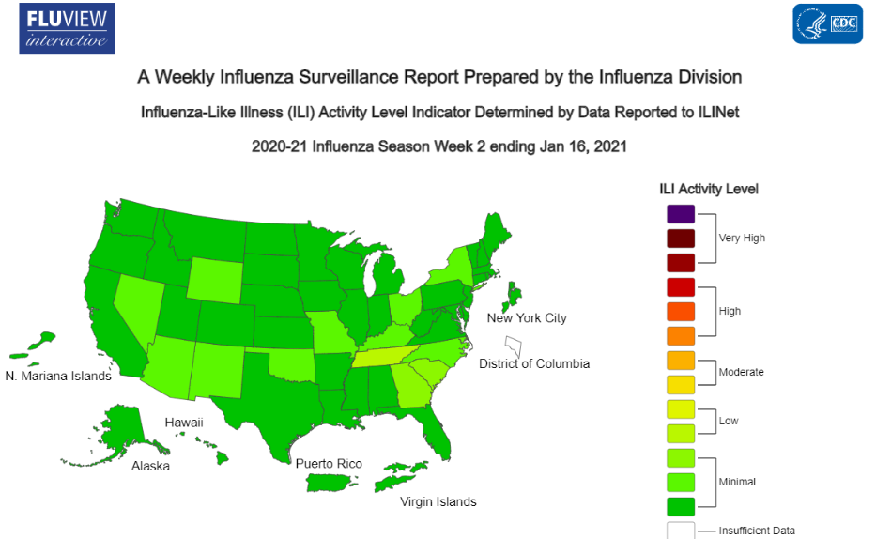
Source: https://www.cdc.gov/flu/weekly/fluviewinteractive.htm

Slide 41
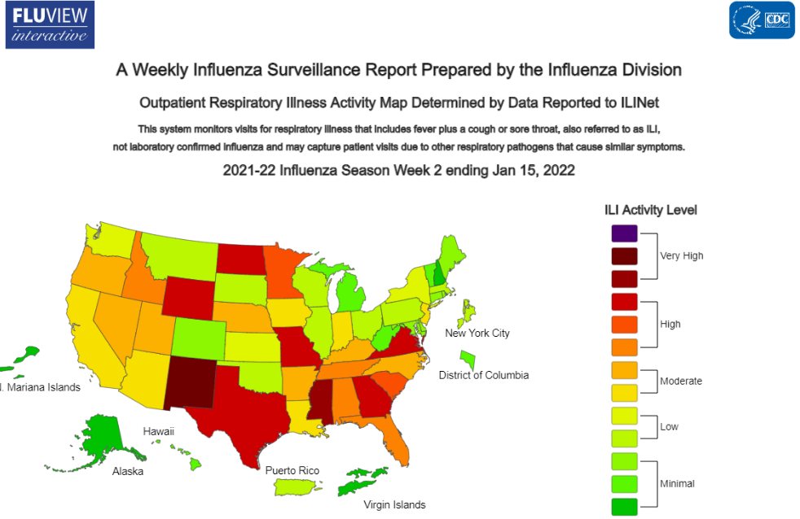
Source: https://www.cdc.gov/flu/weekly/index.htm#ILIActivityMap

Slide 42
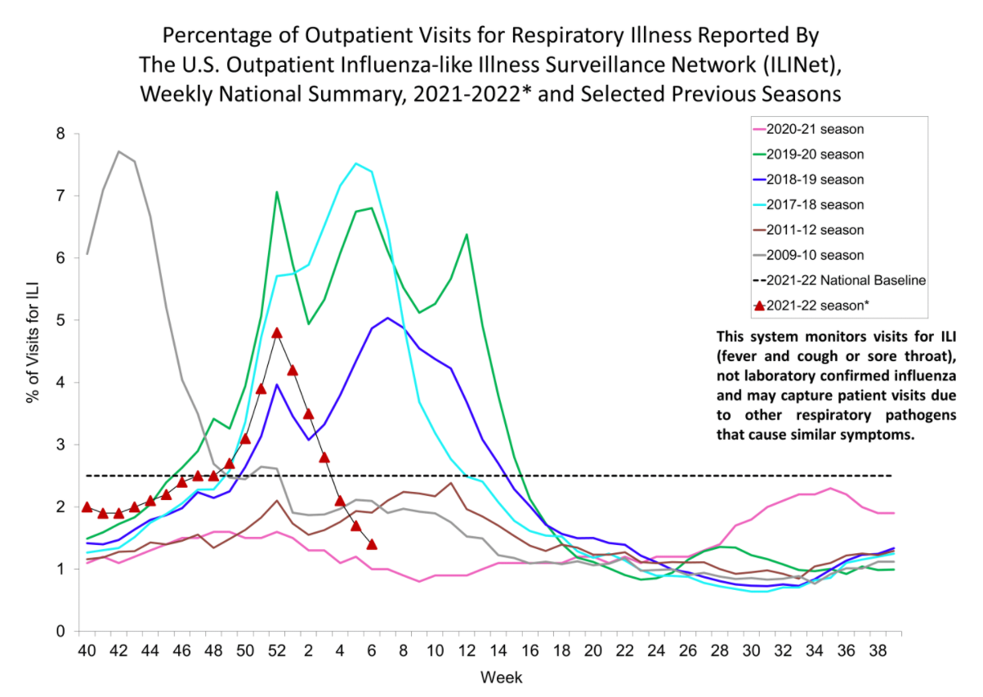
Source: https://www.cdc.gov/flu/weekly/fluviewinteractive.htm

Slide 43
Source: MMWR / September 18, 2020 / Vol. 69 / No. 37

Slide 44
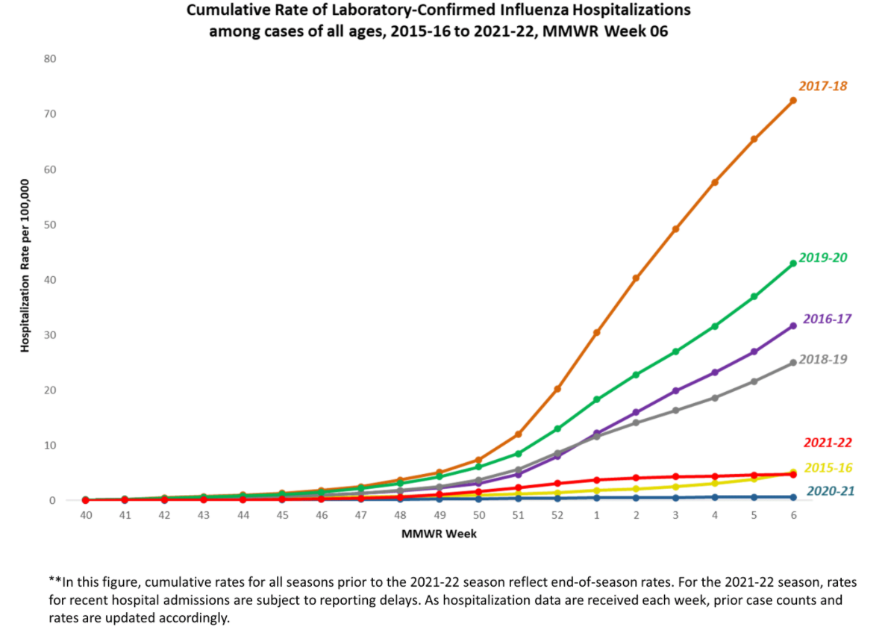
Source: https://www.cdc.gov/flu/weekly/weeklyarchives2021-2022/EIPRates06.html

Slide 45
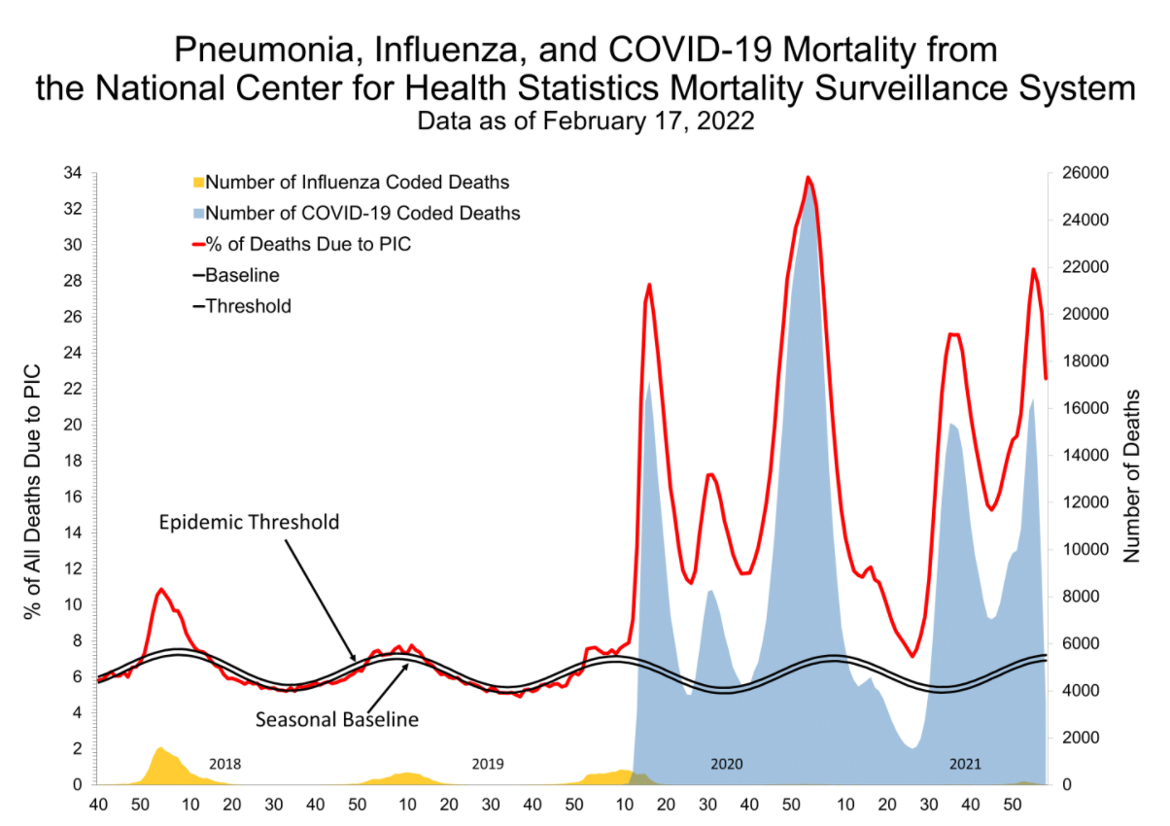
Source: https://www.cdc.gov/flu/weekly/index.htm

Slide 46
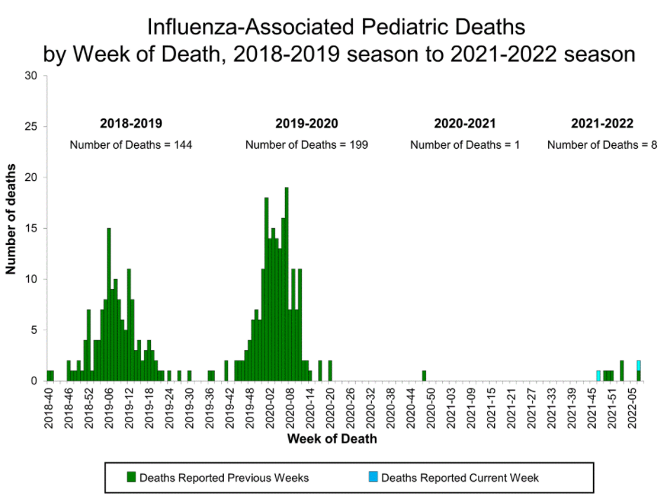
Source: https://www.cdc.gov/flu/weekly/index.htm

Slide 47
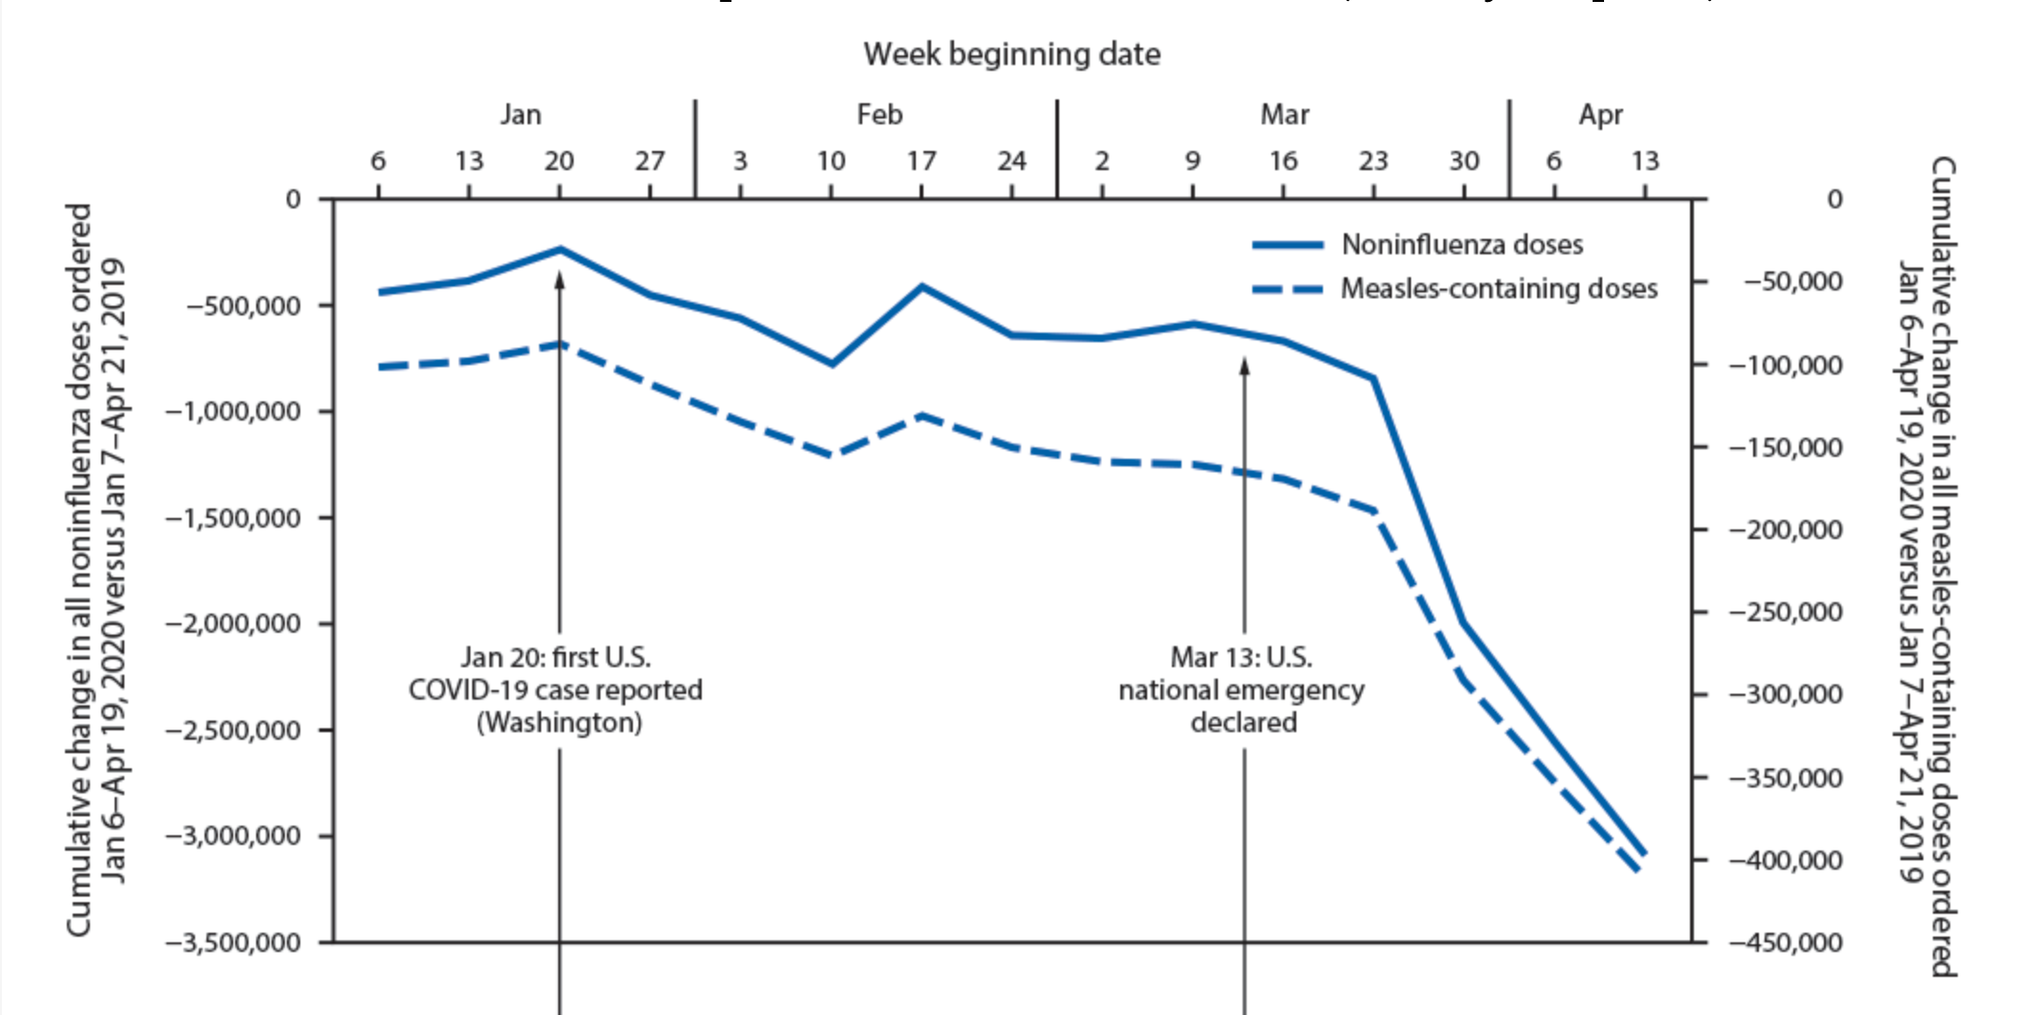
Decreased Immunization Rates with COVID-19 Onset
Weekly changes in Vaccines for Children Program provider orders and Vaccine Safety Datalink (VSD) doses administered† for routine pediatric vaccines — U.S., Jan 6 – Apr 19, 2020
Source: Szablewski CM et al. MMWR 2020;69:591–593
Notes:
Community mitigation measures such as shelter-in-place orders resulted in declines in outpatient pediatric visits and fewer vaccine doses administered during the early COVID-19 pandemic,³⁰ leaving children at risk for vaccine-preventable diseases.

Slide 48
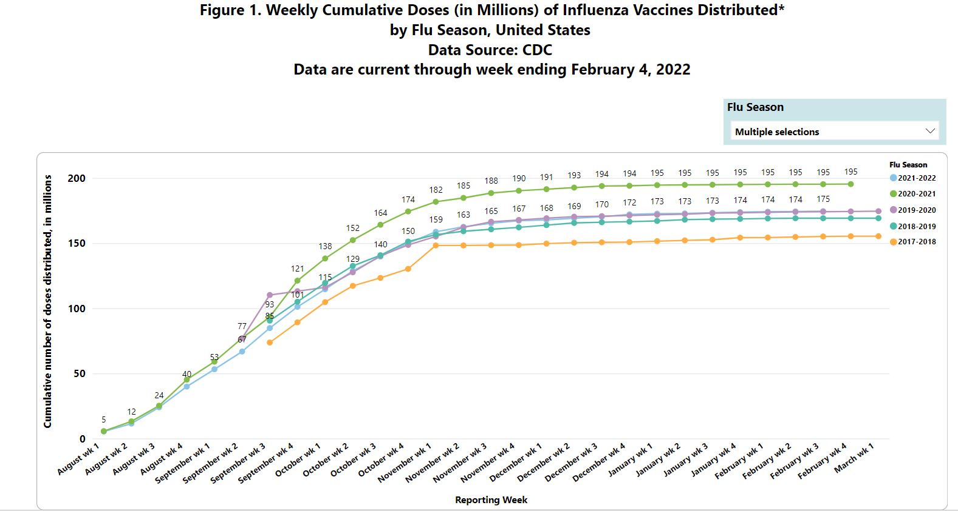
Source: https://www.cdc.gov/flu/fluvaxview/dashboard/vaccination-doses-distributed.html

Slide 49
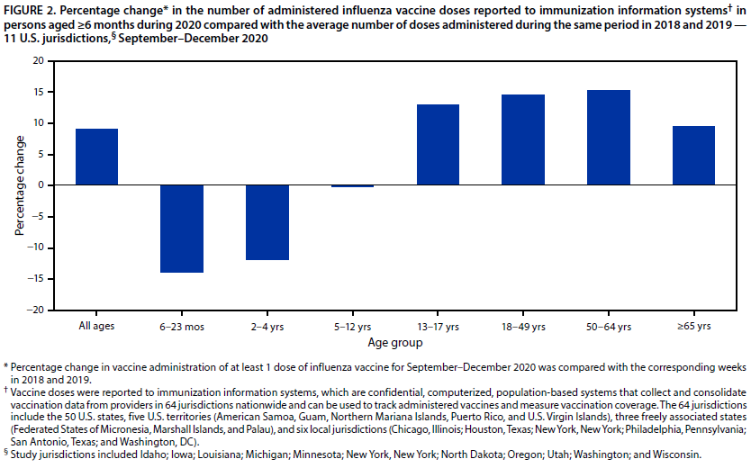
% Change in Administered Flu Vaccines from 2018/2019 to 2020
Source: MMWR 2021 Nov 12;70(45):1575-1578.

Slide 50
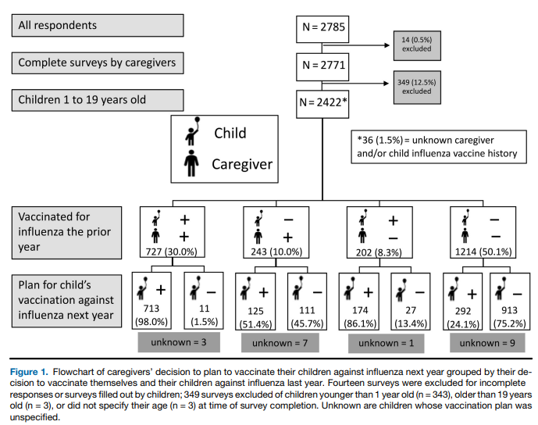
Decision to Vaccinate Against Flu During Pandemic
Source: Goldman RD, et al; International COVID-19 Parental Attitude Study (COVIPAS) Group. Pediatr. 2021 Jan;228:87-93.e2.
Notes:
This study is part of a larger COVID-19 Parental Attitude Study (COVIPAS) study, surveying caregivers of children presenting for emergency care, in the era of COVID-19. Caregivers who arrived to 17 pediatric emergency departments (EDs) in the US (Seattle, Tacoma, Los Angeles, Dallas, Atlanta), Canada (Vancouver, Toronto, Saskatoon, Edmonton, Calgary), Israel (Shamir), Japan (Tokyo), Spain (Barcelona), and Switzerland (Zurich, Bern, Geneva, Bellinzona) were asked to participate, using posters in waiting areas and patient rooms.
Flowchart of caregivers’ decision to plan to vaccinate their children against influenza next year grouped by their decision to vaccinate themselves and their children against influenza last year. Fourteen surveys were excluded for incomplete responses or surveys filled out by children; 349 surveys excluded of children younger than 1 year old (n = 343), older than 19 years old (n = 3), or did not specify their age (n = 3) at time of survey completion. Unknown are children whose vaccination plan was unspecified.
A total of 1314 (54.3%) respondents stated they intend to vaccinate their children against influenza in the coming 12 months, an increase of 15.9% compared with those that reported an influenza vaccine for their child in the past 12 months (Figure 1).

Slide 51
Comparing Caregivers Who Plan to Vaccinate vs Do Not Plan to Vaccinate Against Influenza
Those who planned to vaccinate statistically significantly were more likely to
Have child with chronic illness or on chronic meds
Have had higher education
Have child with vaccines up to date
Had caregiver and child that had received influenza vaccine in previous 12 months
Be less concerned about missing work or their child missing school
Source: Goldman RD, et al; International COVID-19 Parental Attitude Study (COVIPAS) Group. Pediatr. 2021 Jan;228:87-93.e2.
Notes:
year (Table I). Table I provides demographic information including a comparison between caregivers who plan to vaccinate for influenza in the coming season and those who do not. The greatest likelihood of planning to vaccinate the child next year was if the caregiver planned to vaccinate themselves in the upcoming year (1213/2422; 50.1% of children). Caregivers were more likely to suggest they will immunize next year if they had education beyond high school, if the child had a chronic illness or took medications regularly, if the child was up-to-date on their vaccines other than influenza according to their country-specific vaccination schedule, or if the child or caregiver received influenza vaccine the previous year.

Slide 52
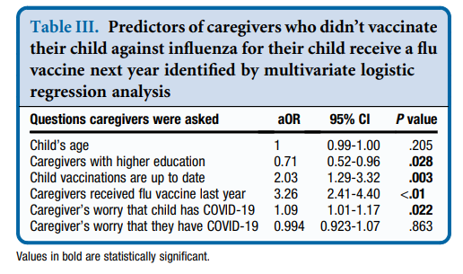
Goldman RD, et al; International COVID-19 Parental Attitude Study (COVIPAS) Group. Pediatr. 2021 Jan;228:87-93.e2. doi: 10.1016/j.jpeds.2020.08.005. Epub 2020 Aug 7
Notes:
the following factors predicted a willingness to change from not vaccinating the previous year to vaccinating their child next year: children were up-to-date with non-influenza vaccinations (aOR 2.03, 95% CI 1.29-3.32, P = .003); caregivers received influenza vaccine last year (aOR 3.26, 95% CI 2.41-4.40, P < .010); and caregivers were worried their child had COVID-19 in the ED (aOR 1.09, 95% CI 1.01-1.17, P = .022). Unlike the bivariate analysis, caregivers with higher than high-school education were less likely to change from non-vaccination in the previous year to vaccination in the coming year (aOR 0.71, 95% CI 0.52- 0.96, P = .028).

Slide 53
Strategies to Promote Influenza Vaccination Rates

Slide 54
Background
Children have highest attack rates of influenza
Children play major role in transmission to household and other close contacts
Children <5 years old, especially those < 2 years old, and those with underlying medical conditions at increased risk of hospitalization and complications
Source: Infectious Diseases Com. Recommendations for Prevention and Control of Influenza in Children, 2020–2021. Pediatrics. 2020;146(4):e2020024588
Notes:
School- aged children bear a large influenza disease burden and are more likely to seek flu-related medical care compared to healthy adults. Decreasing transmission among kids decreased burden of childhood flu and transmission to others of all ages.

Slide 55
Why Should Your Patient Get an Influenza Vaccine?
They are a safe way to help prevent severe influenza illness, complications
To prevent influenza-related deaths in children
To protect (cocoon) vulnerable people around you from getting flu
To help keep kids from missing school and parents from missing work
To decrease the burden on the healthcare system

Slide 56
Influenza Vaccine Efficacy
Based on prevention of laboratory confirmed medically attended cases of influenza
Underestimates impact
Missed school and work
Doctor’s visits, hospitalizations, ICU admissions
Transmission to others

Slide 57
Flu Vaccine Prevents Pediatric Deaths
Of 291 deaths w/known vaccine status, only 26% got vaccine before illness onset
Of deaths in children with high-risk medical conditions, only 31% got vaccine before illness onset
Vaccine effectiveness against death was 65%
Vaccine effectiveness in high-risk conditions was 51%
Source: Flannery B, Reynolds SB, Blanton L, et al. Influenza Vaccine Effectiveness Against Pediatric Deaths: 2010-2014. Pediatrics. 2017;139(5):e20164244.
Notes:
July 2010 – June 2014, 358 lab-confirmed flu-associated pediatric deaths (6 mo – 17 yo)
Of 291 deaths w/known vaccine status, only 26% got vaccine before illness onset
VE against death was 65% (95% CI, 54%-74%)
VE in high-risk conditions was 51% (95% CI, 31%-67%)
Of deaths in children with high-risk medical conditions, only 31% vaccinated
VE in kids w/o high-risk was 65% (95% CI, 47%-78%)
By season, VE ranged from 54% in the 2010 to 2011 season to 80% (with overlapping credible intervals) in the mild 2011 to 2012 season, with the lowest number of pediatric deaths. By virus type, VE point estimates were similar against death associated with influenza A virus (66%) and influenza B virus (62%

Slide 58
Cocooning
Immunizing people in close contact to those patients who are susceptible to an illness but cannot be vaccinated due age ineligibility or due to permanent or temporary medical contraindications

Slide 59
Protecting Infants Through Maternal Flu Vaccination
Infants can have a risk reduction of up to 72% (95% CI, 39% to 87%) for laboratory confirmed influenza hospitalization in the first few months of life
Pregnant women immunized against flu provide their babies protection against influenza
Breastfeeding also protects babies, boosting the immune response
Source: Infectious Diseases Com. Recommendations for Prevention and Control of Influenza in Children, 2020–2021. Pediatrics. 2020;146(4):e2020024588
Notes:
Infants born to women who receive influenza vaccination during pregnancy can have a risk reduction of up to 72% (95% CI, 39% to 87%) for laboratory confirmed influenza hospitalization in the first few months of life
Pregnant women immunized against flu at any time during pregnancy provide their babies protection for the first 6 months of life from transplacental antibody transfer
Breastfeeding also protects babies against influenza viruses by activating innate antiviral mechanisms, specifically type 1 interferons. Human milk from mothers vaccinated during the third trimester also contains higher levels of influenza-specific immunoglobulin A (IgA).67 Greater exclusivity of breastfeeding in the first 6 months of life decreases the episodes of respiratory illness with fever in infants of vaccinated mothers

Slide 60
Reasons Parents May Give for Not Getting the Flu Shot
I just never get around to it
The flu shot is unsafe (ie. thimerosal, GBS)
My kids never get influenza
Flu shot made me or child sick
Flu shot doesn’t work – child still got flu
Influenza is not that bad
Fear of exposure to COVID-19 at doctor’s office
Source: Pellman H. PIDJ 2006 Nov;25(11):1086-7
Notes:
Just did not get around to it” (41 responses). Other common reasons included: “My child does not get the flu” (24); “I or someone I know got the flu from the vaccine in the past” (17); “The flu is not a serious illness”(15); “Safety concerns regarding flu vaccines” (14); and “Not routinely recommended for my child's age or medical condition.” (11) “Cost” (5) and “The vaccine is not very effective” (3) were infrequent responses.

Slide 61
Addressing Those Who "Just never got around to it"
Vaccination services should be readily available (#1 Standard for NVAC)
Create vaccine-only appointments
Dedicate certain office hours to vaccination
Vaccinate siblings present at well-child visit
Ensure proper storage and handling practices
If shortage, refer to public health service or other practice
Notes:
National vaccine advisory committee – endorsed by AAP
Create Vaccination-only Appointments or Dedicate Certain Office Hours to Vaccination • When parents receive a reminder that their child is due for vaccinations, they may be assured of timely available appointments. A parent may be reminded of these available appointments and encouraged not to wait until her child is sick to make another appointment that includes vaccination. • Hold flexible office hours at non-traditional times, such as weekends, evenings, early mornings, or lunch hours in keeping with the schedules of working parents or those who are at home full- or part-time. • Ensure immunizations are available at all visits, sick or well, regular hours, or weekend clinics. • Increase access during periods of peak demand. In the case of back to school time, flu season, or other cases where demand may be higher than usual, increase the number of vaccination-only appointments.
Provide a Vaccine-only Clinic • Another option for increasing access during periods of peak demands is to offer a vaccine clinic. The clinic could be once a week with office staff during normal office hours that are simply dedicated to administering one kind of vaccine. Develop vaccine standing orders so that nursing staff can give the vaccine without the pediatrician seeing the patient. • Consider hiring temporary staff to handle the clinic a few days a week so that regular office staff can continue with the regular operations of the practice. • A third option is to hold clinics after regular hours or on the weekends, using permanent or temporary office staff as the practice sees fit. • Consider integrating immunization services into days and hours when other child health services, such as the Special Supplemental Food Program for Women, Infants, and Children are offered.

Slide 62
Reasons Parents May Give for Not Getting the Flu Shot
I just never get around to it
The flu shot is unsafe (ie. thimerosal, GBS)
My kids never get influenza
Flu shot made me or child sick
Flu shot doesn’t work – child still got flu
Influenza is not that bad
Fear of exposure to COVID-19 at doctor’s office
Source: Pellman H. PIDJ 2006 Nov;25(11):1086-7
Notes:
Just did not get around to it” (41 responses). Other common reasons included: “My child does not get the flu” (24); “I or someone I know got the flu from the vaccine in the past” (17); “The flu is not a serious illness”(15); “Safety concerns regarding flu vaccines” (14); and “Not routinely recommended for my child's age or medical condition.” (11) “Cost” (5) and “The vaccine is not very effective” (3) were infrequent responses.

Slide 63
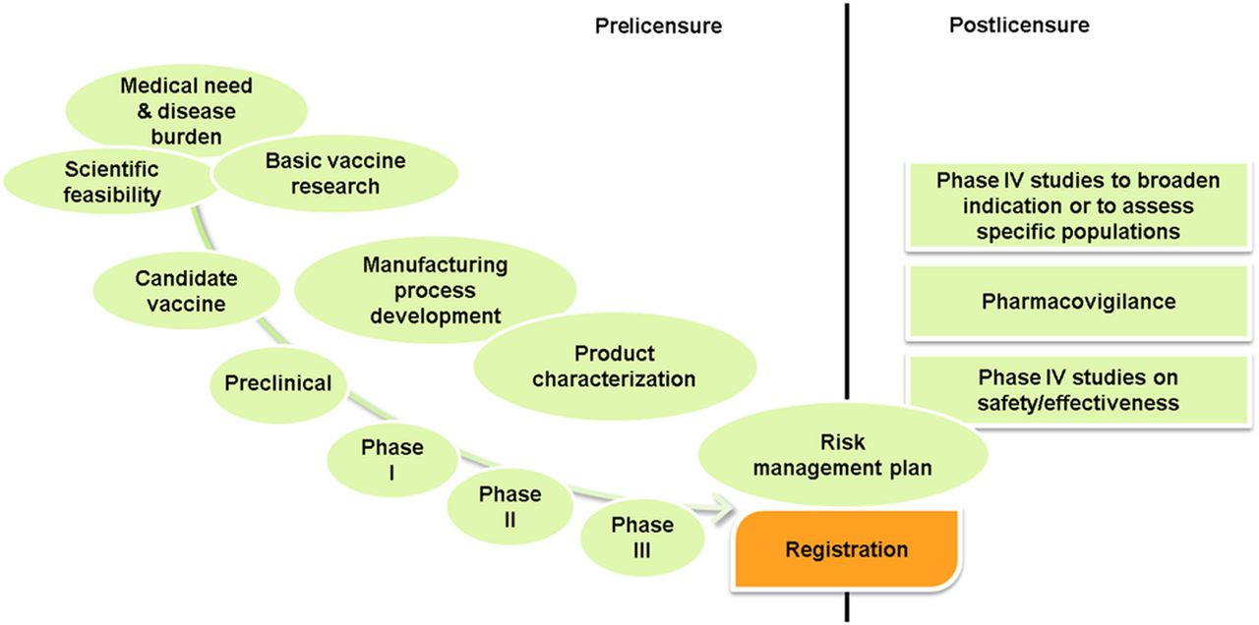
Influenza Vaccine Safety
Flu vaccines are thoroughly tested
Safety actively monitored after licensure
Over 150 million doses safely given each year
Source: Edwards KM, Hackell JM. Pediatrics. 2016;138(3):e20162146

Slide 64
Concern for Safety of Flu Vaccine
Concern for Guillain Barré Syndrome (GBS)
Variable data ranges season to season on association of flu vaccine and GBS
1-2 additional GBS cases per million flu vaccine doses administered
More likely a person will get GBS after getting the flu than after vaccination
Concern for Thimerosal
Single-dose vials used in infant influenza vaccination contain no thimerosal

Slide 65
Reasons Parents May Give for Not Getting the Flu Shot
I just never get around to it
The flu shot is unsafe (ie. thimerosal, GBS)
My kids never get influenza
Flu shot made me or child sick
Flu shot doesn’t work – child still got flu
Influenza is not that bad
Fear of exposure to COVID-19 at doctor’s office
Source: Pellman H. PIDJ 2006 Nov;25(11):1086-7
Notes:
Just did not get around to it” (41 responses). Other common reasons included: “My child does not get the flu” (24); “I or someone I know got the flu from the vaccine in the past” (17); “The flu is not a serious illness”(15); “Safety concerns regarding flu vaccines” (14); and “Not routinely recommended for my child's age or medical condition.” (11) “Cost” (5) and “The vaccine is not very effective” (3) were infrequent responses.

Slide 66
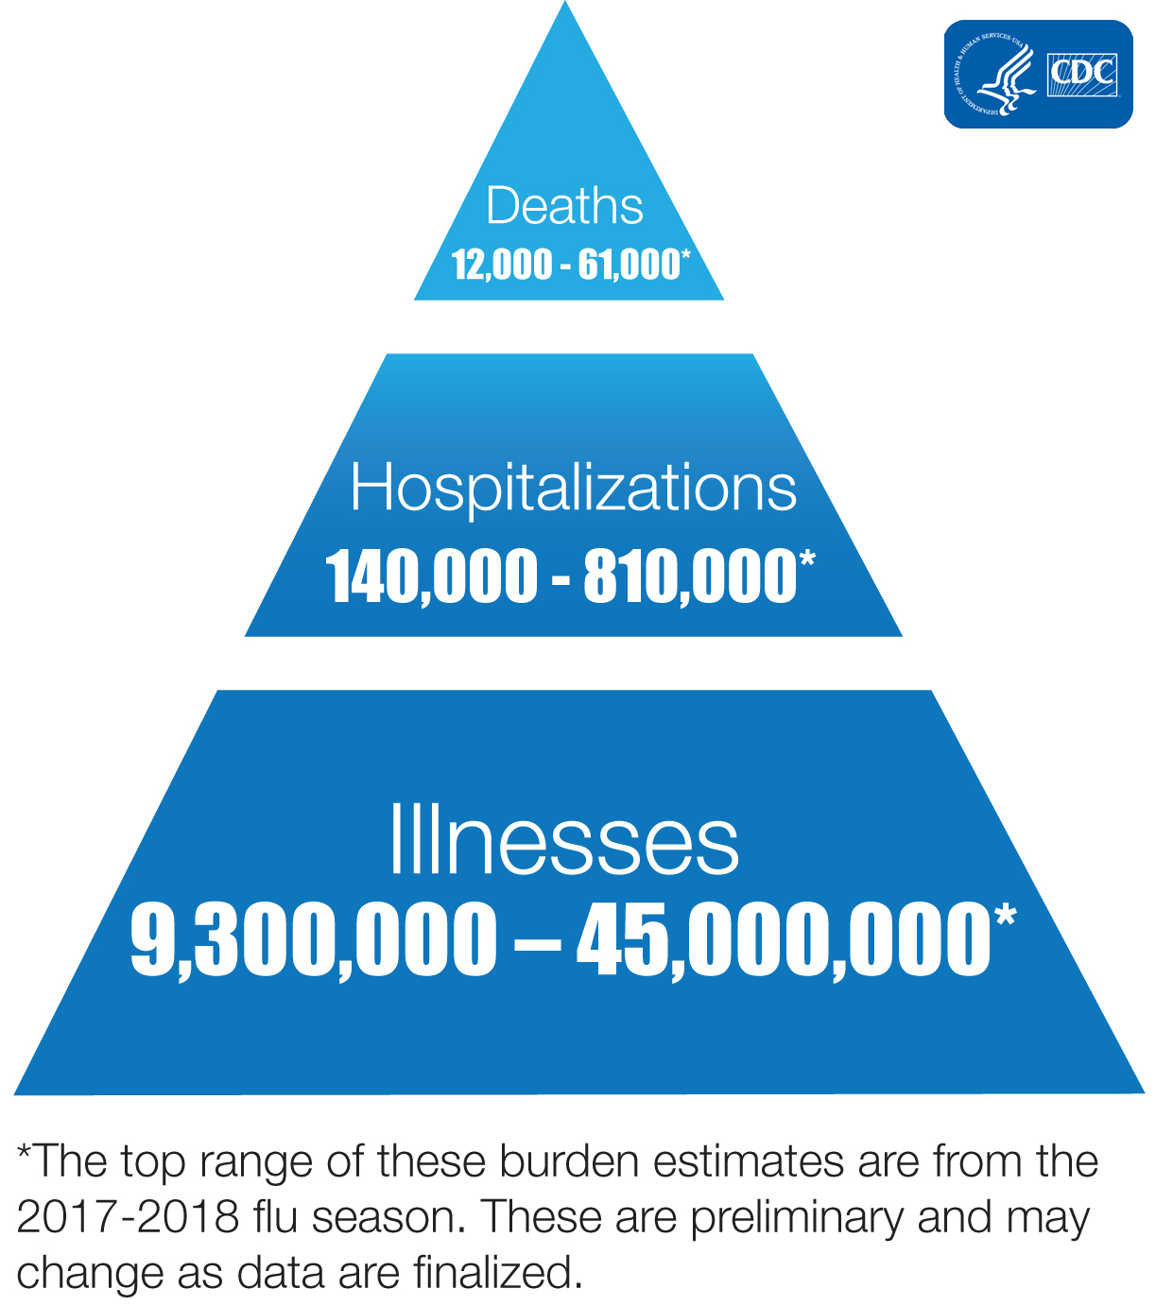
My Child Has Never Had Flu
No way to predict who will get flu in future
Vaccination is #1 most important thing you can do to prevent influenza
Influenza kills up to 79,000 people each year in U.S. and sickens many more
Source: https://www.cdc.gov/flu/about/burden/index.html

Slide 67
Reasons Parents May Give for Not Getting the Flu Shot
I just never get around to it
The flu shot is unsafe (ie. thimerosal, GBS)
My kids never get influenza
Flu shot made me or child sick
Flu shot doesn’t work – child still got flu
Influenza is not that bad
Fear of exposure to COVID-19 at doctor’s office
Source: Pellman H. PIDJ 2006 Nov;25(11):1086-7
Notes:
Just did not get around to it” (41 responses). Other common reasons included: “My child does not get the flu” (24); “I or someone I know got the flu from the vaccine in the past” (17); “The flu is not a serious illness”(15); “Safety concerns regarding flu vaccines” (14); and “Not routinely recommended for my child's age or medical condition.” (11) “Cost” (5) and “The vaccine is not very effective” (3) were infrequent responses.

Slide 68
The Flu Vaccine Made Me Sick
Not all flu-like illnesses are influenza
Injected vaccine does not contain viable virus
LAIV is attenuated so as to not make you sick
Mild side effects are not flu (low-grade fever)
May have been exposed to virus prior to or during 2-week period of developing immunity
Notes:
Consider framing influenza as one of the most severe viruses that children can get – yes, other viruses can cause similar symptoms, but influenza is really the worst of the viruses commonly encountered by children, and it can be prevented.
takes about 2 weeks for the body to build protection after the shot, so some people get sick just before or during that time period and blame the shot
Flu shots given with a needle are made with either killed viruses or with only a single protein from the flu virus. The nasal spray vaccine contains live viruses that are weakened so that they will not cause illness.

Slide 69
Reasons Parents May Give for Not Getting the Flu Shot
I just never get around to it
The flu shot is unsafe (ie. thimerosal, GBS)
My kids never get influenza
Flu shot made me or child sick
Flu shot doesn’t work – child still got flu
Influenza is not that bad
Fear of exposure to COVID-19 at doctor’s office
Source: Pellman H. PIDJ 2006 Nov;25(11):1086-7
Notes:
Just did not get around to it” (41 responses). Other common reasons included: “My child does not get the flu” (24); “I or someone I know got the flu from the vaccine in the past” (17); “The flu is not a serious illness”(15); “Safety concerns regarding flu vaccines” (14); and “Not routinely recommended for my child's age or medical condition.” (11) “Cost” (5) and “The vaccine is not very effective” (3) were infrequent responses.

Slide 70
I Got the Shot, But Still Got Flu
Highly effective in reducing serious illness
Effective in reducing complications from influenza
Prevents influenza related deaths which can occur even if child previously healthy
Not 100% effective at preventing influenza illness

Slide 71
Reasons Parents May Give for Not Getting the Flu Shot
I just never get around to it
The flu shot is unsafe (ie. thimerosal, GBS)
My kids never get influenza
Flu shot made me or child sick
Flu shot doesn’t work – child still got flu
Influenza is not that bad
Fear of exposure to COVID-19 at doctor’s office
Source: Pellman H. PIDJ 2006 Nov;25(11):1086-7
Notes:
Just did not get around to it” (41 responses). Other common reasons included: “My child does not get the flu” (24); “I or someone I know got the flu from the vaccine in the past” (17); “The flu is not a serious illness”(15); “Safety concerns regarding flu vaccines” (14); and “Not routinely recommended for my child's age or medical condition.” (11) “Cost” (5) and “The vaccine is not very effective” (3) were infrequent responses.

Slide 72
Flu is Not That Bad
Leads to hospitalization, ICU stays with intubation, secondary bacterial infection, and even death in otherwise healthy children
Mild illness still leads to missed school/work
Not all flu-like illness is true influenza

Slide 73
Reasons Parents May Give for Not Getting the Flu Shot
I just never get around to it
The flu shot is unsafe (ie. thimerosal, GBS)
My kids never get influenza
Flu shot made me or child sick
Flu shot doesn’t work – child still got flu
Influenza is not that bad
Fear of exposure to COVID-19 at doctor’s office
Source: Pellman H. PIDJ 2006 Nov;25(11):1086-7
Notes:
Just did not get around to it” (41 responses). Other common reasons included: “My child does not get the flu” (24); “I or someone I know got the flu from the vaccine in the past” (17); “The flu is not a serious illness”(15); “Safety concerns regarding flu vaccines” (14); and “Not routinely recommended for my child's age or medical condition.” (11) “Cost” (5) and “The vaccine is not very effective” (3) were infrequent responses.

Slide 74
COVID-19 Fears
Emphasize infection prevention measures implemented by your practice
Masks
Screenings
Sick vs Well areas
Importance of well child care despite pandemic to prevent other diseases

Slide 75
DISCUSSION
Questions?
Comments?
SAMPLE PHOTO SAMPLE PHOTO SAMPLE PHOTO SAMPLE PHOTO

Slide 76
Additional Information

Slide 77
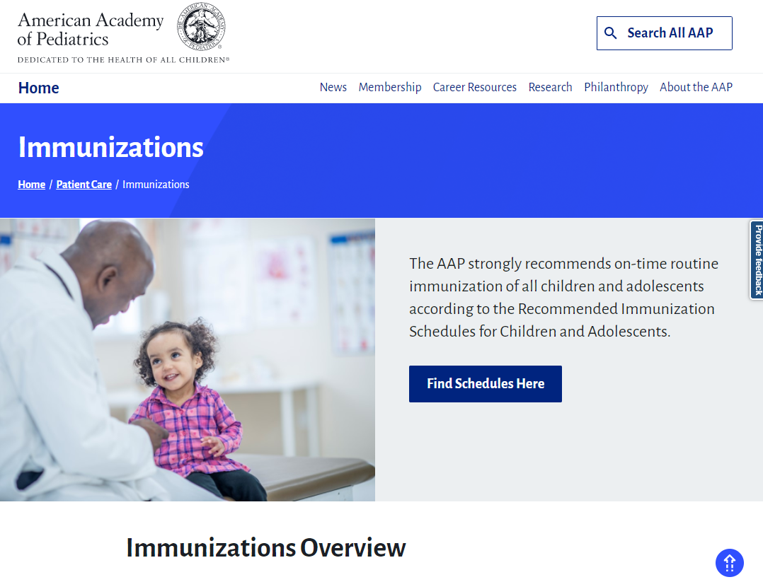
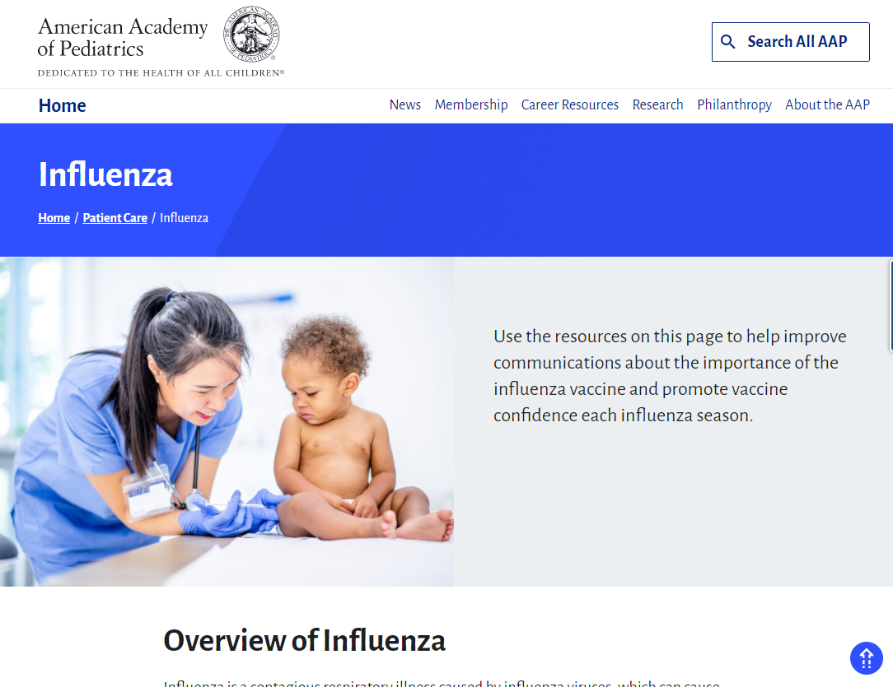
AAP Resources
https://www.aap.org/en/patient-care/immunizations/
https://www.aap.org/en/patient-care/influenza/

Slide 78
AAP Immunization Web Pages
https://www.aap.org/en/patient-care/immunizations/
https://www.aap.org/en/patient-care/influenza/
Find the latest Information on:
Policy
Promotional campaigns and advocacy
Communicating with families
Practice management, improvement, and communications
State-specific information
Addressing vaccine hesitancy

Slide 79
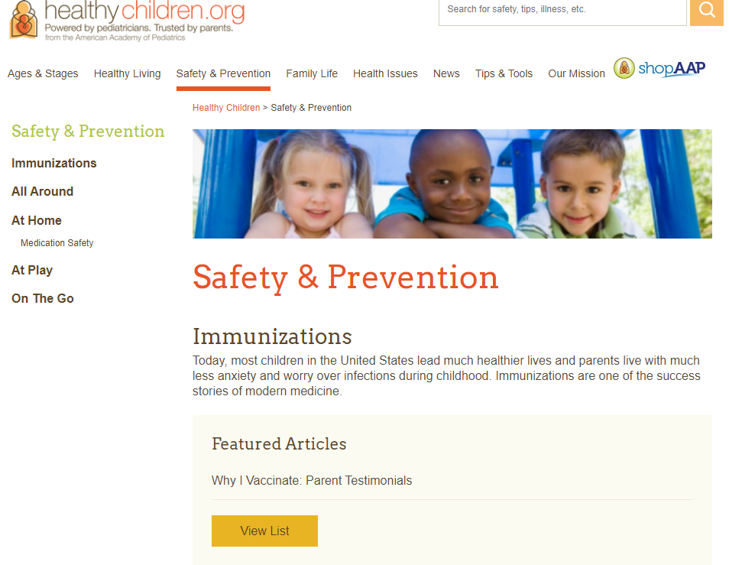
Parent Resources
https://www.healthychildren.org/English/safety-prevention/Pages/default.aspx
Information for parents on:
Individual childhood vaccines
Vaccine schedules
Safety of vaccines
How vaccines work
Common questions answered

Slide 80
LAST MINUTE QUESTIONS & HOUSEKEEPING ITEM REVIEW
Have a Question?
Locate the Q & A box and type them there. We will address as many questions as we can today.
Recording & Slides
The recorded webinar and slides will be posted to ImmunizeNevada.org/nile-webinars.

