Slide 1
WELCOME TO SUPER NILE:
FLU EDITION
Immunize Nevada is a nonprofit 501c3 coalition that is widely recognized as Nevada’s trusted resource for immunization information and community health outreach for all ages. We accomplish this by fostering education and statewide collaboration with a variety of health partners and collaborators.
You may view upcoming web trainings at ImmunizeNevada.org/webinars
Thank you for joining us today!

Slide 2
HOUSEKEEPING ITEMS
Connectivity issues
Please log back in and we’ll continue where we left off.
Have a question?
Locate the Q & A box and type them there. We will address all questions at the end of the presentation.
CEU Claiming
Complete the post-event survey that will pop up immediately following the webinar, OR in tomorrow’s follow-up email. Certificates will be emailed within one week of the live presentation.
Recording & Slides
The recorded webinar and slides will be posted to ImmunizeNevada.org/webinars.

Slide 3
2020-21 Flu Season Kick-Off in Nevada: Lessons from Last Season and How Our State Can Increase Flu Vaccine Uptake
September 21, 2020
Nevada Immunization Learning Exchange (NILE)

Slide 4
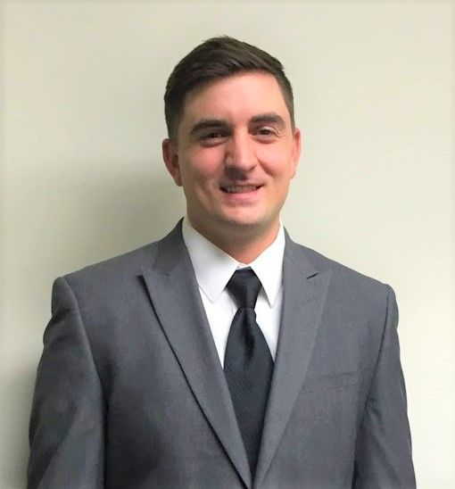
Max Wegener,
MPH
Epidemiologist | Influenza Surveillance Coordinator,
Nevada Division of Public and Behavioral Health’s Office of Public Health Informatics and Epidemiology (OPHIE)

Slide 5
2019-2020 Nevada Influenza Season: Summary, Updates, and This Season’s Expectations
Maximilian Wegener, MPH
Influenza Coordinator
Office of Public Health Investigations & Epidemiology
mwegener@health.nv.gov

Slide 6
Outline
Introduction
2019-2020 season
COVID-19
Looking ahead

Slide 7
Introduction – Reporting Requirements
NAC 441A.575 Influenza (NRS 439.200, 441A.120)
Prior to the 2019-2020 flu season
All cases of influenza were reportable
The presence of influenza viruses in clinical specimens tested by a medical laboratory using either viral culture or polymerase chain reaction; or
A positive rapid influenza diagnostic test in a patient with an influenza-like illness
During the 2019-2020 flu season
Hospitalized influenza cases
Influenza cases who are under 18 that die
A strain of influenza that poses a pandemic risk (determined by the CDC or WHO)
Strain of novel or untypeable influenza
Influenza outbreaks

Slide 8
Introduction – Data Sources
Data sources
ILINet
Sentinel surveillance for ILI
Influenza typing from sentinel labs
ESSENCE
Syndromic Surveillance (ILI with patient category)
FluView dashboards
Influenza surveillance data compiled by the CDC from state, local, and territorial health departments, public health and clinical laboratories, vital statistics offices, healthcare providers, clinics, and emergency departments
Pneumonia deaths and cases – state, regional, and national levels
LHAs
Hospitalizations
Deaths

Slide 9
Introduction – Definitions
ILINet
Fever (≥ 100° F)
Cough and/or sore throat
Without a known cause other than influenza
ESSECE
ILI = Influenza or (FeverPlus and (Cough or SoreThroat) and not NonILIFevers)
Patient class = ED, IP, OP, other
Hospitalization
Anyone who is hospitalized that tests positive for influenza

Slide 10
2019-2020 Season - Disclaimer
COVID-19 lead to delays or incompleteness of influenza reporting. Please consider this with the following information.

Slide 11
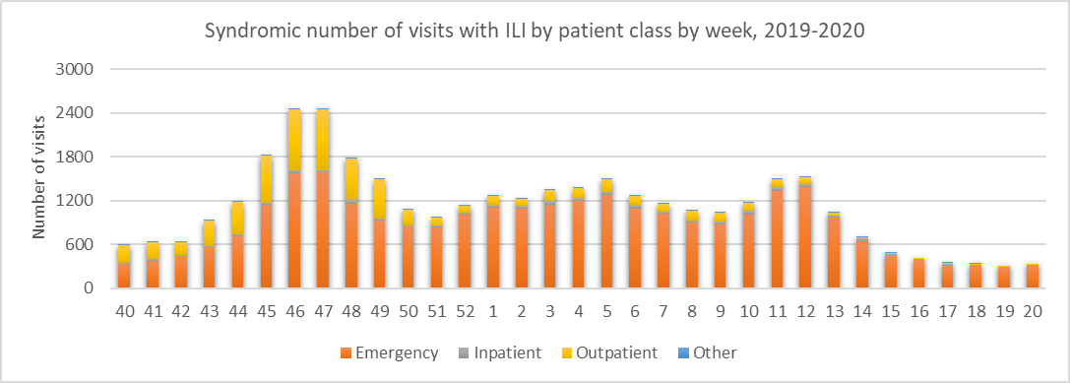
2019-2020 Season – ILI Reported

Slide 12
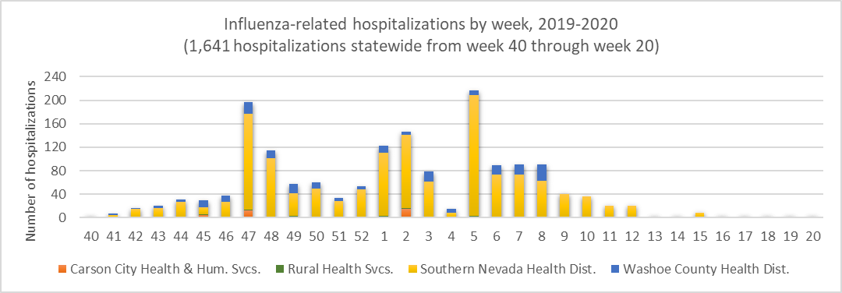
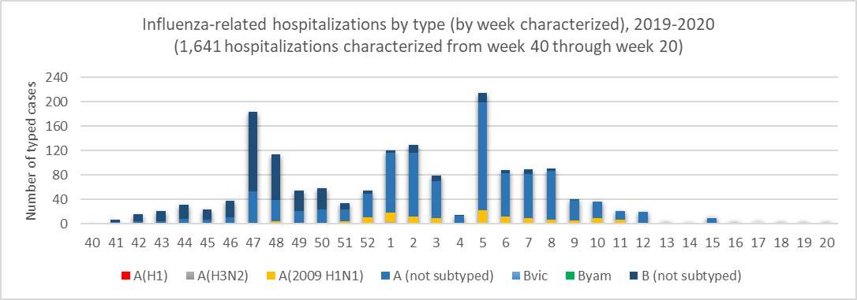
2019-2020 Season - Hospitalizations

Slide 13
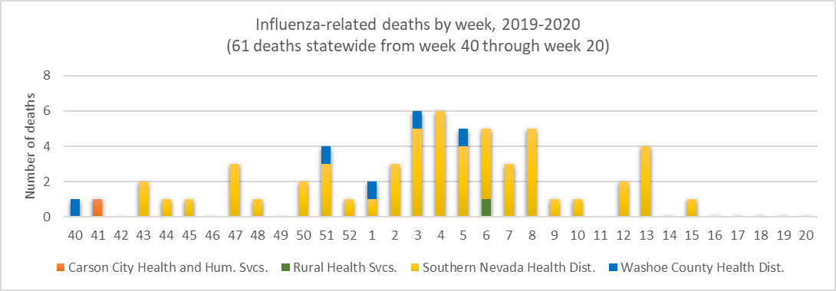
2019-2020 Season - Deaths
* 49 deaths were reported during the 2018-2019 season

Slide 14
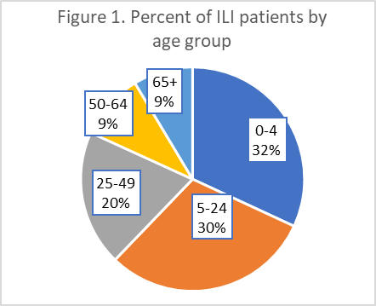
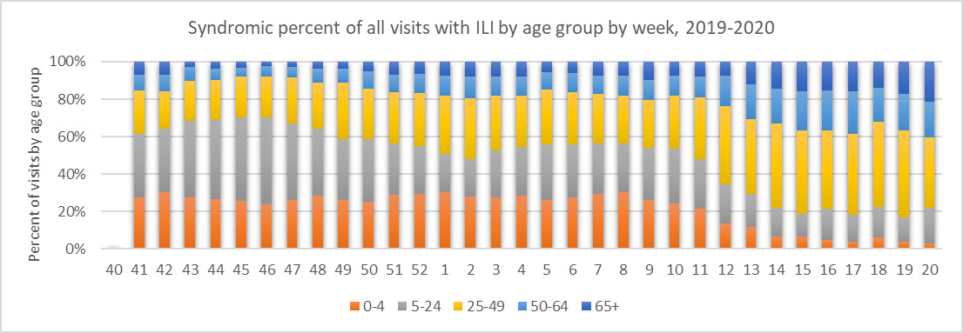
2019-2020 Season – Age Group

Slide 15
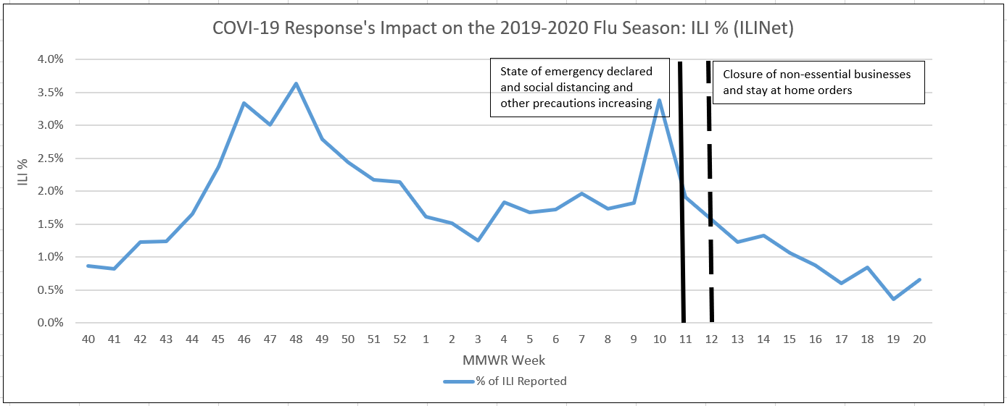
COVID-19 – Impact on 2019-2020 Season
Closures of non-essential businesses and a statewide stay-at-home order lead to a potential drop in influenza hospitalizations
Workforce needs for COVID-19 response, influenza reporting may have been delayed or incomplete (local, state, and federal)

Slide 16
Looking Ahead - Improvements
Increase sentinel site participation
If any facility or provider would like to join, please email me at mwegener@health.nv.gov
CSTE influenza conference - Increase subtyping at state labs
Enhance virologic surveillance
Assess data at geographical level (state and nationally)
Improved integration of reporting systems
ILINet
ESSENCE
LHA data
CDC updates

Slide 17
Looking ahead – 2020-2021 Flu season
COVID and flu season
Testing measures to differentiate both
Coinfection impact unknown – flu vaccination more important than ever
Cautious optimism
Southern hemisphere experienced a very mild flu season
Previous slides showing decreases in ILI and medical visits
Vaccine recommendations
No changes in CDC’s recommendations for timing of flu vaccine
September or October and possibly into January or February
Vaccination sites may need to change based on COVID precautions
What the 2020-2021 season will look like based on upcoming vaccines
Influenza A-H1N1 (A/Guangdong-Maonan/SWL1536/2019 (H1N1)pdm09-like virus (updated))
Influenza A-H3N2 (A/Hong Kong/2671/2019 (H3N2)-like virus (updated))
Influenza B-Victoria (B/Washington/02/2019 (B/Victoria lineage)-like virus (updated))
Influenza B-Yamagata (B/Phuket/3073/2013-like (Yamagata lineage))
Notes:
https://www.npr.org/sections/goatsandsoda/2020/08/26/906323250/from-the-global-south-hints-that-u-s-may-be-spared-flu-on-top-of-covid-19
https://jamanetwork.com/journals/jama/fullarticle/2769835
https://www.cdc.gov/flu/season/faq-flu-season-2020-2021.htm

Slide 18
Acknowledgements
Sentinel providers
Syndromic surveillance providers
Local Health Authorities
Immunization Programs
Laboratory partners
All Nevada Health facility staff and providers

Slide 19
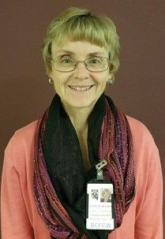
Pam Forest,
MD
Provider Quality Assurance Manager,
Nevada State Immunization Program

Slide 20
Division of Public and Behavioral Health
Seasonal Influenza 2020-2021
Pam Forest MD

Slide 21
Flu vaccine presentations
Flu vaccine and age groups
Increase influenza vaccine immunization rates

Slide 22
Influenza Vaccine - History
1940s: Thomas Francis, Jr., MD and Jonas Salk, MD serve as lead researchers at the University of Michigan to develop the first inactivated flu vaccine with support from the U.S. Army. Their vaccine uses fertilized chicken eggs in a method that is still used to produce most flu vaccines today. The Army is involved with this research because of their experience with troop loss from flu illness and deaths during WWI. This original vaccine only includes an inactivated influenza A virus.
1945: Inactivated influenza vaccine is licensed for use in civilians.

Slide 23
By Nevada Day,
Get your dose of 2020-2021 season influenza vaccine!
Get your patients and family and friends vaccinated with seasonal influenza vaccine!

Slide 24
2020-2021 Seasonal Influenza Vaccine
Contains Hemagglutinin from 2 influenza A viruses and 2 influenza B viruses (all but one presentation.)
influenza A/Guangdong-Maonan/SWL1536/2019 (H1N1)pdm09-like virus
influenza A/Hong Kong/2671/2019 (H3N2)-like virus
influenza B/Washington/02/2019 (Victoria lineage)-like virus
influenza B/Phuket/3073/2013 (Yamagata lineage)-like virus.

Slide 25
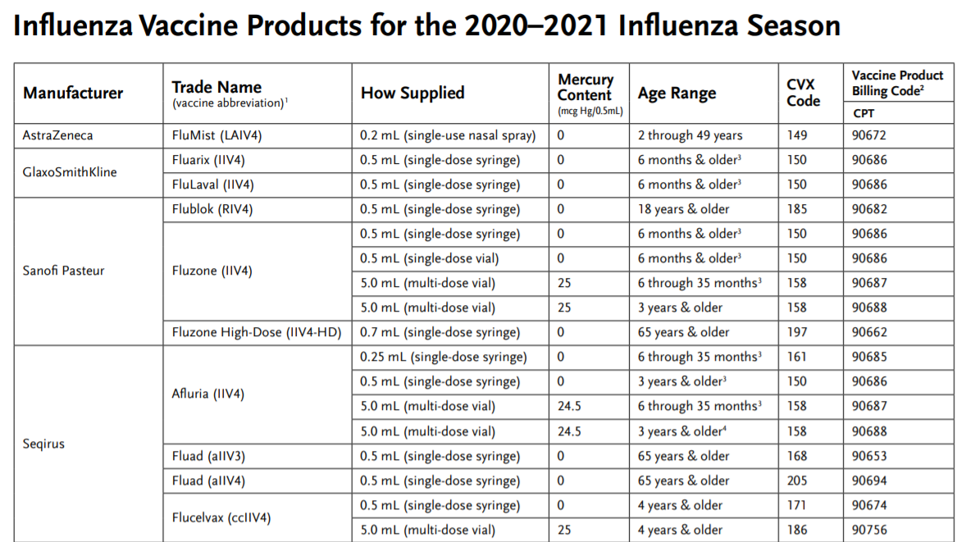
2020-2021 Seasonal Influenza Vaccine
Immunize.org – presentation list

Slide 26
2020-2021 Seasonal Influenza Vaccine
Who should get a flu vaccine this year?
Everyone 6 months and older unless a contraindication exists.

Slide 27
2020-2021 Seasonal Influenza Vaccine
Special age groups – 65 years and up

Slide 28
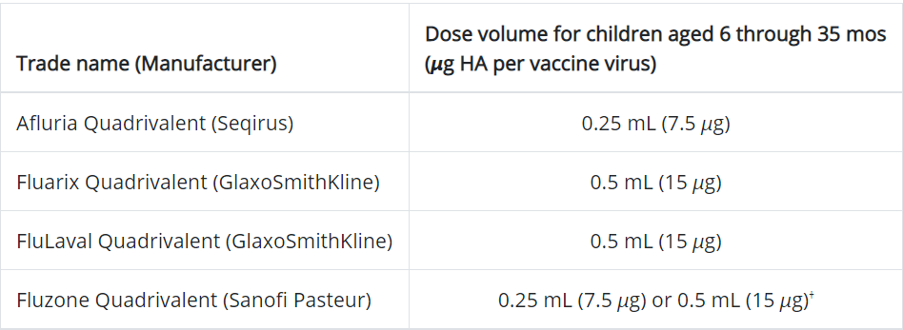
2020-2021 Seasonal Influenza Vaccine
For children 6 months – 35 months:

Slide 29
2020-2021 Seasonal Flu Vaccine Children ages 6 month – 8 years

Slide 30
2020-2021 Seasonal Influenza Vaccine
Live Attenuated Influenza Vaccine (Flumist):
Ages 2 – 49 years
Administered nasally
Healthy, non-pregnant

Slide 31
2020-2021 Seasonal Influenza Vaccine
Flumist contraindications:
History of severe allergic reaction to any component of the vaccine† or to a previous dose of any influenza vaccine§
Concomitant aspirin- or salicylate-containing therapy in children and adolescents§
Children aged 2 through 4 years who have received a diagnosis of asthma or whose parents or caregivers report that a health care provider has told them during the preceding 12 months that their child had wheezing or asthma or whose medical record indicates a wheezing episode has occurred during the preceding 12 months
Children and adults who are immunocompromised due to any cause, including but not limited to immunosuppression caused by medications, congenital or acquired immunodeficiency states, HIV infection, anatomic asplenia, or functional asplenia (e.g., due to sickle-cell anemia)
Close contacts and caregivers of severely immunosuppressed persons who require a protected environment
Pregnancy
Persons with active communication between the CSF and the oropharynx, nasopharynx, nose, or ear or any other cranial CSF leak
Persons with cochlear implants¶
Receipt of influenza antiviral medication within the previous 48 hours for oseltamivir and zanamivir, previous 5 days for peramivir, and previous 17 days for baloxavir**

Slide 32
2020-2021 Seasonal Flu Vaccine
Federal law requires you to provide the Vaccine Information Statement (VIS) to the patient or guardian and give them time to read and ask questions. (Various languages available)

Slide 33
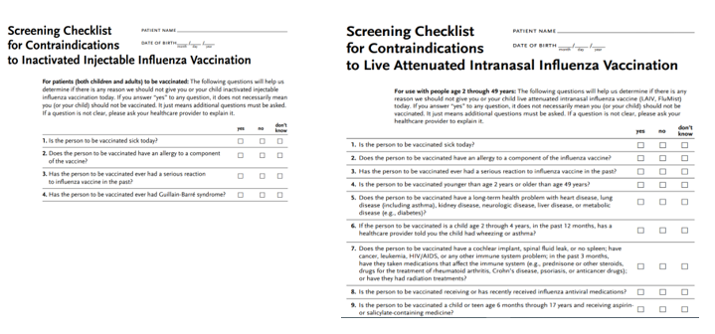
2020-2021 Seasonal Flu Vaccine
Use the appropriate screening questionnaires found at Immunize.org (Spanish and English)

Slide 34
2020-2021 Seasonal Flu Vaccine
Increase your practice’s flu immunization rates:
Appoint an immunization champion!
Institute standing orders
Use the presumptive approach
Create and post an office policy
Never miss an opportunity to vaccinate
Convince vaccine hesitant patients to be vaccinated
Have nurse only appointments
Hold a “flu clinic immunization day”
Remind patients to come to the office

Slide 35
CONTACT INFORMATION
Pam Forest
pforest@health.nv.gov
Office: 775-684-5903
Cell: 775-434-4610

Slide 36
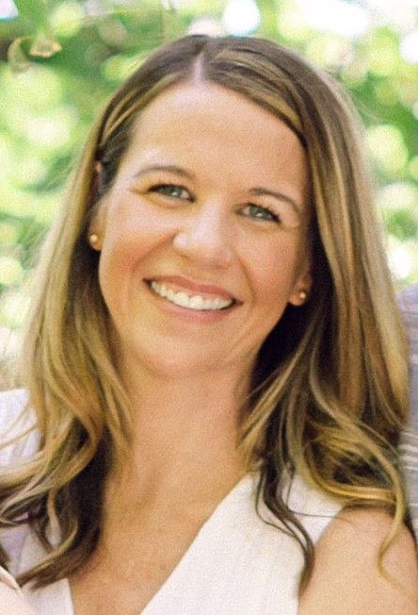
Breanne Van Dyne
Education Manager,
Immunize Nevada

Slide 37
2020-21
Flu Season
Resources
Breanne Van Dyne, Education Manager
Immunize Nevada

Slide 38
2020-2021 FLU SEASON GOALS
Efforts to span statewide.
Increase flu vaccine access and uptake
Bolster awareness of importance of
flu vaccine and improve vaccine
confidence.
Increase flu vaccine awareness and confidence
Strengthen partner &
stakeholder relationships
Leverage community partnerships to address
flu vaccine hesitancy and access challenges.
Leverage community partnerships to address
flu vaccine hesitancy and access challenges.
Target vulnerable, at-risk, and
minority populations to address disparities in flu
vaccination coverage and COVID-19 incidence.
Increase
outreach
Increase outreach
Use flu mass vaccination, messaging, and
community outreach to prepare for the COVID-19
vaccine response.
Prepare for COVID-19 vaccine

Slide 39
01
02
03
04
05
WHERE TO GO & HOW TO GET THERE
Connecting insured & uninsured individuals to immunization locations
TEXT REMINDERS
Because life gets busy!
FLU VACCINE PROMOTIONAL MATERIALS
Did we mention they’re FREE?
COMMUNITY PRESENTATIONS
Convincing a crowd to get their flu vaccine is our speciality!
WHAT CAN YOU DO TO BE A #NVFluFighter?
How YOU can help to protect yourself and our community against flu

Slide 40
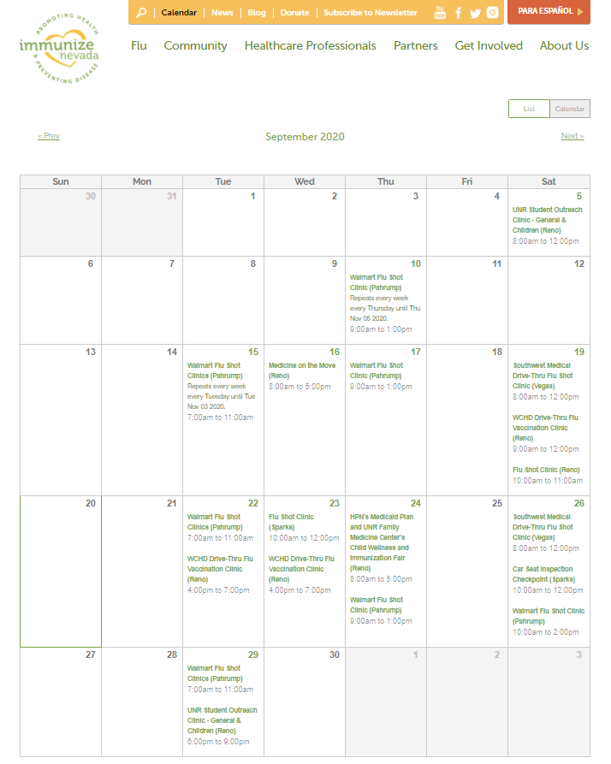
WHERE TO GO &
HOW TO GET THERE: CLINIC LOCATIONS
Nevadans can make an appointment with their healthcare provider, visit the pharmacy, or a drive-through or limited capacity community clinic.
Find clinics at immunizenevada.org/calendar and immunizenevada.org/community/where-go

Slide 41
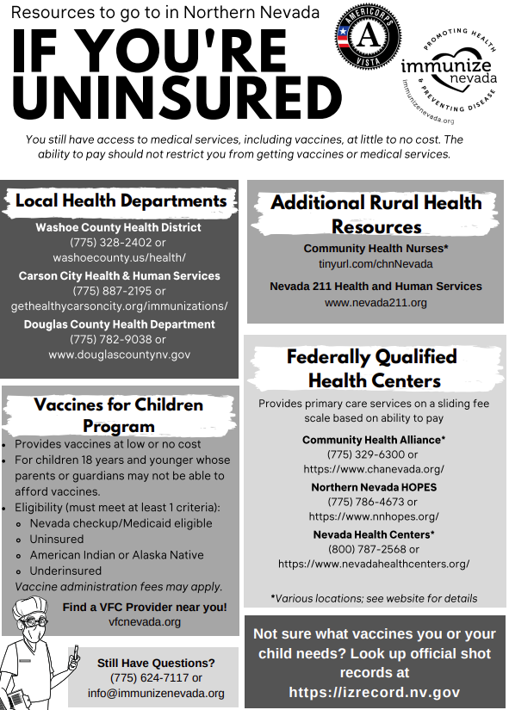
WHERE TO GO &
HOW TO GET THERE: UNINSURED INDIVIDUALS
In addition to our immunizenevada.org/community/where-go page, we have the following handout available for both northern & southern Nevada, and in English & Spanish.

Slide 42
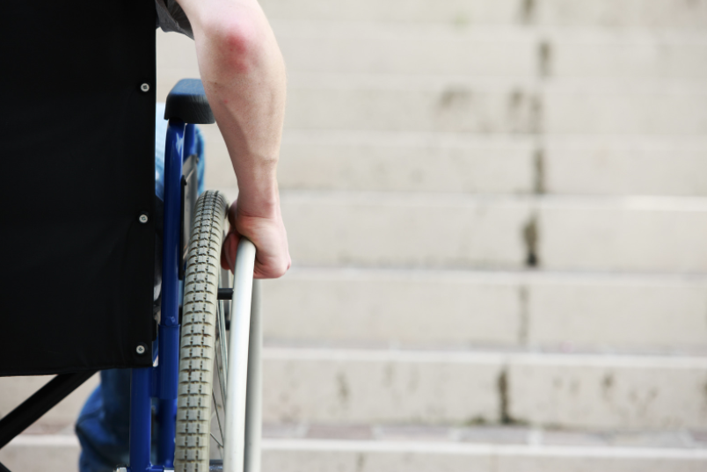
WHERE TO GO &
HOW TO GET THERE:
TRANSPORTATION
Transportation option:
MTM, Inc. can provide transportation for Medicaid members who qualify. Call toll-free 1-844-879-7341, TTY 711, at least 5 days in advance.
Photo: cyano66, Canva

Slide 43
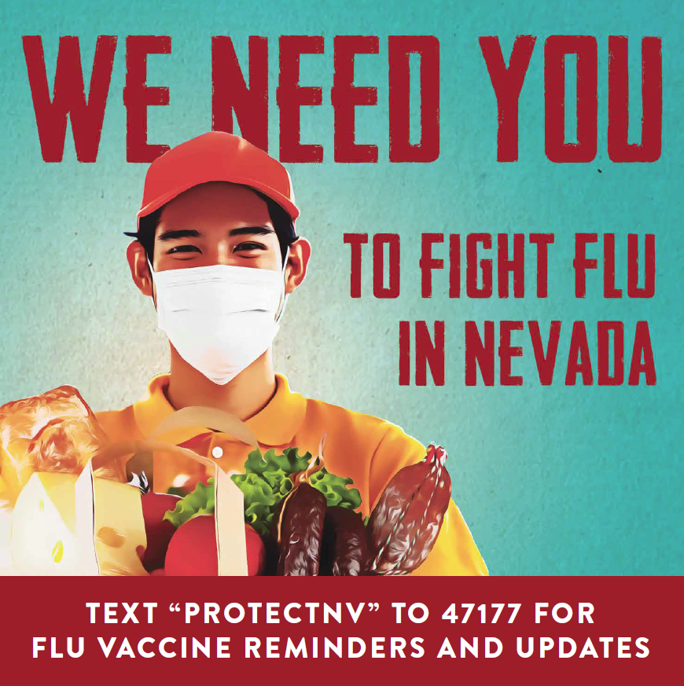
TEXT REMINDERS
Sign up for a flu vaccine reminder by texting “ProtectNV” to 47177 and help keep Nevada healthy.

Slide 44
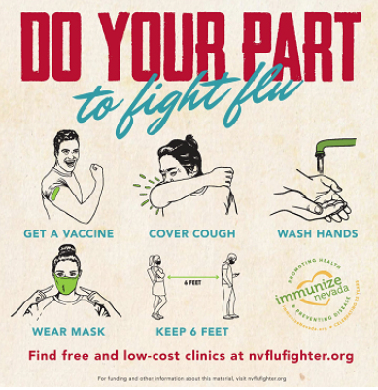
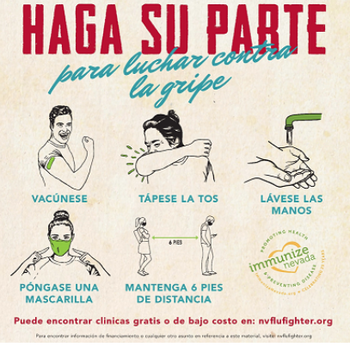
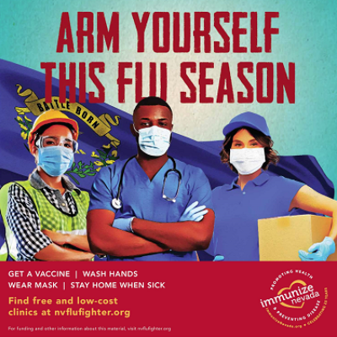
FREE FLU VACCINE PROMOTIONAL MATERIALS: PRINT
(Available in both English & Spanish, unless noted)
Wall clings (featured)
General Public
Healthcare Professionals
Bookmarks
Parents
Children
Cards “Top Ten Reasons to Get a Flu Vaccine”
General Public
Stickers “I got my flu vaccine”
Buttons “Flu Vaccine “ (English only)
Post-It Pad “I got a flu vaccine”
Sticker Poster “Wash Your Hands”
Order free materials online: https://loom.ly/UkPXuwk

Slide 45
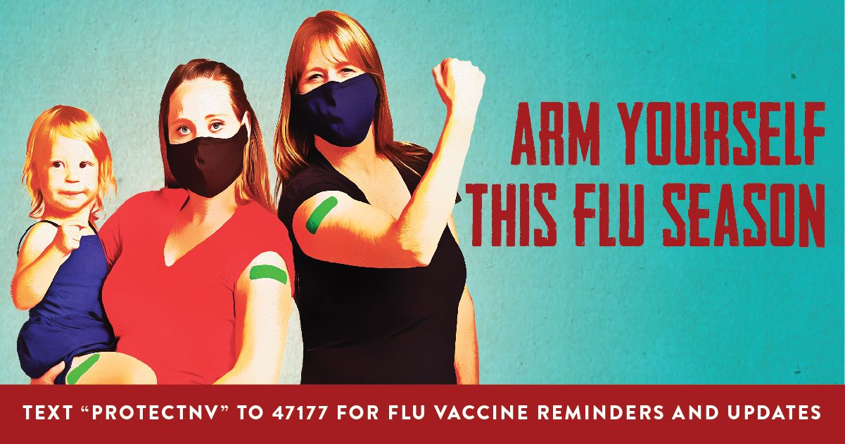
FREE FLU VACCINE PROMOTIONAL MATERIALS:
COMMUNICATIONS
Answering Questions About the Flu Vaccine
Social Media Messaging
Catch-up vaccination
#FightFlu (CDC)
Clinic Guidance
Immunize Nevada Flu Campaign Graphics
Immunize Nevada/NSIP Action Plan for 2020-21 Season
Target populations
Key messaging
Flu vaccination within the context of COVID-19
Download social media graphics and more: https://loom.ly/ExQnRZY

Slide 46
COMMUNITY PRESENTATIONS
The Immunize Nevada team is available to present flu prevention information to staff and/or clients.
Email info@immunizenevada.org or call 775-624-7117 to schedule.

Slide 47
CALL TO ACTION:
WHAT CAN YOU DO TO BE A #NVFluFighter?
LEAD BY EXAMPLE
JOIN NEVADA’S FLU/COVID-19 TASK FORCE
Get vaccinated and post a flu shot selfie. Tag @immunizenv and #ProtectNV
Join us in our fight against flu and COVID-19 by emailing info@immunizenevada.org
PRACTICE OTHER PREVENTATIVE MEASURES
HOST A VACCINE CLINIC
The Immunize Nevada team can host a clinic just about anywhere. Fill out our Clinic Request Form to get started!
Physical distancing, washing hands, wearing a mask, cleaning surfaces, and staying home if sick.

Slide 48
THANKS!
Questions?
Info@ImmunizeNevada.org
(775) 624-7117
ImmunizeNevada.org

Slide 49
QUESTIONS?
Type your questions for
Max, Dr. Forest or Breanne
in the Q&A box!

