Slide 1
Communicating with Pregnant Women about Flu and Tdap Vaccinations Jennifer Zavolinsky, Director of Outreach Initiatives, Vaccinate Your Family

Slide 2
Vaccinate Your Family (VYF) Strives to Protect People of All Ages from Vaccine-Preventable Diseases
Educate the public about the importance of timely immunizations for people of all ages and the safety of vaccines.
Serve as a source of accurate immunization information to the media.
Keep providers and public health partners up-to-date on the latest immunization information and assist vaccine advocates in their educational efforts.
Advocate for pro-immunization policies at the state and federal levels.

Slide 3
Today’s Discussion
Vaccination recommendations for pregnant women in the U.S. and the new “Call to Action”.
Overview of the statistics related to maternal vaccinations.
Key drivers/motivations and barriers to maternal vaccination.
VYF’s activities to promote maternal and childhood vaccinations to pregnant women and educate healthcare providers.
Current partner research and activities related to communicating with pregnant women about maternal and childhood vaccinations.
Credible resources to help educate pregnant women about the importance and safety of maternal vaccinations.

Slide 4
Vaccination Recommendations for Pregnant Women
Tdap vaccine is recommended during every pregnancy, between 27 and 36 weeks gestation (preferably early during this period).
Tdap vaccination is the best way to protect pregnant women and their babies from pertussis (also known as whooping cough).
Flu vaccine (any age-appropriate, inactivated flu vaccine) is recommended for pregnant women and is safe to administer during any trimester.
Flu vaccination is the best way to protect pregnant women and their babies from the flu and can prevent possible flu-associated pregnancy complications.
When given during pregnancy, Tdap vaccine boosts antibodies in the mother, which are transferred to her developing baby.
Early third trimester administration optimizes neonatal antibody levels.
Ideally, a flu shot should be given before the end of October, but vaccination later in the flu season is still encouraged and beneficial.
Flu vaccination during helps protect babies from flu for several months after birth.
Source: CDC - www.cdc.gov/vaccines/pregnancy/hcp-toolkit/important-maternal-vaccines.html

Slide 5
Maternal Immunization Summit (June 2019 and July 2020)
Led by Maternal Immunization Task Force funded through CDC cooperative agreement (ACOG, AAFP, AWHONN, ACNM)
Summit representatives from a variety of national groups representing pregnant women/immunizations
Presentations from CDC and MITF members on their organizations’ research & activities related to maternal immunizations.
Summit participants identified and discussed challenges and possible solutions.

Slide 6
Immunization for Pregnant Women: A Call to Action (Summer 2020)
“Immunizations are an essential part of prenatal care, offering critical protection to women and their fetuses against potentially deadly diseases. The Centers for Disease Control and Prevention (CDC) Advisory Committee on Immunization Practices recommends that women who are pregnant receive an inactivated influenza and a tetanus/diphtheria/acellular pertussis (Tdap) vaccine in every pregnancy. The American Academy of Family Physicians; American College of Nurse-Midwives; American College of Obstetricians and Gynecologists; and Association of Women’s Health, Obstetric and Neonatal Nurses strongly support this recommendation. As professional organizations whose members care for pregnant women, we affirm the importance of recommending and advocating that pregnant women receive all recommended vaccines at the appropriate time during each pregnancy. The current increase in hesitancy about the safety and efficacy of vaccines has created an environment that calls for our urgent commitment to discussing the evidence-based benefits of vaccination with pregnant women.”
Source: Maternal Immunization Task Force’s Immunization for Pregnant Women: A Call to Action
www.acog.org/programs/immunization-for-women/activities-initiatives/immunization-for-pregnant-women-a-call-to-action

Slide 7
Overview of the Statistics
Pregnant women have more than double the risk of hospitalization compared to nonpregnant women of childbearing age if they get the flu.
Flu vaccination during pregnancy lowers risk of hospitalization (due to flu) in babies younger than 6 months old by an average of 72%.
Two-thirds (67%) of babies younger than two months old who get whooping cough need care in the hospital.
Only 1 in 3 (35%) U.S. pregnant women get BOTH flu and Tdap vaccines.
54% of pregnant women reported flu shot before or during pregnancy (Most common reason for NOT getting flu shot was believing the vaccine is not effective)
Getting a flu shot reduces a pregnant woman’s risk of being hospitalized due to flu by an average of 40%.
55% of pregnant women reported getting Tdap during pregnancy. (Most common reason for NOT getting Tdap was not knowing the Tdap vaccination is needed during each pregnancy.)
Women who get vaccinated with Tdap vaccine in third trimester of pregnancy prevent 3 in 4 cases of whooping cough in babies under 2 months old.
Tdap vaccination during pregnancy lowers risk of hospitalization (due to whooping cough) in babies less than 2 months old by 91%.
Source: CDC Vital Signs (Oct 2019): www.cdc.gov/vitalsigns/maternal-vaccines/pdf/vs-1008-maternal-vaccines-H.pdf

Slide 8
Overview of the Statistics
Pregnant women whose healthcare providers offered them the vaccine(s) or referred them for vaccination had the highest vaccination rates.
Among women whose healthcare providers offered vaccination or provided referrals, 65.7% received influenza vaccine and 70.5% received Tdap
Black, non-Hispanic pregnant women had lower vaccination rates than women of other races & were less likely to report a HCP offer of vaccines/referral for vaccination.
Source: CDC Vital Signs (Oct 2019): www.cdc.gov/vitalsigns/maternal-vaccines/pdf/vs-1008-maternal-vaccines-H.pdf

Slide 9
Motivations for Maternal Vaccinations (Flu and Tdap)
Strong recommendation from healthcare provider remains key driver on whether or not pregnant women decide to get vaccinated.
CNMs not as comfortable as OB-GYNs in making a strong recommendation as many feel it is a patient decision.
Pregnant women also look to peers, family, friends and online sources (including blogs) for vaccine information and advice.
CDC mistrusted by some.
Concerns about effectiveness of vaccine (flu) and risks/safety of vaccines (flu & Tdap) & lack of knowledge about recommendation (Tdap) all make impact on whether or not pregnant women decide to get vaccinated.
Health of the baby plays a significant role in woman’s decisions to immunize during pregnancy.
Pregnant women are most focused on protecting their own family.
Community immunity usually a secondary benefit.
Sources: ACOG Survey and Online Focus Groups, 2019 and ACNM Survey of Members, 2019

Slide 10
Barriers to Maternal Vaccinations (Flu and Tdap)
Questions about effectiveness of flu vaccine adds to doubts, and safety debate stems from questions about ingredients.
Concerns about vaccine ingredients now go beyond questions about thimerosal and include concerns about adjuvants; Just saying “vaccines are safe” is not good enough as patients want more specific information.
Flu vaccination is a fluid recommendation that changes from season to season, whereas Tdap is a very standard recommendation. This can complicate flu vax messaging.
Previous first trimester flu vaccine restriction may have planted a seed that it is unsafe to receive flu vaccine during pregnancy and contributed to hesitancy.
Source: ACOG Survey and Online Focus Groups, 2019

Slide 11
Barriers to Maternal Vaccinations (Flu and Tdap)
The primary reasons pregnant women refuse vaccines are:
Safety concerns for the fetus (64%)
Think vaccinations are not necessary because they are healthy (63%)
Personal or religious beliefs (62%)
Safety concerns for self (57%)
Patients distrust of big pharma, the government or the medical community
Fear of needles
Becoming ill from vaccine (e.g., catching the flu from the vaccine)
Anecdotally, other barriers include:
The dissemination of misinformation from anti-vaxxers
Source: AAFP Maternal Immunization Survey ,2019

Slide 12
Talking to Your Pregnant Patients about Maternal Vaccinations
Assess vaccine status and discuss which vaccines your pregnant patients should receive and when, ideally during the first prenatal visit.
Strongly recommend that all pregnant women receive an annual flu shot (in any trimester).
Discuss the benefits of vaccination with pregnant women early and often and reinforce that vaccination is the best way to protect young babies from flu and whooping cough.
Provide each of your patients with information and resources about flu and Tdap vaccines when you meet with her at her first prenatal visit and mention the timeframe for each vaccine when you discuss her pregnancy.
Ensure all office staff are delivering consistent messages about the importance of maternal vaccinations.
Strongly recommend that all pregnant women receive a Tdap vaccine between 27 weeks and 36 weeks of gestation in each pregnancy (preferably during the earlier part of this time period.)
Normalize vaccines as a routine part of a woman’s pregnancy care.
Sources: Maternal Immunization Task Force’s Call to Action and
CDC - cdc.gov/vaccines/hcp/adults/downloads/standards-immz-practice-recommendation.pdf

Slide 13
Tips for Making a Strong Recommendation: SHARE
H - HIGHTLIGHT positive experiences with vaccines (personal or in your practice) to reinforce the benefits of flu and Tdap vaccinations during pregnancy and strengthen her confidence in vaccination.
A - ADDRESS her questions and any concerns about the flu and Tdap vaccinations, including possible side effects, safety, and vaccine effectiveness in plain and understandable language.
E - EXPLAIN the potential costs of getting flu and pertussis, especially for babies.
R - REMIND her that vaccinating during every pregnancy protects both protect her and her baby from serious diseases like flu and pertussis.
S - SHARE specific reasons why the flu and Tdap vaccines are right for her as a pregnant women.
Source: CDC (cdc.gov/vaccines/hcp/adults/downloads/standards-immz-practice-recommendation.pdf)

Slide 14
Talking with Your Pregnant Patients about Maternal Vaccinations
Offer flu and Tdap vaccines to pregnant women or provide referrals to other vaccination providers.
Use electronic medical record (EMR) or Immunization Information System (IIS) prompts to identify patients for which vaccines are recommended.
Consider using standing orders to avoid missed opportunities.
If a pregnant woman declines vaccination, inquire about her reasons; reintroduce the discussion and offer the immunization(s) at the next office visit.
Become educated on the safety and efficacy of vaccines during pregnancy and be comfortable communicating this information thoroughly to patients.
If you do refer your patient to an outside vaccination provider, make sure to follow up with your patient and document in their medical record and IIS, if applicable.
Sources: Maternal Immunization Task Force’s Call to Action and CDC’s Making a Strong Referral (www.cdc.gov/pertussis/pregnant/hcp/strong-referral.html)

Slide 15
Communicating with Pregnant Woman via Online or Print Materials (Tips for Vaccine Advocates)
Pregnancy and Immunization: A Guide to Creating Patient Materials
Source: ACOG’s Guide to Creating Patient Materials

Slide 16
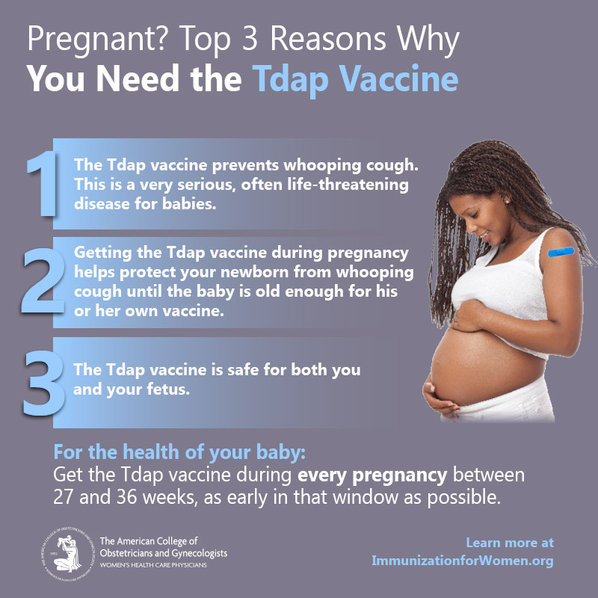
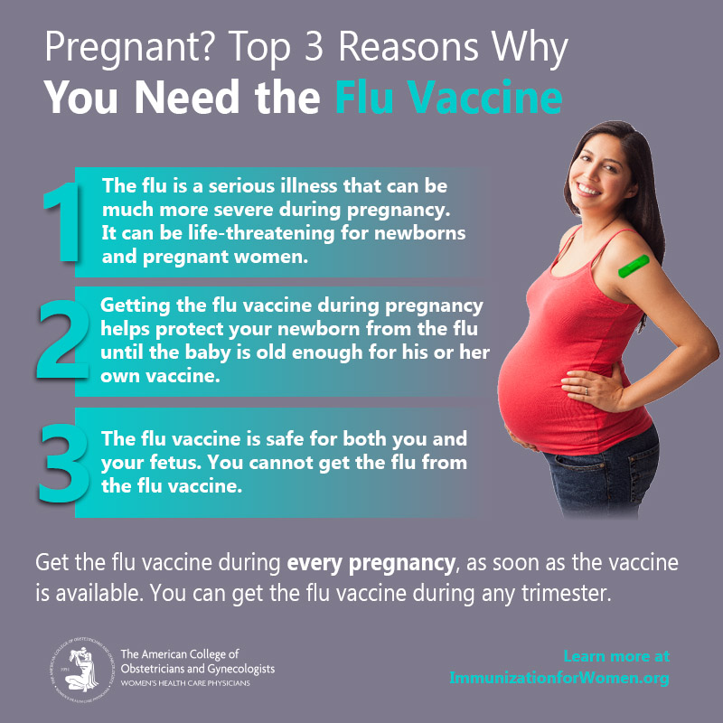
ACOG’s Infographics and Accompanying Text (Spanish version coming soon)
www.acog.org/programs/immunization-for-women/provider-tools/infographic-tdap-vaccine-top-3-reasons
www.acog.org/programs/immunization-for-women/provider-tools/infographic-flu-vaccine-top-3-reasons

Slide 17
The Safety of Flu Vaccinations During Pregnancy
Flu shots have been given to millions of pregnant women over many years and continue to have a good safety record.
Getting a flu while pregnant Does NOT increase the risk of miscarriage.
Studies show that flu vaccines during pregnancy are safe and effective for pregnant women and their babies.
CDC and FDA monitor flu vaccine safety during pregnancy during each flu season using VAERS and VSD.
Babies of women who received the flu shot during their first trimester had no increased risk of having children with major birth defects.
Pregnant women can safely get the flu and the Tdap vaccines at the same time.
Flu shots cannot cause you or your baby to get the flu.
Flu Vaccine Safety and Pregnancy/List of Studies: www.cdc.gov/flu/highrisk/qa_vacpregnant.htm#studies

Slide 18
The Efficacy of Flu Vaccinations During Pregnancy
Studies show that flu vaccines during pregnancy are safe and effective for pregnant women and their babies.
Flu vaccination offers significant protection against flu illness and flu-related complications.
A study during the 2012–2013 influenza season demonstrated that pregnant women who were vaccinated had significantly fewer hospitalizations than those who were not,
Four large-scale, randomized controlled trials and numerous observational studies have shown neonatal protection from maternal flu vaccination.
Studies also have demonstrated a reduction in flu-related hospitalizations among infants born to women who received the vaccine during pregnancy.
ACOG: Influenza Vaccination During Pregnancy/Study References
www.acog.org/clinical/clinical-guidance/committee-opinion/articles/2018/04/influenza-vaccination-during-pregnancy

Slide 19
The Safety of Tdap Vaccinations During Pregnancy
Pregnant women can safely get the Tdap vaccine even if they recently got a tetanus-containing shot (Td or Tdap).
Studies show that the Tdap vaccine it is safe and effective for pregnant women and their babies.
There is a low risk of severe side effects from multiple Tdap vaccinations.
Tdap vaccines cannot cause pregnant women or their babies to get pertussis (whooping cough).
Tdap vaccines are inactivated, which means they are made by inactivating or killing the germ during the process of making the vaccine.
CDC and FDA monitor Tdap vaccine safety during pregnancy using VAERS.
Both manufacturers of Tdap vaccine created pregnancy registries to collect information from pregnant women who got Tdap vaccine. No safety concerns reported.
Breastfeeding is safe after getting the Tdap vaccine.
Tdap Vaccine Safety and Side Effects
www.cdc.gov/pertussis/pregnant/mom/safety-side-effects.html
Source: www.cdc.gov/pertussis/pregnant/research.html

Slide 20
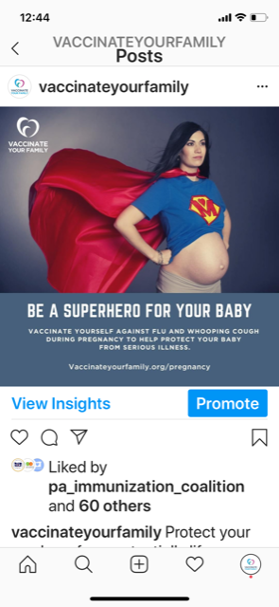
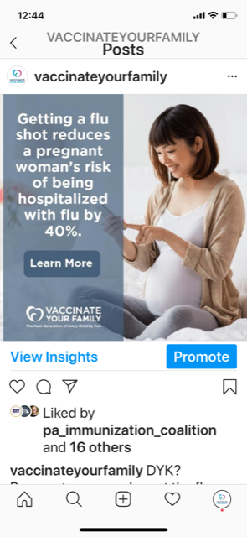
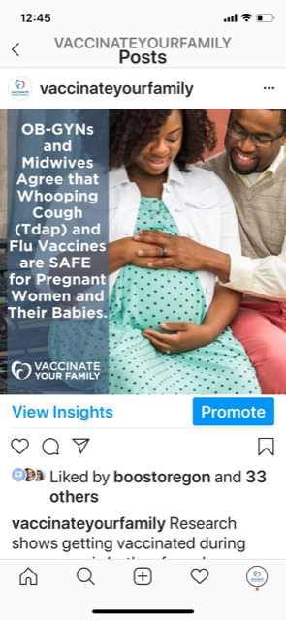
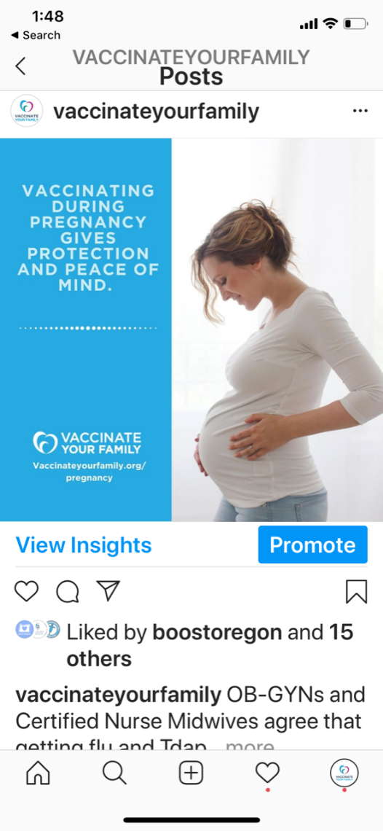
Instagram (@Vaccinateyourfamily)

Slide 21
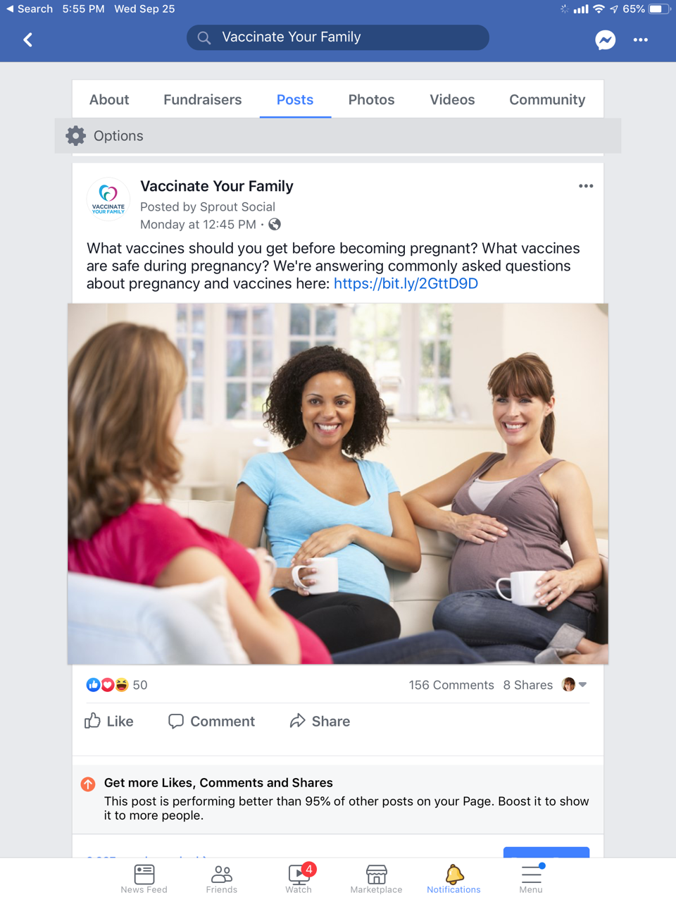
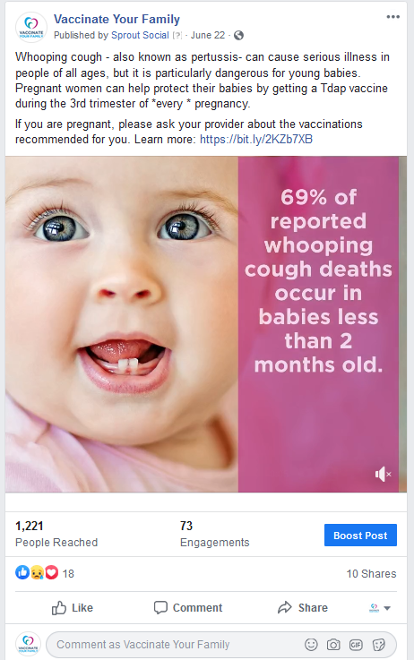
Facebook (@Vaccinateyourfamily) and Twitter (@Vaxyourfam)

Slide 22
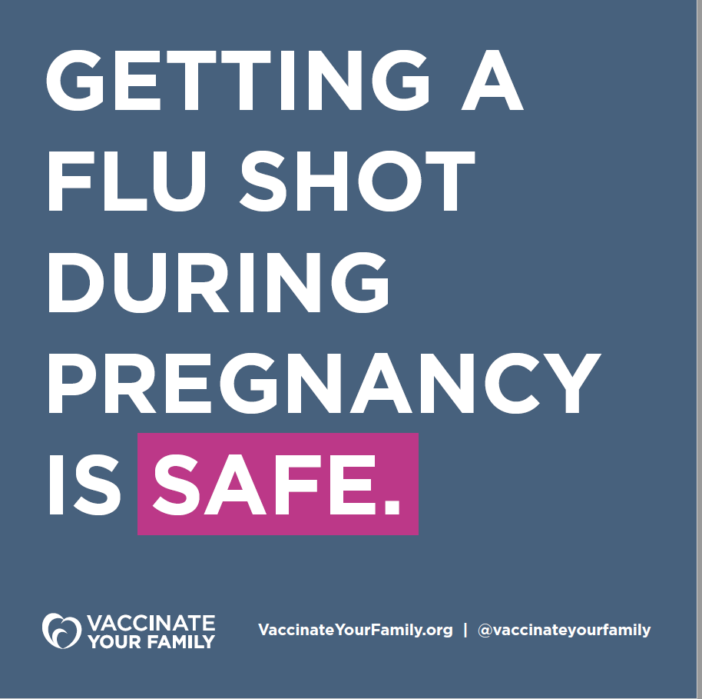
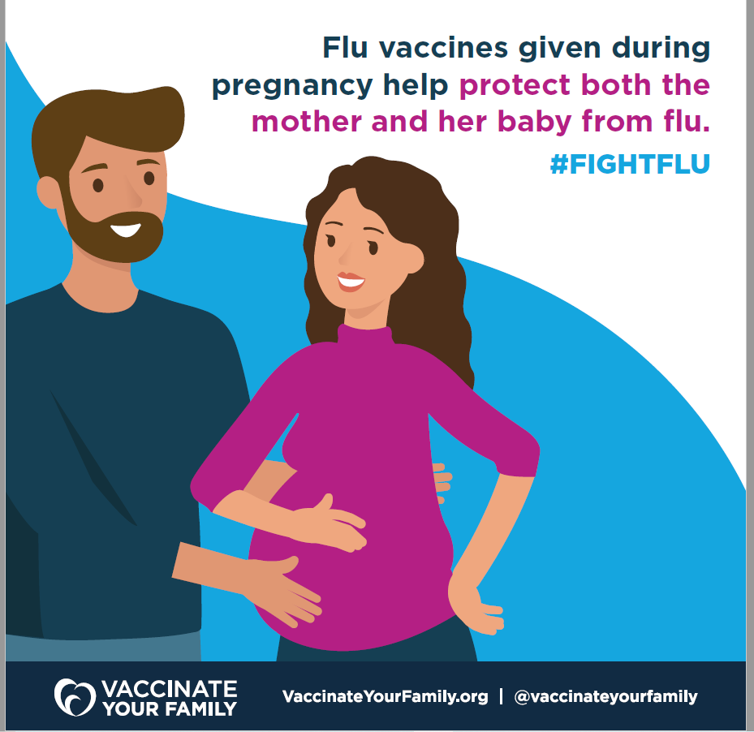
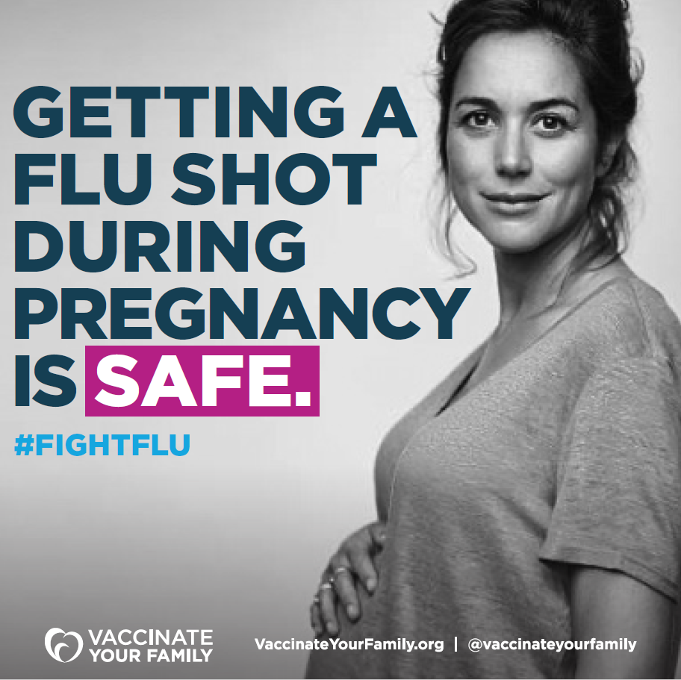
New Graphics Coming Soon on Instagram (@VaccinateYourFamily), Facebook (@Vaccinateyourfamily) and Twitter (@Vaxyourfam)
Notes:
/like them, etc…

Slide 23
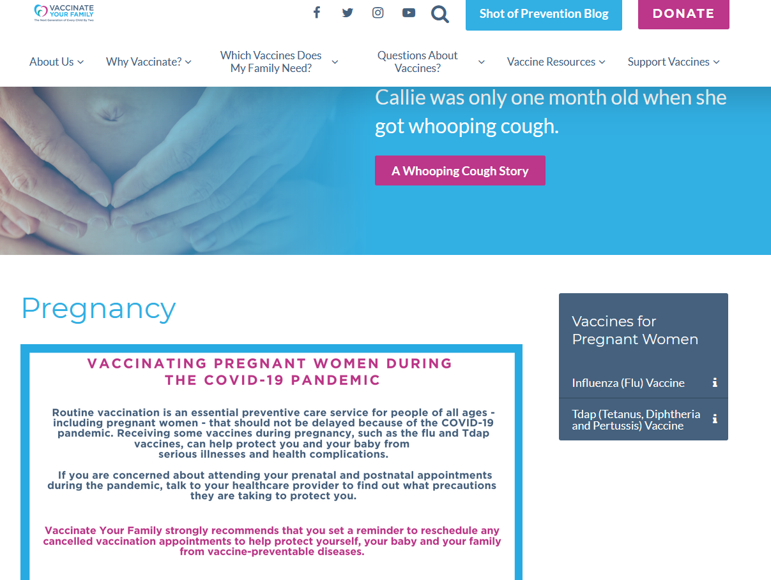
Vaccinate Your Family Website Vaccinateyourfamily.org/pregnancy

Slide 24
Let’s Vaccinate Website for Healthcare Providers Letsvaccinate.org/pregnancy

Slide 25
Callie: A Whooping Cough Story (Available on VYF’s Website and YouTube Channel)
Source: Vaccinateyourfamily.org/testimonials/callie

Slide 26
Reaching Low-Income Pregnant Women and Moms through USDA’s WIC
Immunization Resources for Parents and Parents-to-Be (English and Spanish) and Vaccines 101: Information for WIC Staff (Available for download in Resources section of Vaccinate Your Family website).
Vaccination lesson (English and Spanish) to educate WIC participants (pregnant women and mothers of children through 5 y.o.) on WICHealth.org.
Annual Immunization Webinar for WIC Staff (Archived webinar available to view in Resources section of Vaccinate Your Family website)
Vaccinateyourfamily.org/vaccine-resources/
Vaccinateyourfamily.org/vaccine-resources/
Launched in March 2020
Contact Jennifer Zavolinsky at VYF if you are interested in having this vaccine lesson available for your state’s WIC participants
Through August 31 – 4,583 lessons have been completed (3,848 English; 176 Spanish)

Slide 27
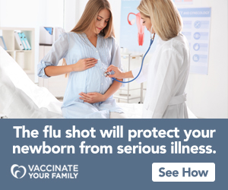
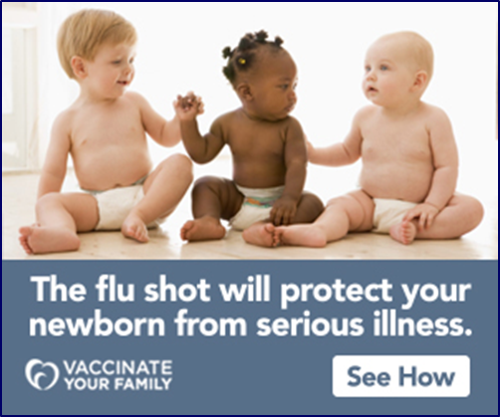
Online Ads for Pregnant Women

Slide 28
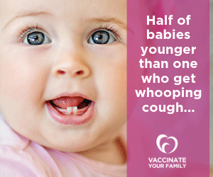
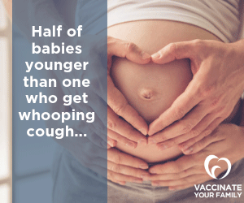
Online Animated Ads for Pregnant Women

Slide 29
Online Display Ads (Top performers)
#3 – 15,196 impressions – 17 clicks – 0.11% CTR
#4 – 16,188 impressions – 16 clicks – 0.10% CTR
#5 – 9,881 impressions – 10 clicks – 0.10% CTR
#1 – 31,055 impressions – 40 clicks – 0.13% CTR
#2 – 18,805 impressions – 25 clicks – 0.13%CTR

Slide 30
Notes:
Ad Messenger Mobile Display (74 Stores) – 19 Buy Buy Baby Stores and 55 Carters Stores (Stores in the demographic areas of Seattle, WA - 16,320; Phoenix, AZ - 6,792; Provo, UT - 11,052; Dallas / Fort Worth (inclusive of Plano) - 3,120; New York City, NY - 66,400; Atlanta, GA - 26,640; Detroit, MI (inclusive of Troy) - 15,840)

Slide 31
Ads on Mobile Phones in Select Buy Buy Baby and Carters Stores in 7 Demographic Areas
Not sure what to buy? Make an easy decision. Get vaccinated during pregnancy to protect you & your baby. Learn more now.
TFW you can't decide on a car seat. Make an easy decision instead: Get vaccinated while pregnant to protect your new baby. Learn more.
OB-GYNs and midwives agree. Vaccines during pregnancy are safe and effective for you and your baby. Learn which vaccines you need by tapping here.
DYK half of babies younger than one who get whooping cough end up in the hospital. Protect your new baby. Get the Tdap vaccine while pregnant. Learn more.
The majority of whooping cough deaths occur in babies younger than three months. Don't let your child become a statistic. Get the Tdap vaccine during pregnancy.
Getting the flu shot while pregnant will help protect your newborn from serious illness and being hospitalized. See how.
Getting vaccines while pregnant will help protect your newborn from serious illness and being hospitalized. Docs & midwives agree: It's Safe! Learn More.
Getting the Tdap vaccine while pregnant will help protect your newborn from serious illness and being hospitalized. Learn more here.
Those footie pajamas will look adorable on your baby during their two month appt. Find out which vaccines they will get. See the recommended vaccine schedule.

Slide 32
Credible Resources for Providers and Pregnant Women from Maternal Immunization Task Force Members
ACOG
ACNM
Immunization Resources for Providers (www.midwife.org/Immunization-Resources-for-Providers)
Talking Points for CNMs/CMs about Immunization in Pregnancy and Postpartum, Letter to Providers from ACNM President, Immunization Position Statements, Patient Handouts, and Curriculum on Immunization for midwifery students and other health care professionals
Immunization for Pregnant Women: A Call to Action from the Maternal Immunization Task Force (www.acog.org/programs/immunization-for-women/activities-initiatives/immunization-for-pregnant-women-a-call-to-action)
Immunization for Women Website (immunizationforwomen.org)
FAQs, Tip sheets, Downloadable infographics
AAFP
Shots Immunizations APP by the American Academy of Family Physicians and Society of Teachers of Family Medicine
Information for pregnant women; Factsheets
AWHONN
Vaccination Saves Lives (awhonn.org/education/vaccination)
Tdap and flu vaccine videos; Downloadable Tdap, influenza, and SHARE infographics
Health4Mom.org website (www.health4mom.org)
Immunization Physician Tools (www.acog.org/programs/immunization-for-women/provider-tools)

Slide 33
AWHONN’s Flu Vaccine Video
Source: https://youtu.be/yKwh3bozliU

Slide 34
Credible Resources for Providers and Pregnant Women
CDC
VYF
Vaccinate Your Family’s Website (Vaccination Information for Pregnant Women) - Vaccinateyourfamily.org/pregnancy
Comprehensive Toolkit for Prenatal Care Providers (www.cdc.gov/vaccines/pregnancy/hcp-toolkit/index.html)
Flu Vaccine and Pregnancy Research Studies; Tdap Vaccine and Pregnancy Research Studies; and Much More.
Additional Websites and Resources
Families Fighting Flu’s Family Stories and Flu Champion Toolkits for Healthcare Providers, Schools, Community Organizations, Vaccine Advocates (Familiesfightingflu.org)
Vaccine Education Center at Children’s Hospital of Philadelphia Video for Pregnant Women: Are Vaccines Safe During Pregnancy? (www.chop.edu/centers-programs/vaccine-education-center/video/are-vaccines-safe-during-pregnancy)
Let’s Vaccinate: Immunization Strategies and Resources for Healthcare Providers (Letsvaccinate.org/pregnant-women)
Immunization Action Coalition’s Standing Orders for Administering Vaccines to Pregnant Women (www.immunize.org/catg.d/p3078b.pdf)
Information on Vaccinations for Pregnant Women (www.cdc.gov/vaccines/pregnancy/index.html)
Pregnancy and Vaccine Videos (also available on CDC’s YouTube Channel); Flu Vaccine Safety and Pregnancy Q&A; and Much More (www.cdc.gov/flu/highrisk/qa_vacpregnant.htm?CDC_AA_refVal=https%3A%2F%2Fwww.cdc.gov%2Fflu%2Fprevent%2Fqa_vacpregnant.htm)
Vaccinate Your Family’s Video: Callie: A Whooping Cough Story (www.vaccinateyourfamily.org/testimonials/callie/)

Slide 35
Contact Me
Jennifer Zavolinsky, MHS, CHES
jennifer@vaccinateyourfamily.org
Website: Vaccinateyourfamily.org
Blog: Shotofprevention.com
Facebook: @Vaccinateyourfamily
Twitter: @Vaxyourfam
Instagram: @Vaccinateyourfamily
YouTube: Vaccinate Your Family

